Slide 1
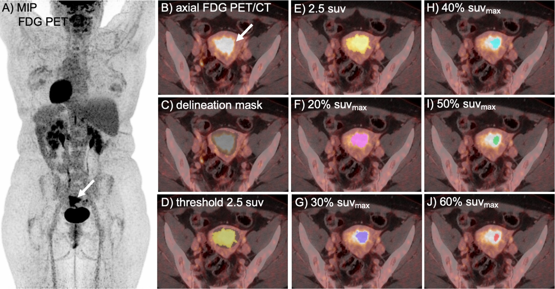
Volumetric [¹⁸F]FDG PET/CT tumor assessments in endometrial cancer
- A retrospective image study
Sunniva Lindås
University of Bergen Sunniva.Lindas@student.uib.no
BACKGROUND
Metabolic tumor volume (MTV) reportedly predicts aggressive disease and poor outcome in endometrial cancer ^{1,2}. MTV is derived from diagnos;c imaging by [¹⁸F]ﬂuoro-deoxy-glucose ([¹⁸F]FDG) positron emission tomography with computed tomography (PET/CT).
MTV delineated by different SUV thresholds
Predic<on of aggressive disease features
MTV_{2.5} generally showed higher or equal scores compared to the other thresholds.
 | LNM (14/91 patients^{i}) ROC AUC | FIGO III-IV (21/154 patients) ROC AUC | Recurrence/progression (29/154 patients) tdROC AUC 1y/3y
MTV_{2.5} | 0.72 | 0.77 | 0.74/0.66
MTV_{20%} | 0.71 | 0.77 | 0.72/0.65
MTV_{30%} | 0.71 | 0.77 | 0.72/0.65
MTV_{40%} | 0.70 | 0.77 | 0.72/0.66
MTV_{50%} | 0.69 | 0.77 | 0.74/0.68
MTV_{60%} | 0.66 | 0.74 | 0.72/0.66
AIM
The purpose of this study is to ﬁnd the most favorable method for MTV delinea<on in endometrial cancer by assessing:
Interobserver agreement
Correla<on to anatomic tumor volume measured by magne;c resonance imaging (MRI)
Predic<on of aggressive disease features (i.e. lymph node metastases (LNM), FIGO stage III-IV and recurrence/progression of endometrial cancer)
iii.
Figure 1 ([¹⁸F]FDG) (PET/CT) coronal maximum intensity projec2on (MIP) (A), and
(B) show an endometrial tumor (arrow). The tumor was delineated using a masking tool (in gray, C). Within the delinea2on mask diﬀerent SUV thresholds were applied to form MTVs. MTV delineated by the diﬀerent thresholds applied is illustrated in (D-J). Figure 1(B-J) is a screenshot from LIFEx So0ware, Version (7.4.0) ³
Table 1 shows the predictive power for aggressive endometrial cancer features measured by ROC AUC. Recurrence/progression is measured in time dependent (td) ROC AUC 1 and 3 years (1y/3y) after primary treatment. ^{i}Lymphadenectomy was performed in 91/154 patients
MATRIALS AND METHODES
154 endometrial cancer pa<ents were included. Two readers (R1 and R2) individually delineated a mask of the primary tumor (ﬁgure 1C) from PET/CT images . R1 applied six diﬀerent standardized uptake value (SUV) based thresholds: 20%, 30%, 40%, 50% and 60% of SUV_{max} and 2.5 SUV (MTV_{20-60%} and MTV_{2.5}). R2 applied two thresholds: MTV_{40%} and MTV_{2.5}.
Interobserver agreement was assessed for MTV_{40%} and MTV_{2.5}, using intraclass correla;on coeﬃcients(ICC) with 95% conﬁdence interval (CI).
All the thresholds were assessed for correla;on to anatomical
CONCLUTION:
MTV_{2.5} yielded higher interobserver agreement compared to ^{MTV}40%.
MTV_{2.5} showed the highest positive correlation to MRI_{TV.} MTV_{30%}
was the best match in volume to MRI_{TV.}
MTV_{2.5} generally showcased the highest predictive power of aggressive endometrial cancer. Although, all the MTVs showed similar predictive power of aggressive disease
RESULTS
Interobserver agreement
MTV_{2.5} showed excellent interobserver agreement between the readers (ICC [95% CI]=0.97 [0.96, 0.98]).
MTV_{40%} showed good to excellent interobserver agreement
(ICC [95% CI]=0.91 [0.88, 0.93])
Correlation to MRI_{TV}
MTV_{2.5} showed the highest positive correlation to MRI_{TV} (ρ=0.862) All the other thresholds also showed similar scores (ρ ≥ 0.805)
tumor volume measured from MRI (MRI ), using Spearman
TV
correla;on (ρ). 153/153 pa;ents had MRI_{TV} available.
Predic;ve power of aggressive endometrial cancer features was assessed by area under the curve (AUC) of receiver opera;ng characteris;c curves (ROC).
MTV_{30%} was the best match in volume to MRI_{TV} with a median % difference of -3 % from MRI_{TV .}
MTV_{2.5} and MTV_{60%} differed most from MRI_{TV} (median % difference of respectively 87% and -72%).
REFERENCES
Husby JA, Reitan BC, Biermann M, Trovik J, Bjorge L, Magnussen IJ, et al. Metabolic Tumor Volume on 18F-FDG PET/CT Improves PreoperaKve IdenKﬁcaKon of High-Risk Endometrial Carcinoma PaKents. J Nucl Med. 2015;56(8):1191-8.
Fasmer KE, GulaK A, Dybvik JA, Ytre-Hauge S, Salvesen O, Trovik J, et al. PreoperaKve 18F-FDG PET/CT tumor markers outperform MRI-based markers for the predicKon of lymph node metastases in primary endometrial cancer. Eur Radiol. 2020;30(5):2443-53.
Nioche C, Orlhac F, Boughdad S, Reuzé S, Goya-OuK J, Robert C, et al. LIFEx: A Freeware for Radiomic Feature CalculaKon in MulKmodality Imaging to Accelerate Advances in the CharacterizaKon of Tumor Heterogeneity. Cancer Res. 2018;78(16):4786-9. (h#ps://www.lifexso0.org)
SUPERVISORS:
Prof. MD Ingfrid Salvesen Haldorsen ^{3,4} & PhD Kristine Eldevik Fasmer ³
³Mohn Medical Imaging and Visualization center (MMIV), Department of Radiology, Haukeland University Hospital, Bergen, Norway
⁴Section For Radiology, Department of Clinical Medicine, University of Bergen, Norway

