Slide 1
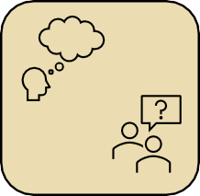


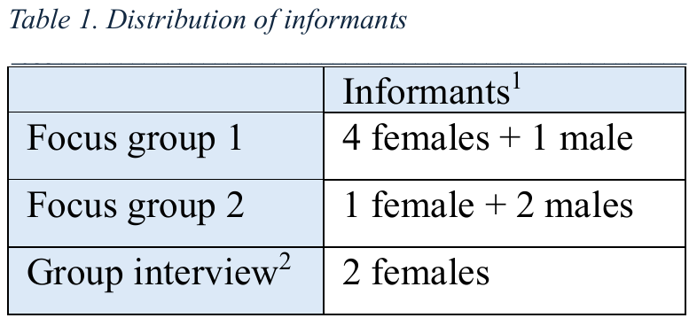
How near-peer supervisors experience their own development when shifting from written to oral interactive feedback
A qualitative interview study
Anna Victoria Flankegård
University of Bergen afl043@uib.no
Anna Victoria Flankegård (1), Julie Solberg Knutsen, Eivind Alexander Valestrand, Knut Eirik Ringheim Eliassen
(1): Corresponding author
Background
Oral interactive feedback has been shown to provide greater learning outcomes compared to feedback in monologue. While we know this is true for the student learner, there is still a gap in understanding the learning outcomes for the student supervisors themselves. This study explored near-peer supervisors’ experiences of their own development when shifting from one- way written feedback to oral interactive feedback, meaning feedback provided in an oral, two-way dialogue, where both sides have active roles, and the supervisor stimulates the learner to reflect.
Results
The supervisors experienced that oral interactive feedback promoted their development in several ways. They developed through conversations with students by gaining more confidence and experiencing professional and personal benefits. The supervisors also experienced how to adapt feedback methods to different purposes. They linked their supervisor experiences to meeting patients as physicians, describing improvement in communication skills, leadership and professional relationship establishment, and acquired new insights in their future role as physicians.
“And that I believe one will find use for later, simply daring to be a little bit quiet, just listening.”
(Supervisor 6)
Communication and leadership
Interpretation
Establishing relationships
Methods
We conducted a qualitative interview study with 10 medical student supervisors in groups. We asked how they experienced the difference between providing written and oral interactive feedback, and what impact it had on them. Analysis was conducted with systematic text condensation, a method for thematic cross-case analysis.
Conclusions
Our study shows that through providing oral interactive feedback, student supervisors can develop their skills in communication and supervision. Through reflecting on their experiences, they can explore the close connection between their role as supervisors and their future role as physicians. Institutions should more frequent facilitate oral interactive feedback, and address potential challenges, as there are reciprocal benefits for both feedback providers and receivers.
“I was nervous before the first oral feedback. Then I provided the feedback, and then I looked forward to the rest of the feedback sessions. It was just a bit like that, a threshold.” (Supervisor 1)
1: To preserve anonymity, citations in the results are only signed with supervisor number because of gender distribution and different numbers of informants in the groups.
2: Planned as a focus group. However, only two informants showed at the set time.
REFERENCES
Illustrations generated with Stock pictures from Microsoft 365.
The text on this poster is based on the manuscript «How near-peer supervisors experience their own development when shifting from written to oral interactive feedback: A qualitative interview study».
ACKNOWLEDGEMENTS
I would like to thank the student supervisors who participated in the interviews.
Also, I would like to thank my supervisors for all the help along the way; main supervisor Knut Eirik R. Eliassen and co-supervisors Julie S. Knutsen and Eivind A. Valestrand.

