Slide 1
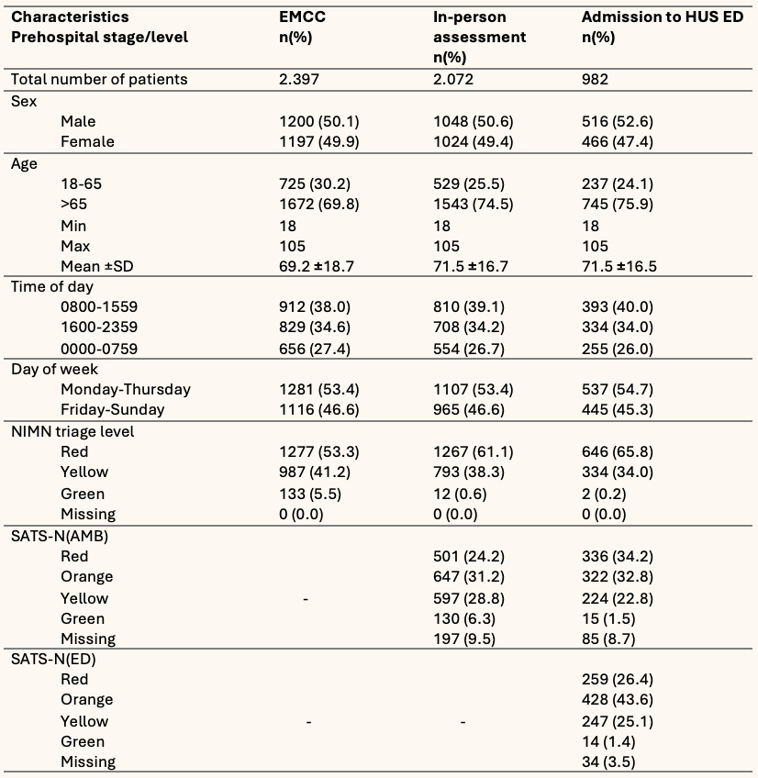
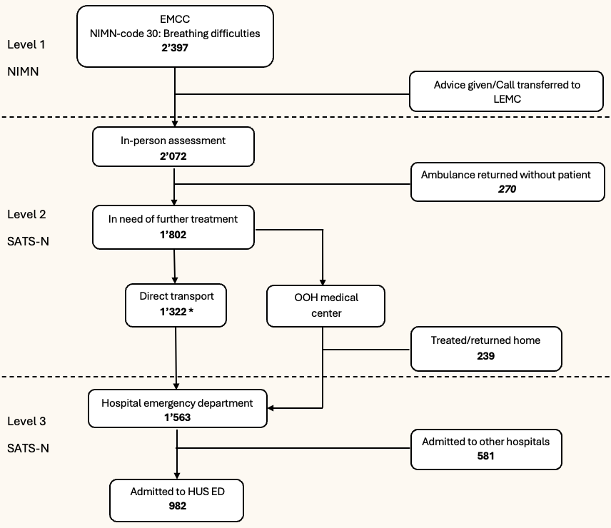
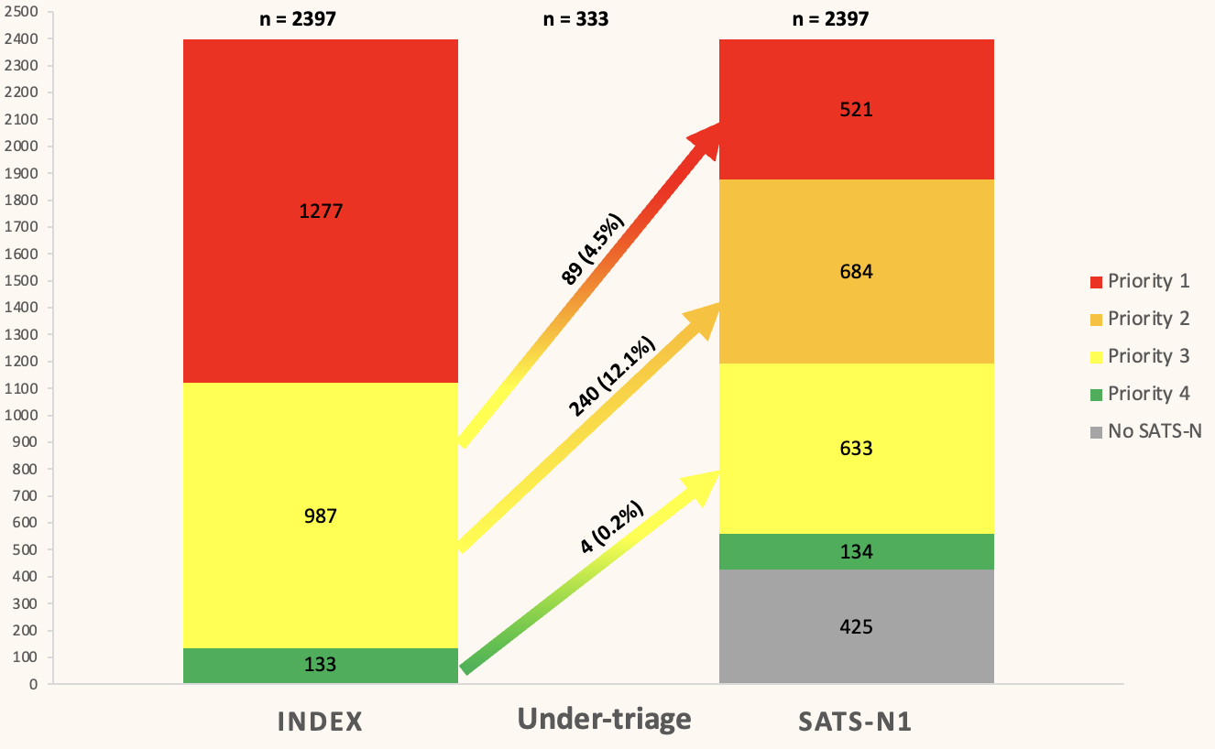
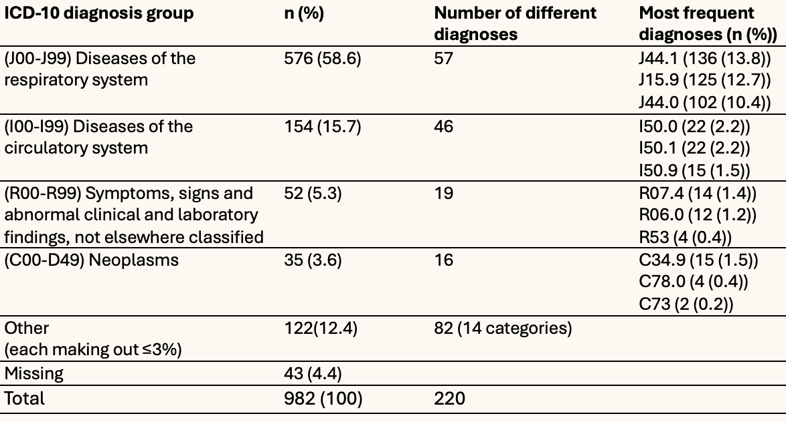
Evaluation of telephone triage of breathing difficulties in Bergen Emergency Medical Services, Norway:
a retrospective study
Lars Kristian Helle
Simen Kutschera Sund
University of Bergen
jew012@uib.no
ssu036@uib.no
A description of the relation between code 30 'Breathing difficulties' in the Norwegian Index for Medical Emergency Care, the SATS-N in the acute medical chain and ICD-10 discharge diagnoses
Introduction
Emergency medical communication centers are critical components of medical emergency assistance to the public and require rapid and accurate decisions to save lives. The Norwegian Index for Medical Emergency Assistance (Index) is a criteria-based dispatch system. Although the only triage tool used nationwide, Index has not been evaluated since its implementation. The aim of this study was to assess the accuracy of Index in telephone triage of patients presenting breathing difficulties by evaluating discrepancies between dispatch priorities and triage using South African Triage Scale Norway (SATS-N).
Methods
We conducted a retrospective cohort study in Bergen, Norway during 2023. Registration of contact- and delivery points were used to map the prehospital phase. To assess levels of over- and under-triage Index priority was compared to priority level given by ambulance personnel or ED nurses, using SATS-N. Length of admittance, intensive care and mortality were used to describe patient outcomes.
Results
A total of 2.397 calls were included, 86% received an in-person assessment, and 65% were admitted to hospital.
Figure 1: Prehospital and hospital distribution of incidents presenting symptoms coinciding with Index code 30; Breathing difficulties.
The level of admission to hospital, intensive care unit and mortality increased with higher Index priority level.
In the total population of 2,397 cases investigated, there were 1.0%, 4.8%, and 8.6% deaths after 24 hours, 7 days, and 30 days respectively.
Table 1: Patient characteristics and distribution according to triage level.
The most common ICD-10 diagnosis group was respiratory disease (58.6%), followed by circulatory disease (15.7%). The most frequent diagnoses were COPD (J44, 29%) and bacterial pneumonia (J15, 15%).
Table 2: ICD-10 discharge diagnoses in patients admitted to Haukeland University Hospital due to breathing difficulties in 2023 in descending order.
The concordance with the Index priority level and the first assessment using SATS-N, was 62.5% while rates of over- and under-triage was 20.6% and 16.9%, respectively. The cases of under-triage were characterized by higher mean age, and higher admission rate to hospital and intensive care, but lower mortality rates.
Figure 2: Distribution based on urgency level in initial telephone triage using the Norwegian Index compared to first in-person triage using SATS-N.
Conclusion
We found a high level of hospitalization in patients calling the EMCC with breathing difficulties, and severity increased with priority level. The rates of over- and under-triage are comparable to previous Scandinavian studies, but with a lower under-triage rate. However, the under-triage rate is still higher than the rate proposed by international guidelines for trauma triage.
Acknowledgements
We would like to thank our supervisor Professor Guttorm Brattebø for his guidance and contribution to this study, as well as Lars Myrmel for help with data collection and statistics.
Notes:
Målet med vår studie var å evaluere hvor nøyaktig Norsk Indeks for Medisinsk Nødhjelp er i telefontriagering av pasienter med pustevansker ved å vurdere forskjell mellom Indeks-prioritet i AMK og triage ved bruk av SATS-N i ambulanse og akuttmottak.
Vi utførte en retrospektiv kohortstudie over alle pasienter som fikk Indeks kode 30; Pustevansker i AMK Bergen i 2023.
Registrering av kontakt- og avleveringspunkt ble brukt i kartlegging av den prehospitale fasen.
For å vurdere nivå av over- og undertriage ble Indeks-prioriteten sammenlignet med prioriteten gitt av ambulansepersonell eller sykepleier i akuttmottak ved hjelp av SATS-N.
Liggetid på sykehus, intensivbehandling og mortalitet ble brukt som parametere for videre beskrivelse av pasientenes utfall.
Vi fant høy forekomst av innleggelse på sykehus blant pasientene som ringte AMK grunnet pustevansker, og alvorligheten økte med økende prioritetsnivå.
Forekomst av over- og undertriage i denne studien kan sammenlignes med tidligere skandinaviske studier, men vi fant noe lavere nivå av undertriage.
Forekomsten av undertriage var likevel høyere enn det som ifølge internasjonale retningslinjer for traumetriage anses som akseptabelt.

