Slide 1

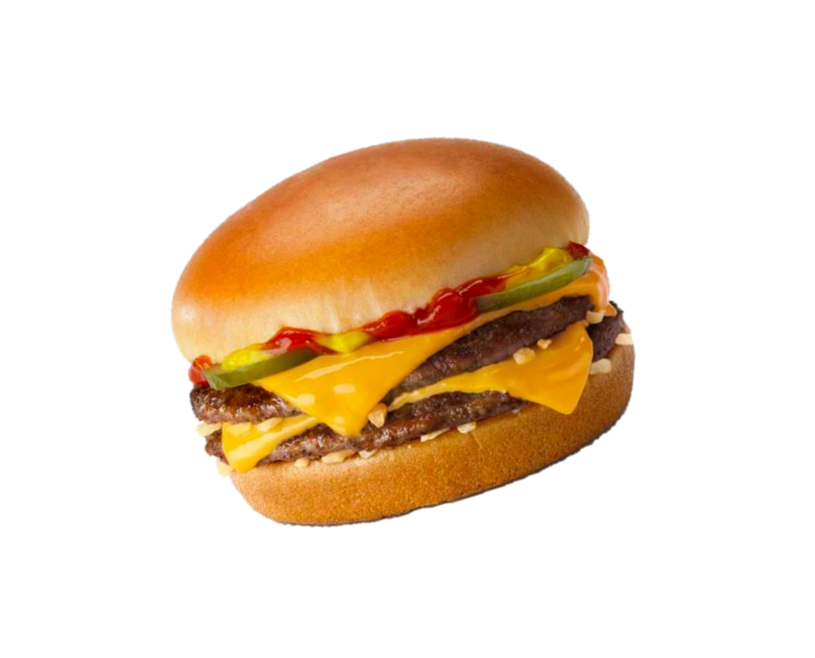
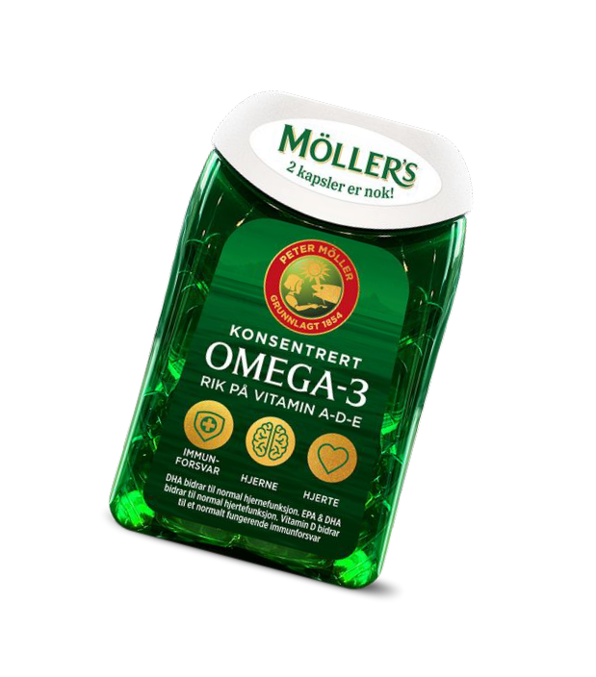
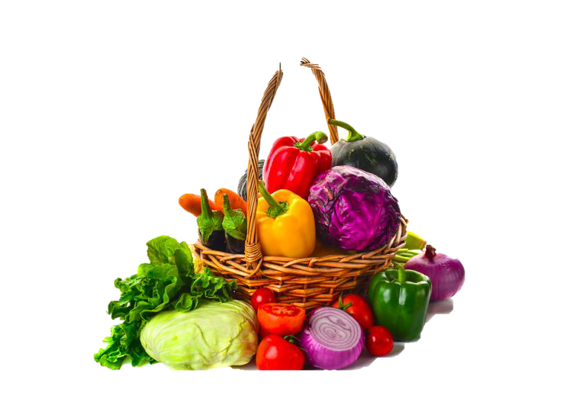
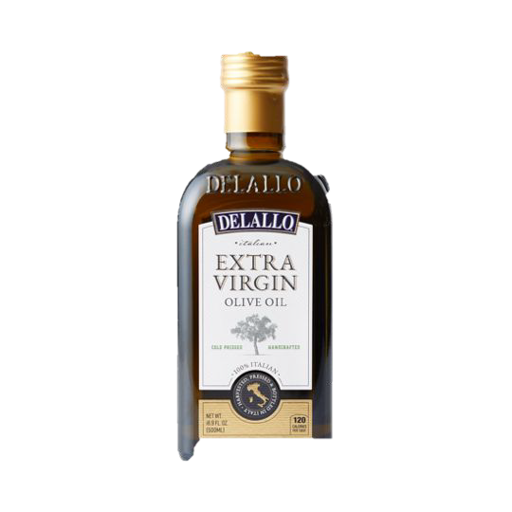
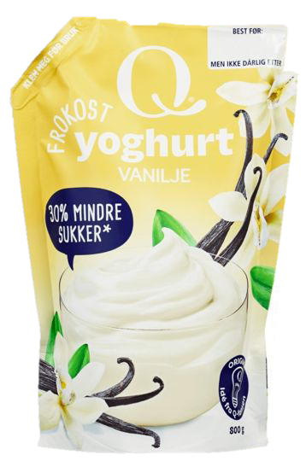
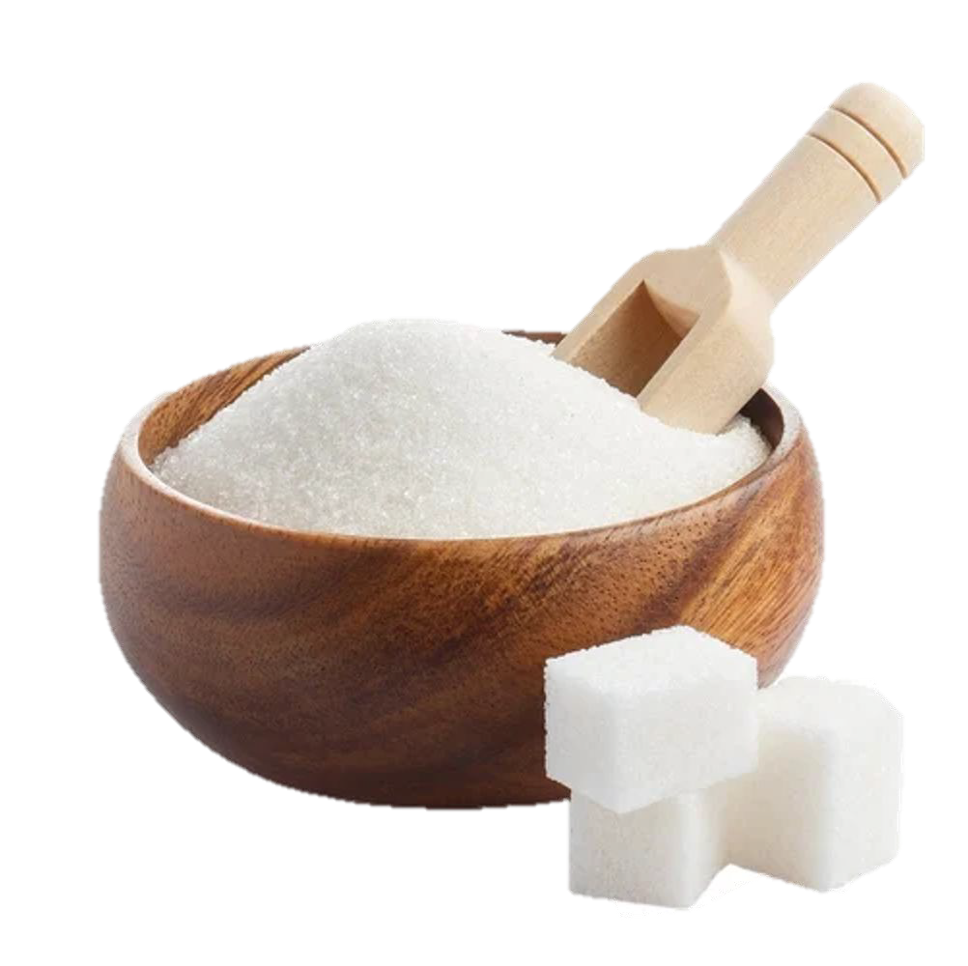

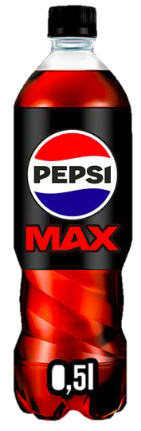
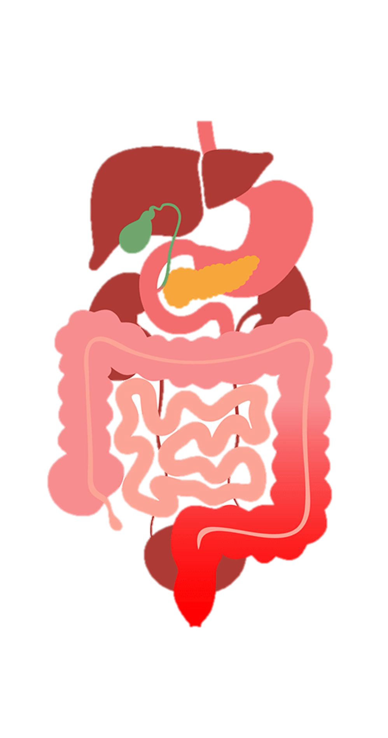
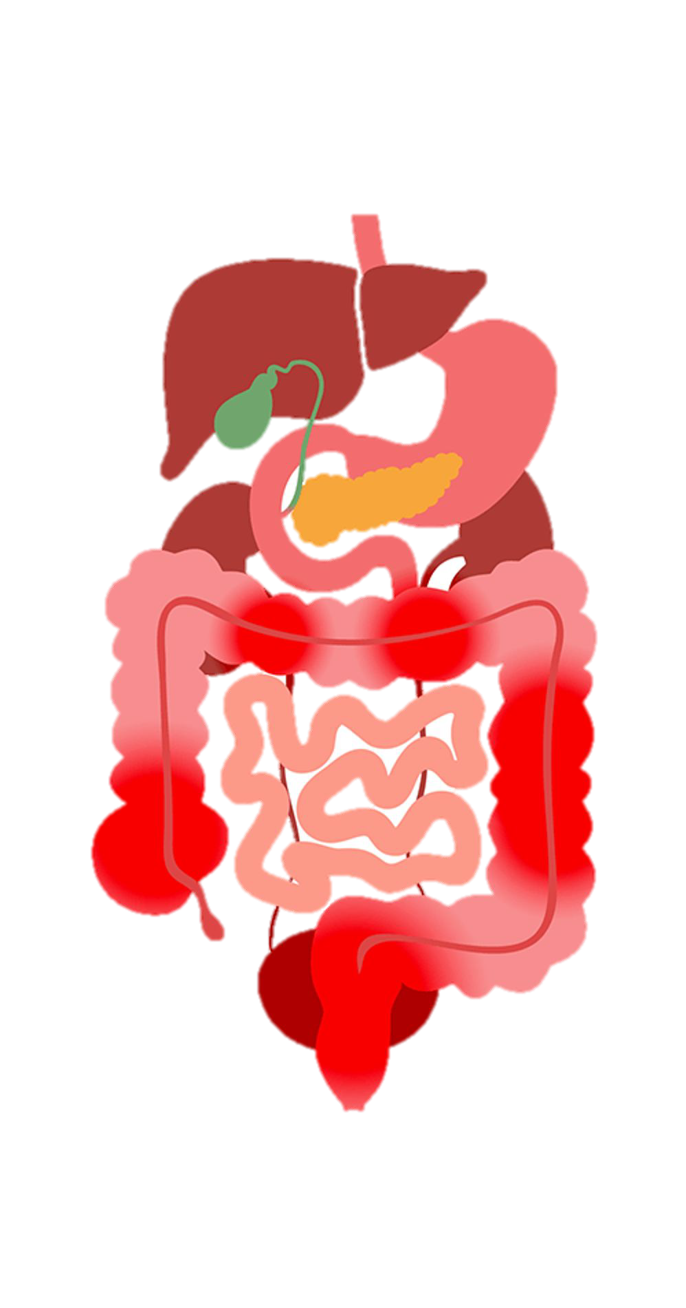
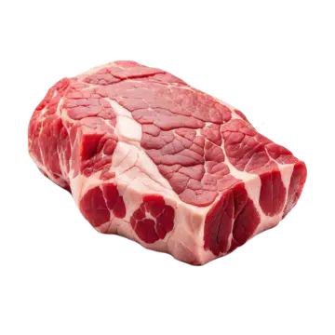
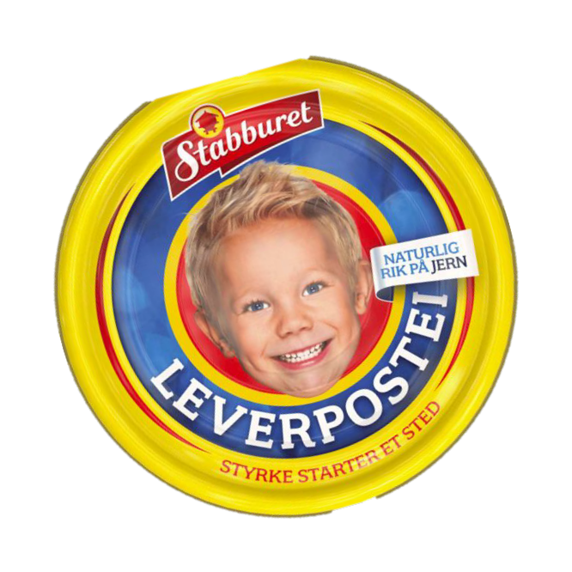
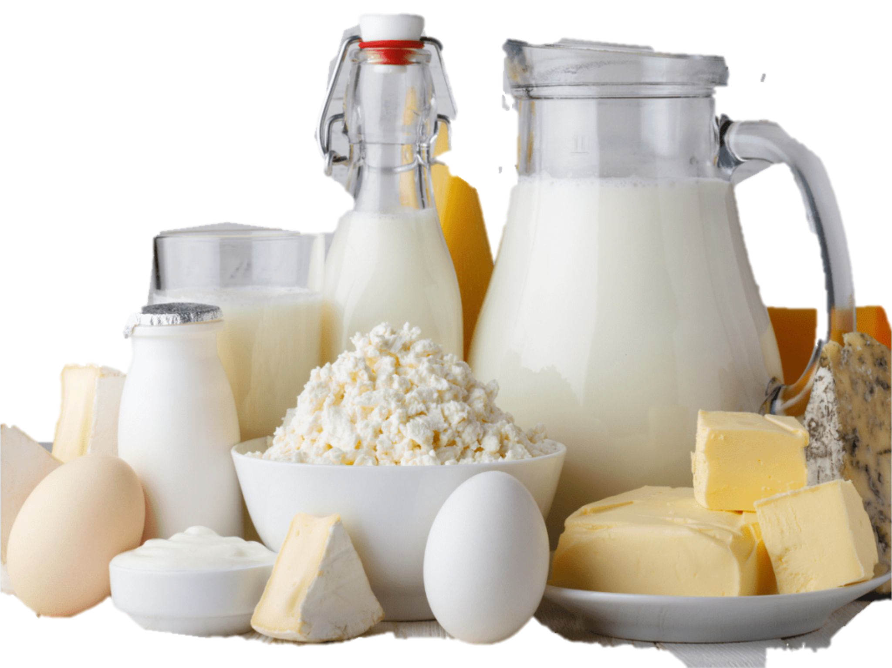
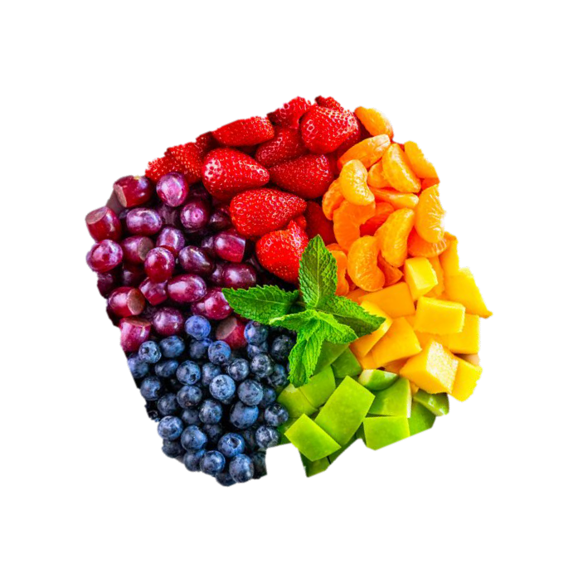

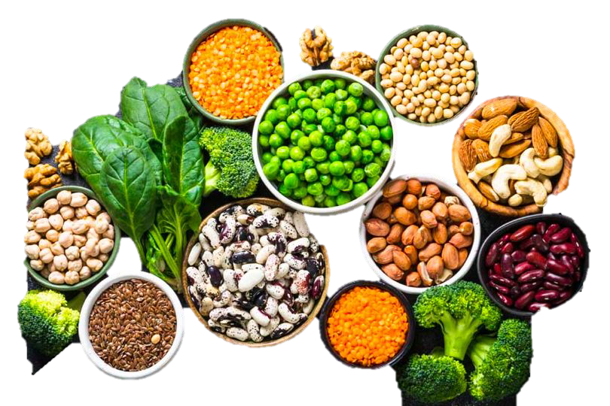
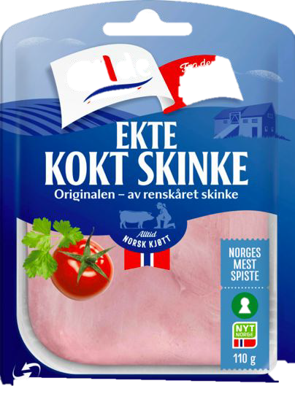
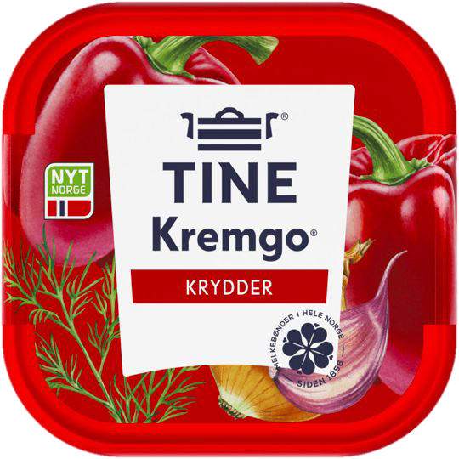
Andrea Knudsen
Diet and inflammatory bowel disease
Diet, Food, and Nutritional Exposures and Inflammatory Bowel Disease or Progression of Disease: an Umbrella Review
University of Bergen akn019@uib.no
Camilla Christensen
University of Bergen cch024@uib.no
ABSTRACT
Inflammatory bowel disease (IBD) includes, but is not
restricted to, Crohn's disease (CD) and ulcerative colitis (UC). The diseases contributes to substantial morbidity and in 2017 was shown to be the cause of 2 million disability-adjusted life years lost globally. IBD is characterized by inflammation of the gastrointestinal tract and dysregulation of immune responses, typically with relapses and remissions. The diseases often require long-term use of immunosuppressive,
anti-inflammatory, biological and immunomodulatory treatment to manage symptoms. It has become clear in recent years that diet may play a crucial role in disease incidence and progression, but a comprehensive overview was lacking. This umbrella review synthesizes evidence from systematic reviews and meta analysis to evaluate these complex associations. The findings of this umbrella review could provide evidence for nutritional counselling and be a valuable addition to the traditional treatment of IBD.
OUR FINDINGS
Eat more
Eat less
Inconclusive
Fruits and vegetables.
Dietary fibers
Mediterranean diets
Specific carbohydrate diet (low in grains, sugars and lactose) Vegetarian and semivegeterian diets.
Western dietary pattern
Meat
Ultraprocessed food
Dietary fats
Refined sugars
Fish
Dietary n-3 PUfA and n-6 PUFA
Dairy
Eggs
Alcohol
Carbohydrates
Cholesterol
●
UC
CD
ACKNOWLEDGEMENTS
Andrea Knudsen and Camilla Christensen contributed equal to this poster and the article.
Lars T Fadnes, Erik K Arnesen, Jan Gunnar Hatlebakk and Ida Sofie Sletten all contributed to the article as well
REFERENCES
C. Christensen et al. Diet, Food, and Nutritional Exposures and Inflammatory Bowel Disease or Progression of Disease: an Umbrella Review, Advances in Nutrition, https://www.sciencedirect.com/science/article/pii/S216183132400053X?via%3Dihub (2024)

