Slide 1
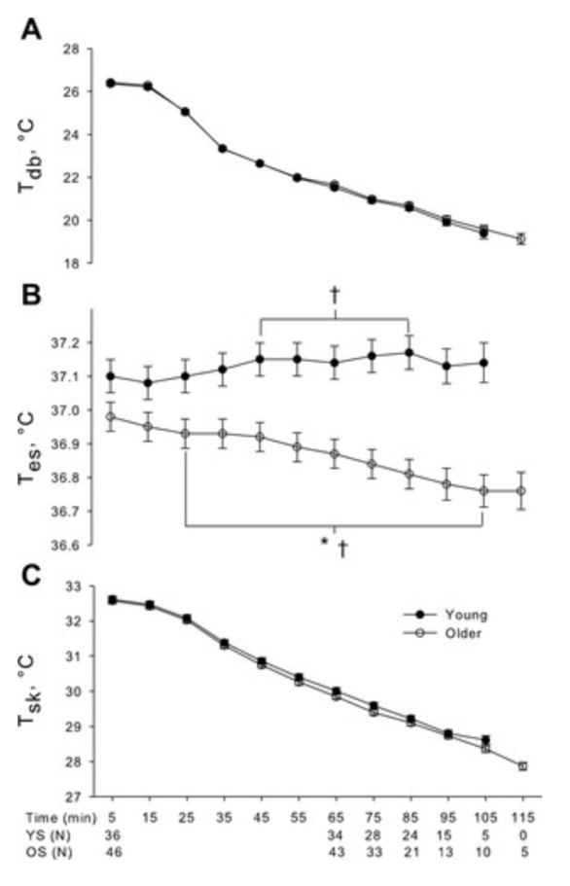
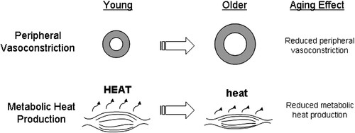
Accidental hypothermia in the elderly
Kristin Otterskred Lundal
Hanna Pedersen Leren
University of Bergen
Kristin.Lundal@student.uib.no
Hanna.Leren@student.uib.no
Accidental hypothermia poses a serious risk for elderly individuals, with increased mortality. This protocol describes an experimental study in which we will examine the extent of hypothermia in elderly who are immobilized at indoor temperatures.
AUTHORS
Hanna Pedersen Leren and Kristin Otterskred Lundal
ABSTRACT
Accidental hypothermia (AH) poses a serious risk to elderly individuals. Age-related factors such as reduced vasoconstriction, muscle mass and heat production make them particularly vulnerable. While younger populations in extreme conditions have been extensively studied, less is known about temperature change in the elderly. AH in the elderly is associated with increased mortality and most cases of AH occur in home settings.
This protocol outlines a study designed to simulate a scenario where an elderly person is immobilized at room temperature to observe temperature changes. The findings may contribute to improved clinical guidelines and early interventions to prevent and treat AH in home-dwelling elderly individuals.
METHOD
The participants will lie immobilized on the floor in ambient temperature of 17˚C for three hours. Baseline physical recordings (HR, BP, SPO2) are made at study start. Core temperature, skin temperature and thermal comfort will be registered throughout the study.
STUDY DESIGN
This is an experimental observation study in 35 volunteers, 65 - 85 years of age, with BMI 18.5 - 35.
EXPECTED OUTCOME
Based on previous experimental studies we expect the core temperature to decrease with approximately 0.5 - 1.0˚C and the skin temperature to decrease with approximately 5˚C.
REFERENCES
1. Kenney WL, Munce TA. Invited Review: Aging and human temperature regulation. Journal of Applied Physiology. 2003;95(6):2598-603.
2. DeGroot DW, Kenney WL. Impaired defense of core temperature in aged humans during mild cold stress. American Journal of Physiology-Regulatory, Integrative and Comparative Physiology. 2007;292(1):R103-R8.
ACKNOWLEDGEMENT
We want to thank our tutors, Guttorm Brattebø and Hans Flaatten, and Fjellgruppen for valuable input.
Figure 2: Co-variation between room temperature (A), core temperature as measured in esophagus (B) and skin temperature (C), for young and older individuals. Borrowed from Impaired defense of core temperature in aged humans during mild cold stress (2).
Figure 1: Summary of age-related changes in thermoregulation during cold stress. Borrowed from Invited Review: Aging and human temperature regulation (1).

