Slide 1
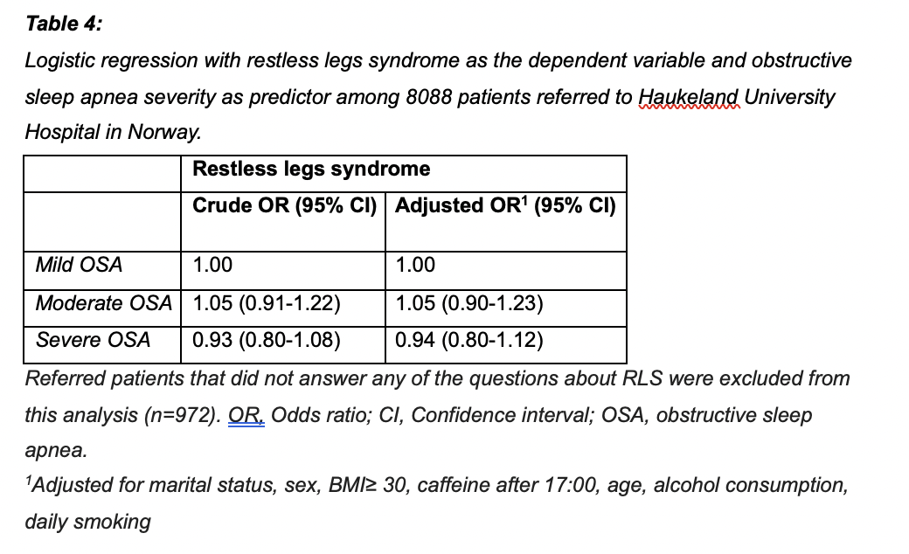
Is there an association between restless legs and obstructive sleep apnea?
Erik Vevatne
University of Bergen
erikvo98@gmail.com
In this large hospital-based cross-sectional study the association between obstructive sleep apnea and restless legs was investigated. The results showed no association between the two.
August Waaraas
University of Bergen
august.arentz@gmail.com
Objective
Some studies have indicated a possible association between obstructive sleep apnea (OSA) and restless legs syndrome (RLS). Our aim was to explore this association in a large sample of patients referred to a hospital for suspected OSA.
Results
In total, 24.1% fulfilled the criteria for RLS, whereas moderate-severe OSA (apnea-hypopnea-index ≥15) occurred in 38.1% of the patients. The proportion of patients with RLS did not differ depending on OSA severity. Furthermore, there was no association between RLS and OSA in either chi-square or logistic regression analyses.
Table 4 shows both crude and adjusted analysis of the association between patients with RLS and wether or not they also had mild, moderate or severe OSA.
Conclusion
The present large, hospital-based, cross-sectional study sought to determine whether an association exists between OSA and RLS in a population of patients referred for suspected OSA. Contrary to our initial hypotheses, the findings demonstrated no significant association between RLS and OSA, nor did the severity of OSA appear to predict the presence of RLS. These results suggest that RLS and OSA are likely to have distinct underlying pathophysiological mechanisms, contributing to their lack of association. Given the study’s limitations, future research should aim to confirm these findings in a broader, more diverse population. Additionally, exploring the impact of treating one condition on the other could provide further insights into their relationship. Clinically, these findings indicate that RLS screening in patients with OSA may not be necessary unless other risk factors are present.
Methods: The sample included 8852 patients referred to Haukeland University Hospital with suspicion of OSA between 2011-2022. OSA was diagnosed and categorized using standard respiratory polygraphy. Prior to the sleep study the patients completed an extensive questionnaire, including questions to determine if they had RLS. Pearson chi-square tests were used to examine differences based on the presence and severity of OSA. Two separate logistic regression analyses were conducted. The first with moderate-severe OSA as the dependent variable and the second with RLS as the dependent variable. Both were adjusted for marital status, sex, body mass index ≥ 30, caffeine after 17:00, age, alcohol consumption and daily smoking.
Authors:
Erik Vevatne Øverland^{1*}, August Waaraas¹, Ragnhild S. Lundetræ^{1,2}, Sverre Lehmann^{3,4}, Ingvild W. Saxvig^{2,3}, Bjørn Bjorvatn^{1,2,3}
¹ Department of Global Public Health and Primary Care, University of Bergen, Bergen, Norway.
² Centre for Sleep Medicine, Haukeland University Hospital, Bergen, Norway.
³ Norwegian Competence Center for Sleep Disorders, Haukeland University Hospital, Bergen, Norway.
⁴ Department of Clinical Science, University of Bergen, Bergen, Norway.
ACKNOWLEDGEMENTS
The text in this template is largely based upon the article ”Is there an association between obstructive sleep apnea and restless legs syndrome? Results from a large hospital-based cross-sectional study”.

