Slide 1
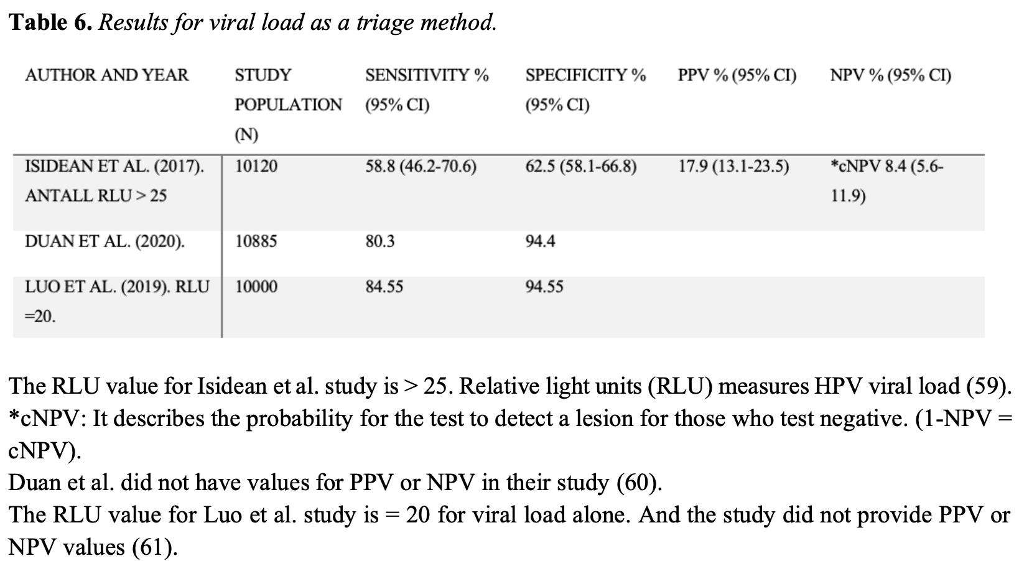
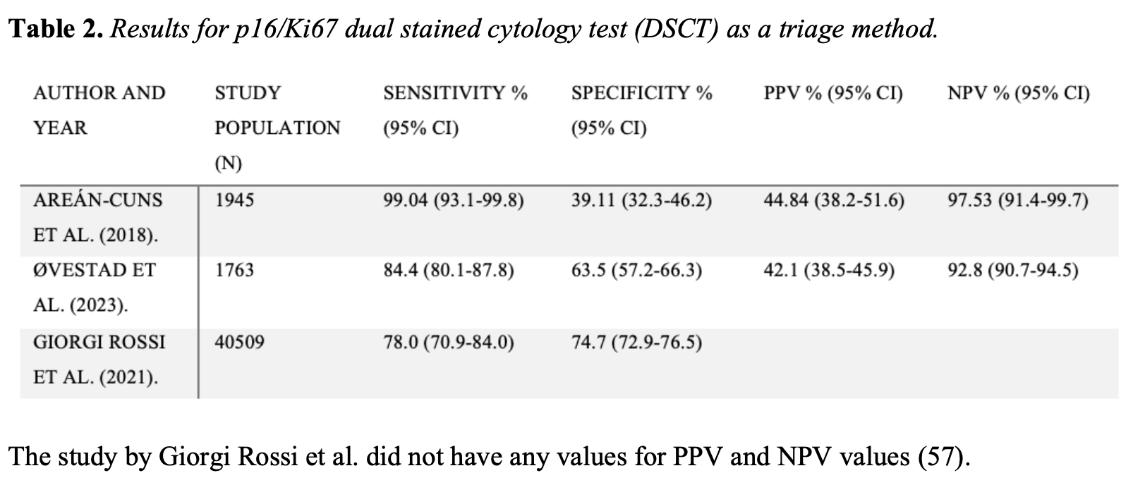
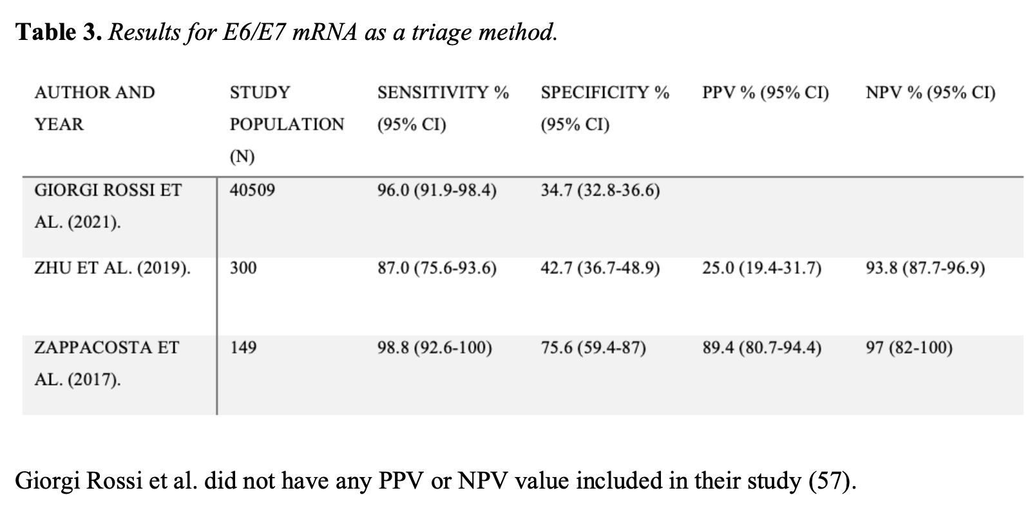
Triage tests in cervical cancer screening – an overview
Primary aim of this study is to provide an overview of different triage methods to optimize the detection and follow-up of pre-cancerous lesions and cervical cancer in women with positive high-risk-HPV test. Our target group is women between 25-69 years of age.
  Jeneta Subramaniam
  University of Bergen
jsu027@uib.no
Background
Cervical cancer is the fourth most common malignancy among women and a significant global health concern in developing countries. There have been several advancements in screening and vaccinations for early detection and prevention of cervical cancer, however this disease is a leading cause of cancer-related deaths among women worldwide. Significant progress can be made for diagnosis, treatment and prognosis by improving the triage methods for high-risk HPV positive women in secondary screening. Several meta-studies have discussed the different triage methods´ accuracy in detecting pre-cancerous lesions, but there are still more improvements to be made in this field.
Results
p16/ki67, E6/E7 and viral load showed the most promising results, with overall decent sensitivity, (78.0% vs 98.8% vs 84.55%), and specificity, (74.7% vs 75.6% vs 94.55%).
Conclusion
In conclusion, this overview highlights the importance of a good triage method for high-risk-HPV positive women in the secondary screening. Our findings suggests that p16/ki67, E6/E7 and viral load can be suggested as future triage methods for these women. Further research should be conducted to assess the optimized triage methods’ long-term effects in terms of incidence and mortality rates of cervical cancer, as well as assess their cost-effectiveness, user-friendliness as a home test, and implementation in healthcare.
Methods
We conducted a literary search using PubMed as our main database. The keywords for the search were “cervical screening”, “high-risk-HPV positive women” and “triage method”. Articles that fulfilled the inclusion criteria and published until 27th of March 2024 were included in this overview.
REFERENCES
Small W, Jr., Bacon MA, Bajaj A, Chuang LT, Fisher BJ, Harkenrider MM, et al. Cervical cancer: A global health crisis. Cancer. 2017;123(13):2404-12.
Arean-Cuns C, Mercado-Gutierrez M, Paniello-Alastruey I, Mallor-Gimenez F, Cordoba-Iturriagagoitia A, Lozano-Escario M, et al. Dual staining for p16/Ki67 is a more specific test than cytology for triage of HPV-positive women. Virchows Arch. 2018;473(5):599-606.
Ovestad IT, Dalen I, Andersland MS, Vintermyr OK, Moltu P, Berland JM, et al. Triaging HPV-Positive Cervical Samples with p16 and Ki-67 Dual Stained Cytology within an Organized Screening Program-A Prospective Observational Study from Western Norway. Int J Mol Sci. 2023;24.
Giorgi Rossi P, Carozzi F, Ronco G, Allia E, Bisanzi S, Gillio-Tos A, et al. p16/ki67 and E6/E7 mRNA Accuracy and Prognostic Value in Triaging HPV DNA-Positive Women. J Natl Cancer Inst. 2021;113(3):292-300.
Isidean SD, Mayrand MH, Ramanakumar AV, Rodrigues I, Ferenczy A, Ratnam S, et al. Comparison of Triage Strategies for HPV-Positive Women: Canadian Cervical Cancer Screening Trial Results. Cancer Epidemiol Biomarkers Prev. 2017;26(6):923-9.
Duan L, Du H, Wang C, Huang X, Qu X, Shi B, et al. The effectiveness of HPV viral load, reflected by Cobas 4800 HPV-Ct values for the triage of HPV-positive women in primary cervical cancer screening: Direct endocervical samples. PLoS One. 2020;15(5):e0232107.
Luo H, Du H, Belinson JL, Wu R. Evaluation of alternately combining HPV viral load and 16/18 genotyping in secondary screening algorithms. PLoS One. 2019;14(7):e0220200.
Zhu Y, Ren C, Yang L, Zhang X, Liu L, Wang Z. Performance of p16/Ki67 immunostaining, HPV E6/E7 mRNA testing, and HPV DNA assay to detect high-grade cervical dysplasia in women with ASCUS. BMC Cancer. 2019;19(1):271.
Zappacosta R, Sablone F, Pansa L, Buca D, Buca D, Rosini S. Analytic and Diagnostic Performances of Human Papillomavirus E6/E7 mRNA Test on up-to 11-Year-Old Liquid-Based Cervical Samples. A Biobank-Based Longitudinal Study. Int J Mol Sci. 2017;18(7).
ACKNOWLEDGEMENTS
I want to thank my supervisors Hans Kristian Haugland and Elisabeth Wik for all their support and patience.

