Slide 1
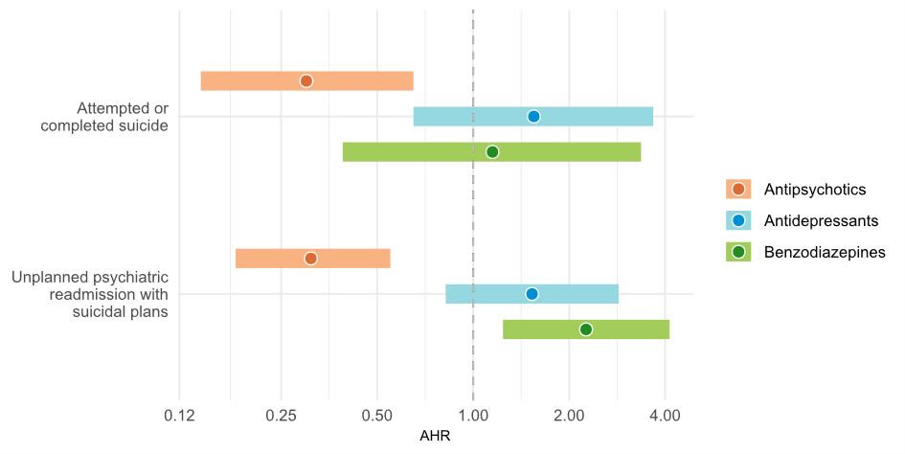
Suicidality and use of psychotropic medications in patients with Schizophrenia: A prospective cohort study
Mina Thue Augustsson
University of Bergen
Mina.augustsson@student.uib.no
M. Fagerbakke Strømme; M. Thue Augustsson; C. Bartz-Johannessen; A.Stautland; A. Mykletun; R. Kroken; L. Mehlum; E. Kjelby; E. Johnsen
BACKGROUND
The lifetime prevalence of suicide is around 5% in patients with schizophrenia.
Non-adherence to antipsychotic medication is an important risk factor, but prospective studies investigating joint effects of antipsychotic drugs, antidepressants, and benzodiazepines on suicidality are limited.
Figure: Associations between psychotropic drug use and suicidality: Adjusted hazard ratios (AHR) from Cox multiple regression models
AIM
To investigate how use and non-use of psychotropic medications are associated with suicidality in schizophrenia.
METHODS
A cohort of 696 patients with schizophrenia who were admitted to the psychiatric acute unit at Haukeland University Hospital, Bergen, Norway, was followed for up to 10 years post-discharge.
At every following readmission, suicidal attempts and suicidal plans were registered. Information on completed suicides were obtained from the Norwegian Cause of Death registry.
Periods of use versus non-use of antipsychotics, antidepressants and benzodiazepines were recorded as time-dependent variables in each patient and compared using Cox multiple regression analyses. Adjustments were made for age, gender, depression, agitation, and use of alcohol and illicit substances.
RESULTS
In all, 32 (4.6%) suicide events were recorded during the follow-up, of which 9 (28%) were completed suicides and 23 (72%) were attempted suicides.
A total of 59 (8.5%) patients were readmitted with suicidal plans during the follow-up.
Compared to non-use:
Antipsychotic use was associated with a 70% reduced risk of attempted/completed suicide and a 69% reduced risk of readmission with suicidal plans.
Prescribed benzodiazepine use was associated with a 126% increased risk of readmission with suicidal plans.
Antidepressant use was not significantly associated with the risk of attempted/completed suicide or readmission with suicidal plans.
CONCLUSION
Adherence to antipsychotic medication is strongly associated with reduced suicidal risk in schizophrenia.
The use of prescribed benzodiazepines was identified as a significant risk factor for being readmitted with suicidal plans.
REFERENCES: The work presented in this poster is due to be published as a research article in the international journal Psychological Medicine
ACKNOWLEDGEMENTS: Bergen Psychosis Research group

