Slide 1
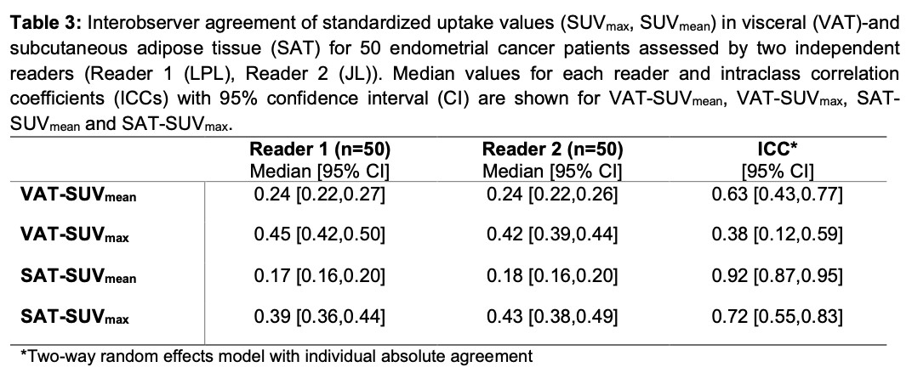
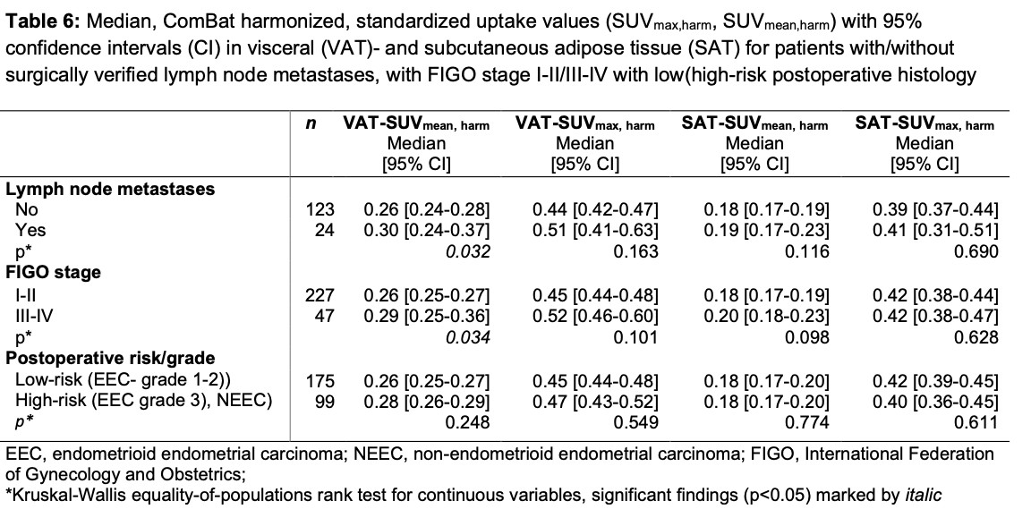
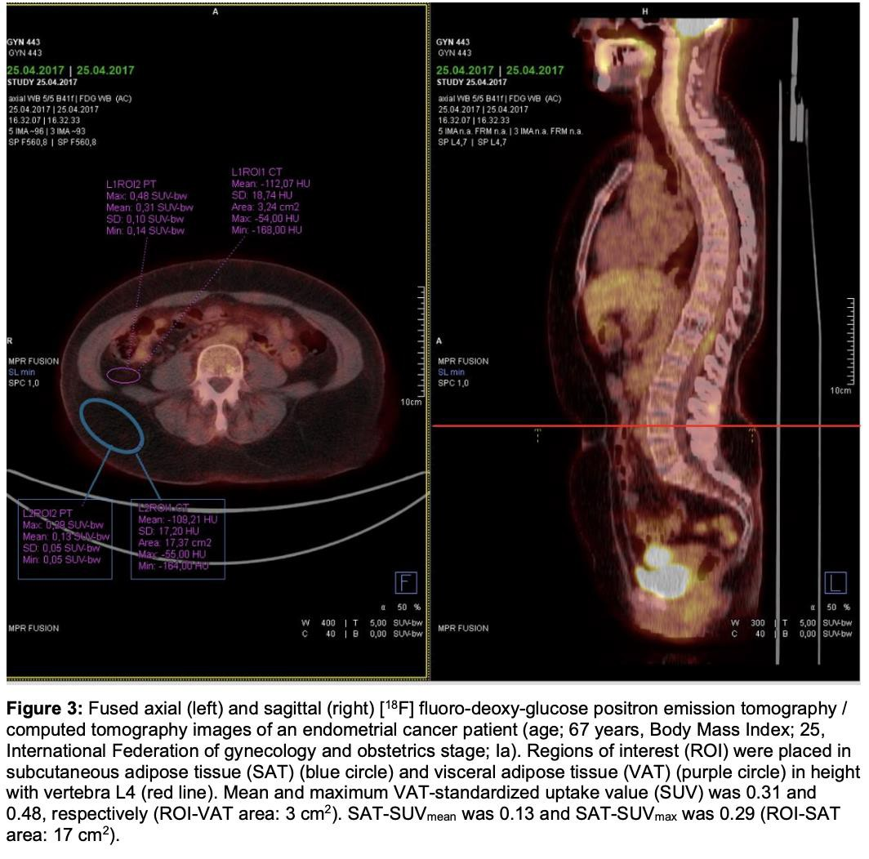
Abdominal metabolic adiposity markers for prediction of aggressive disease in endometrial cancer
Jill Lavik University of Bergen wup010@uib.no
Liv Pauline Lunde University of Bergen llu016@uib.no
Background
Endometrial cancer is one of the most common cancers in women in Norway and
obesity is a well-established risk factor for endometrial cancer development. One mechanism suggested to link obesity to tumorigenesis and disease progression, is secretion of pro-inflammatory cytokines from inflamed visceral adipose tissue (VAT). The metabolic activity in VAT, can be non-invasively
quantified by standardized uptake values (SUV),
from region of interests placed in visceral tissue on [18F]-fluoro-deoxy-glucose positron emission
tomography/computed tomography ([18F]FDG
PET/CT) images. But the potential role VAT metabolism plays in tumorigenesis, tumor progression and patient outcome is only to a minimal extent investigated in endometrial cancer, previously.
Aims
The aim of the study was hence to develop a standardized and reproducible method for quantification of metabolic activity in adipose abdominal tissue compartments (visceral (VAT) and subcutaneous adipose tissue (SAT)), using clinically acquired pre-operative [18F]FDG PET/CT examinations. The study further aimed to explore these metabolic adipose tissue markers in relation to aggressive disease features and abdominal fat distribution (from CT) in endometrial cancer.
Method
Regions of interest were placed by two independent readers on preoperative PET/CT
images in VAT and SAT to measure maximal SUV (VAT/SAT-
SUV ) and mean SUV (VAT/SAT-SUV ). The study
max mean
cohort consisted of 274 endometrial cancer patients diagnosed
and treated in Norway. Interobserver agreement was assessed using intraclass correlation coefficient (ICC). The metabolic VAT and SAT activity was compared with established markers of aggressive disease in endometrial cancer. Further, metabolic activity was compared with adipose tissue volume based on measurements from the corresponding preoperative CT images.
Results
High VAT-SUV_{mean} was associated with lymph node metastases and advanced International Federation of Gynecology and Obstetrics (FIGO) stage (III-IV).
Measurements of metabolic visceral activity yielded moderate interobserver agreement (ICC 0.63) for VAT-SUV_{mean}. No significant associations were observed between metabolic activity and the visceral- or subcutaneous adipose volumes.
Conclusion
We found a significant association between increased metabolic activity in visceral fat and aggressive disease features. However, further studies are needed before concluding on the role of metabolic adipose tissue activity in endometrial cancer development and patient outcome.
ACKNOWLEDGEMENTS
Thanks to our supervisors Ingfrid S. Haldorsen and Kristine E. Fasmer

