Slide 1




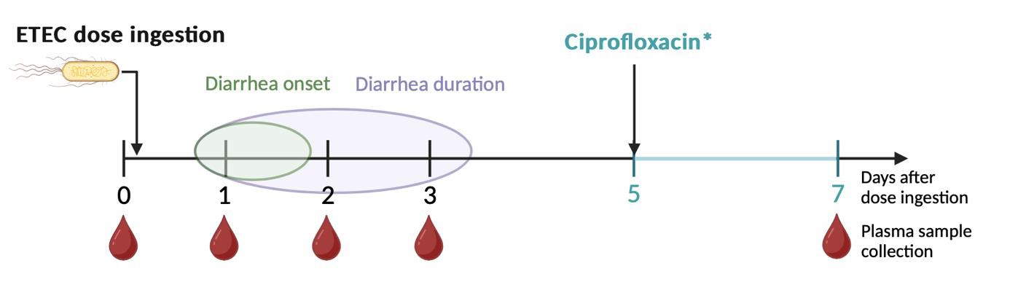


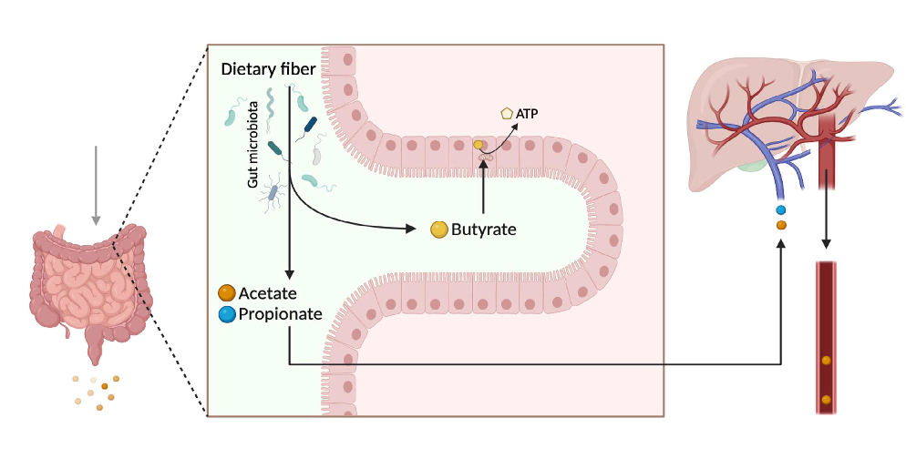

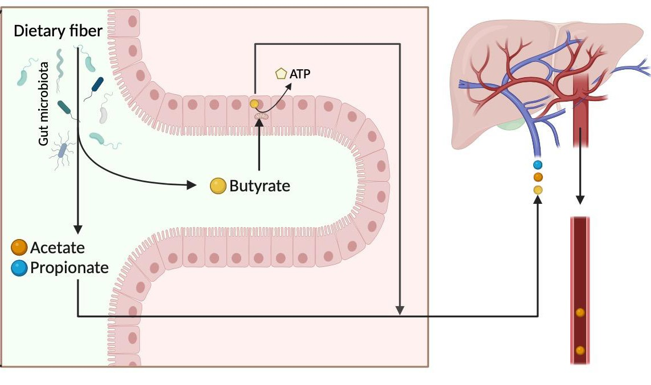



Plasma short-chain fatty acids and host resistance to enterotoxigenic Escherichia coli proliferation
Hanna Stangeland Huseby
hhu015@uib.no
hhu015@uib.no
Pauline Huang
phu007@uib.no
phu007@uib.no
University of Bergen
A statistical analysis of plasma SCFA in relation to experimental ETEC infection
ABSTRACT
Introduction
Enterotoxigenic Escherichia coli (ETEC) infection continues to be a major concern for
children in low-income countries and travelers to endemic areas. Without a licensed
prophylactic agent available, managing and preventing the infection remains challenging. Previous studies have highlighted the importance of short-chain fatty acids’ (SCFA)
role in potentially treating diarrhea. The aim of
the study was to assess changes in plasma SCFA levels in healthy individuals during ETEC infection and investigate whether these changes had a correlation with host resistance to ETEC proliferation in experimental ETEC infection.
Materials and methods
Plasma samples collected from 21 volunteers provided an opportunity to investigate changes in the levels of eight SCFA during experimental ETEC
No differences were found within the NP-group. Only valerate on day 1 (p = 0.046) and isovalerate
the SCFA producing bacteria following antibiotic treatment or disruption of gut integrity and
on day 7 (p = 0.046) showed significant differences uptake. Both valerate and isovalerate displayed
between the P- and NP-groups.
significant differences between the P- and NP- groups. We have not found any specific reason why these SCFAs in particular displayed such difference; both have low plasma levels and the literature on them is limited. Based on our results, we cannot conclude that plasma SCFAs are much impacted by ETEC infection during the symptomatic period, but there was a pattern of plasma SCFA reduction in the aftermath of the infection, where antibiotic treatment may have played a role.
Future research on SCFA during ETEC infection should include both blood and feces sample analysis of a higher number of volunteers. If antibiotic treatment is used, the sampling time points should coincide with the start of, and after antibiotic treatment to better discern the effect of ETEC from the antibiotic treatment.
infection with ETEC strains TW11681 or TW10722. In the group who received antibiotics on day 5,
The volunteers were divided into two groups based on the colonization level of ETEC DNA in stool samples: 14 in the proliferation (P)-group and 7 in the non-proliferation (NP)-group. We analyzed SCFA changes from baseline (day 0) and on subsequent days after ETEC exposure (day 1, 2, 3 and 7) within each group, and compared the groups to identify any significant differences between them.
there was a significant decline between day 3 and 7 for acetate (p = 0.009), propionate (p = 0.005), butyrate (p = 0.019), valerate (p = 0.009) and isovalerate (p = 0.001).
100
A Plasma acetate
90
Mean…
100
Mean Non-…
80
90
Value (µmol/L)
70
80
60
70
50
60
40
50
30
40
20
30
0
1
2
3
Day
7
20
0
1
2
3
Day
7
B Plasma propionate
1,4
1,4
Mean…
1,2
Mean Non-…
1,2
1,0
Value (µmol/L)
1,0
0,8
0,8
0,6
0,6
0,4
0,4
0,2
0,2
0,0
0
1
2
3
Day
7
0,0
0
1
2
3
Day
7
SCFA production by gut microbiota through fermentation
*13 volunteers were administered Ciprofloxacin on day 5, while 8 others received the antibiotic earlier.
1,2
C Plasma butyrate
Fiber-rich diet
Portal circulation
1,0
Mean Proliferation
1,2
Mean Non-…
0,8
1,0
Value (µmol/L)
0,6
0,8
Results
0,4
0,6
0,2
0,4
SCFA
Plasma SCFA
We found a significant decrease in acetate (p = 0.002), propionate (p = 0.008), butyrate (p =
0,0
0,2
0
1
2
3
7
0,0
0
1
2
3
7
Day Day
Conclusion
The decrease in plasma levels from day 0 to day 7 in the P-group could be due to the decrease in
Anerkjennelser
Vi vil takke våre veiledere Sunniva Todnem Sakkestad og Kurt Hanevik for god veiledning under arbeidet med oppgaven; inkludert innspill, tilbakemeldinger og hjelp til analyser.
Fecal SCFA
Plasma SCFA
0.003), isobutyrate (p = 0.006) and valerate (p = 0.002) from day 0 to day 7 in the P-group.

