Slide 1
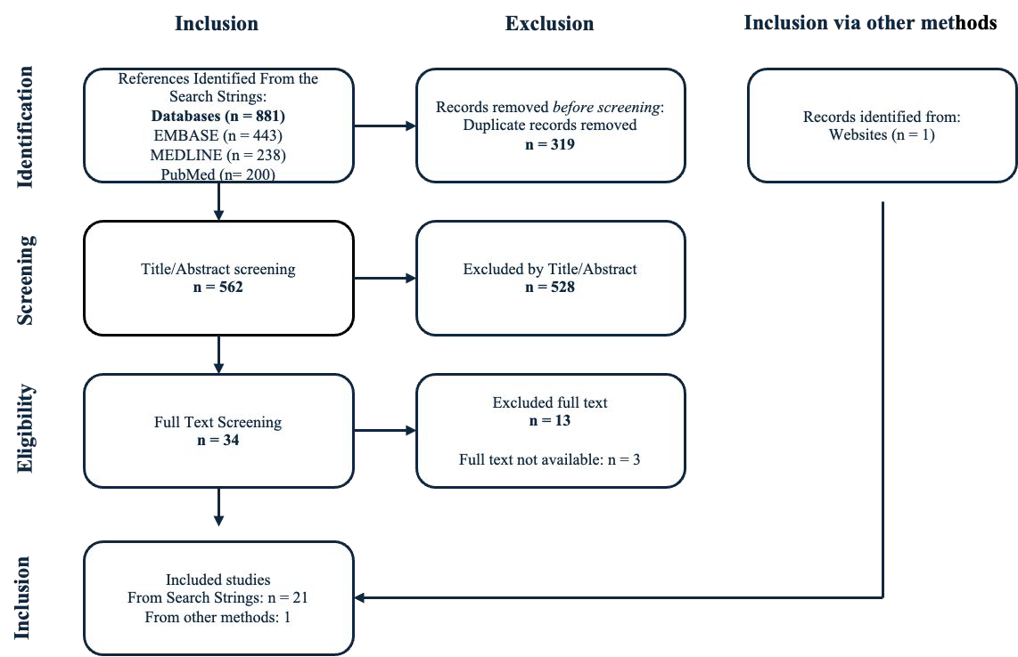
The Role of Respiratory Rate Monitoring
A Scoping Review of its Impact on Early Detection of Clinical Deterioration and Mortality
Sol Agnete Stene Aglen University of Bergen sol.aglen@student.uib.no
Henriette F. Simonsen University of Bergen henriette.simonsen@student.uib.no
Background
Respiratory rate (RR) is a key vital sign used in hospital settings to assess patient health and
Methods
A systematic search of Medline Ovid, EMBASE Ovid, and PubMed was conducted to identify relevant studies. The review focused on studies examining the
predict clinical deterioration. Despite its importance, RR is often underutilised, and a deeper understanding of its full potential is necessary, particularly regarding the value of continuous monitoring and trend analysis.
impact of RR monitoring compared to either no measurement or less frequent manual measurement. The primary outcomes of interest were mortality or
clinical deterioration. Data were synthesised thematically to map the current evidence.
Objective
Results
Several studies indicated that elevated RR, particularly when sustained over time, is associated with severe outcomes such as ICU admission and mortality. In one large analysis of medical-surgical admissions, the highest recorded RR in the previous 24 hours was identified as the strongest predictor of ICU transfer or death (1). Similarly, a study of postoperative inpatients found that RR was the most predictive individual vital sign for severe adverse outcomes, with an Area Under the Curve (AUC) of
0.67 (2). Continuous RR monitoring significantly enhances the detection of tachypnea. For example, continuous monitoring identified tachypnea in 70% of cases, compared to only 33% detected through manual measurement (3).
This scoping review aims to examine the existing evidence on the role of RR monitoring in hospitalised adults (aged 16 years and older) for early detection of clinical deterioration and its potential impact on mortality.
This review compares RR monitoring with early warning scores, organ dysfunction scores, and standard care to assess its impact on
Conclusion
RR monitoring plays a crucial role in early detection of clinical deterioration and mortality, particularly when incorporated into early warning systems. Continuous RR monitoring proved more effective than intermittent measurements in predicting clinical deterioration. Due to differences in study designs, methods, and patient groups, it’s difficult generalise the findings to various clinical settings.
patient outcomes. By synthesising the literature, this review aims to identify potential benefits of RR monitoring and highlight gaps in current clinical practice.
References
Akel MA, Carey KA, Winslow CJ, Churpek MM, Edelson DP. Less is more: Detecting clinical deterioration in the hospital with machine learning using only age, heart rate, and respiratory rate. Resuscitation. 2021;168:6-10.
Bartkowiak B, Snyder AM, Benjamin A, Schneider A, Twu NM, Churpek MM, et al. Validating the Electronic Cardiac Arrest Risk Triage (eCART) Score for Risk Stratification of Surgical Inpatients in the Postoperative Setting: Retrospective Cohort Study. Ann Surg. 2019;269(6):1059-63.
Gronbaek KK, Rasmussen SM, Langer NH, Vincentz M, Oxboll AB, Sogaard M, et al. Continuous monitoring is superior to manual measurements in detecting vital sign deviations in patients with COVID-19. Acta Anaesthesiologica Scandinavica. 2023;67(5):640-8.
Acknowledgements
We thank our supervisor Ib Jammer, co-supervisor Marianne Aanerud, and pulmonary medicine specialist, Tørris Sjøset, for their guidance and support.

