Slide 1
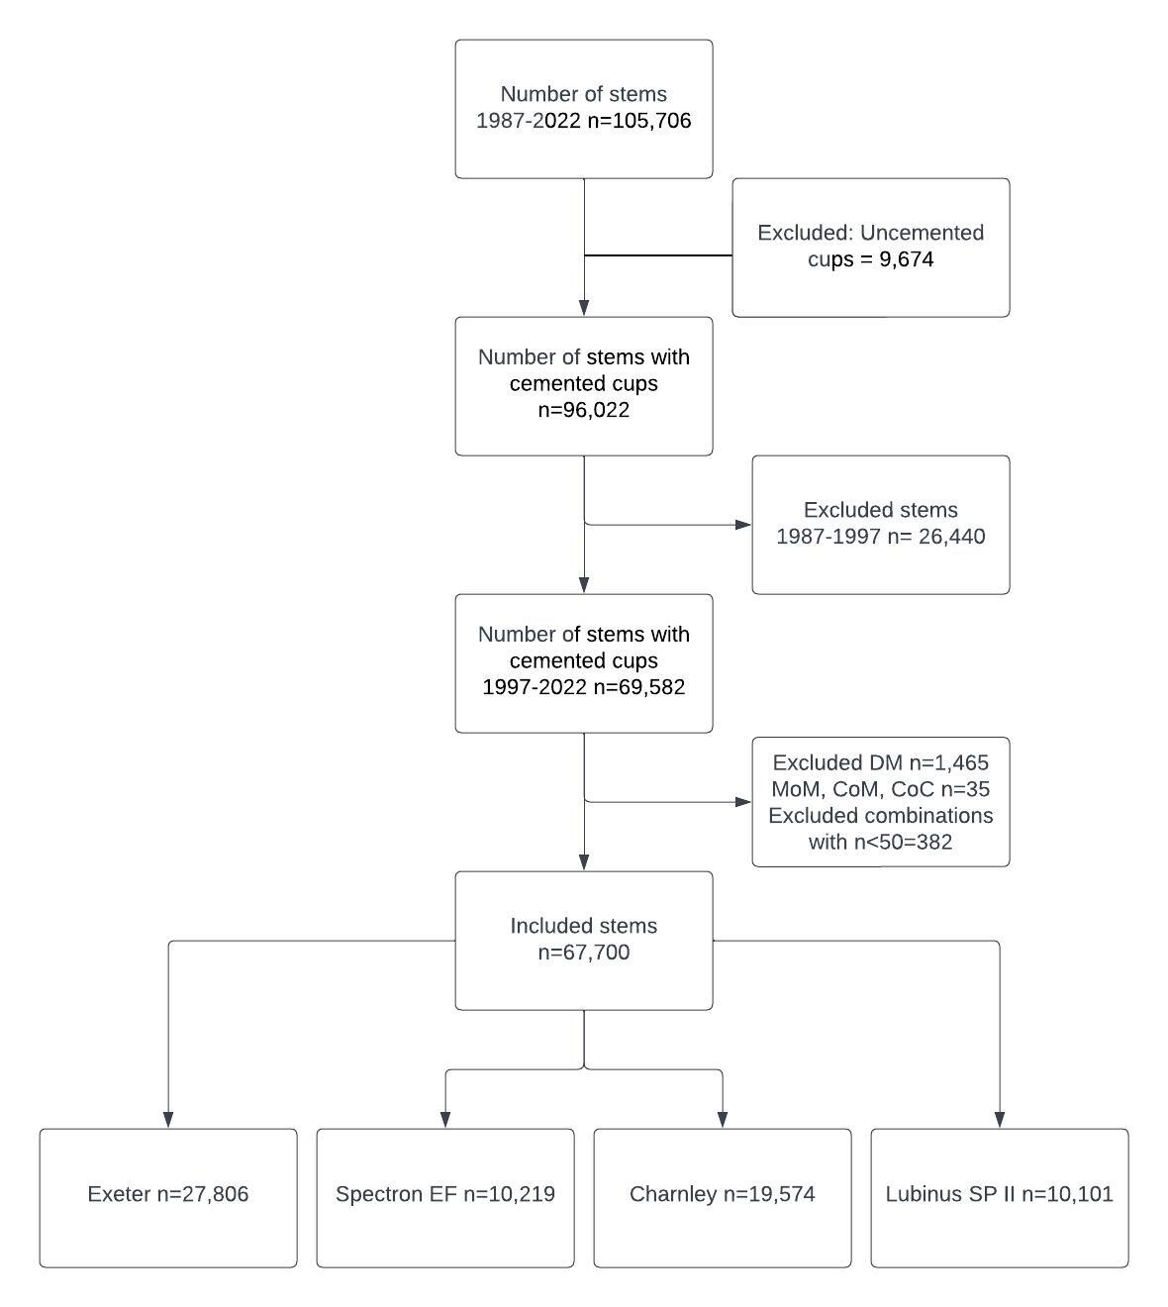

RISK OF REVISION IN CEMENTED TOTAL HIP ARTHROPLASTIES
A STUDY OF 4 COMMON STEMS IN 67,700 HIPS FROM THE NORWEGIAN ARTHROPLASTY REGISTER 1997-2022
Håkon Greve Johannessen ¹, Anne Marie Fenstad ², Geir Hallan ^{1,2}, Paul Johan Høl ^{1,3} and Ove Furnes ^{1,2}
¹ Department of Clinical Medicine, Faculty of Medicine, University of Bergen, Bergen, Norway ² The Norwegian Arthroplasty Register, Department of Orthopaedic Surgery, Haukeland University Hospital, Bergen, Norway ³ Department of Orthopaedic Surgery, Biomatlab, Haukeland University Hospital, Bergen, Norway
Håkon Greve Johannessen
University of Bergen
kig008@uib.no
Introduction
Since the introduction of the Charnley prosthesis for total hip arthroplasty (THA), several developments have been made to both designs and materials used in implants to improve long term performance. Fixation can be uncemented or cemented. For cemented stems, there is debate for which design should be used. The two most utilized principles are the taper-slip and composite-beam principles. We wanted to evaluate implant survivorship of the 4 most frequently used cemented femoral stems the last 25 years in Norway. The main endpoint was stem revision for any cause. Secondary endpoints were all cause revision of the THA (cup and stem), revision due to aseptic loosening of the stem and revision due to periprosthetic femoral fracture (PPFF).
Materials and methods
Primary cemented hip arthroplasties between 1997 to 2022 was collected from the Norwegian Arthroplasty Register. We chose to investigate 3 composite beam stems: Charnley, Spectron EF and Lubinus SP II, and the frequently used taper slip stem Exeter. Patients with uncemented cups were excluded. Other exclusion criteria were use of dual-mobility cups, the articulations of metal on metal, ceramic on metal and ceramic on ceramic, as well as combinations of cup and stem that were used less than 50 times during the study period. In total 67,700 THAs in 57,672 patients were included in the study. Analyses were done using Kaplan-Meier analysis and Cox regression, adjusted for sex, age group, indication for surgery and the time in which the primary surgery was performed. Primary endpoint was stem revision for any cause, and all cause revision of the THA (stem and cup), aseptic stem loosening and PPFF were secondary endpoints. The Exeter stem served as the reference in all analyses.
Conclusion
The Charnley and Lubinus SP II both had excellent long-term performance, and the lowest risk of stem revision. The lowest risk for aseptic loosening was found for the Exeter stem, on the other side the Exeter stem had the highest risk of PPFF. The Lubinus SP II stems, used with contemporary bearing materials, seems to be a good choice in cases were cemented THA is required.
 | Exeter | Spectron EF | Charnley | Lubinus SP II
 | Adjusted HR (95% CI) | Adjusted HR (95% CI) | Adjusted HR (95% CI) | Adjusted HR (95% CI)
Stem Revision | Reference | 1.93 (1.71 – 2.18) | 0.85 (0.75 – 0.97) | 0.62 (0.5 – 0.77)
All-cause revision | Reference | 1.86 (1.73 – 2.01) | 0.64 (0.59 – 0.69) | 0.86 (0.77 – 0.96)
Stem loosening | Reference | 4.74 (3.99 – 5.63) | 1.59 (1.33 – 1.9) | 1.57 (1.2 – 2.05)
PFF | Reference | 0.36 (0.25 – 0.52) | 0.18 (0.13 – 0.25) | 0.18 (0.11 – 0.31)
Results
The Spectron EF had the highest risk of stem revision with hazard ratio (HR) of 1.93 (95%CI 1.71 to 2.18), with similar risk for Charnley 0.85 (95%CI 0.75 to 0.97) and Lubinus SP II 0.62 (95%CI 0.5 to 0.77) compared to the Exeter reference. Similarly, for all cause revision, the Spectron EF group had the highest risk, with an HR of 1.86 (95% CI 1.73 to 2.01). The Lubinus SP II group had a risk of 0.86 (95% CI 0.77 to 0.96), while the Charnley group had the lowest risk at 0.64 (95% CI 0.59 to 0.69). The risk for aseptic loosening of the stem was approximately 1.5 times higher for both the Charnley and Lubinus SP II stems compared to the Exeter stem, while the risk for the Spectron EF stem was 5 times higher than of the Exeter stem. The other 3 stems had significantly lower risk of PPFF compared to the Exeter stem.
KM-survival curve with stem revision as endpoint, including 95% CI
KM survival curve with all cause revision as endpoint including 95% CI
KM curve with aseptic stem loosening as endpoint including 95% CI.
KM curve with periprosthetic femoral fracture as endpoint, including 95%CI.

