Slide 1

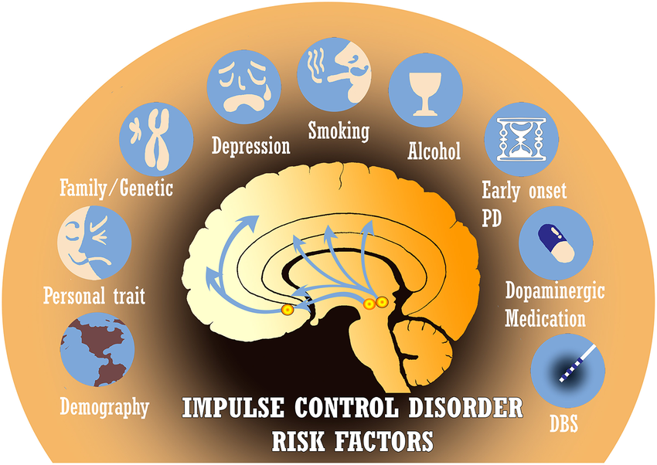
Dopamine Agonists and Impulse Control Disorders in Parkinson’s Disease
Dopamine agonist treatment in Parkinson’s increases the risk of impulse control disorders, especially with factors like higher doses, early onset, and male gender, emphasizing the need for early detection and personalized treatment.
Martin Hvalstad & Kine Ihlebæk
University of Bergen
Kih009@uib.no
mhv004@uib.no
ABSTRACT
This study investigates the association between dopamine agonist (DA) treatment and impulse control disorders (ICD) in Parkinson’s disease (PD) patients. ICDs, including pathological gambling, compulsive eating, hypersexuality, and shopping addiction, are common adverse effects of DA treatment.
Key findings indicate that risk factors such as DA type, higher doses, early onset of PD, and male gender increase the likelihood of ICD development. Psychiatric conditions like depression, anxiety, and alexithymia, along with genetic factors involving specific polymorphisms, also play significant roles. Neurobiological factors, including abnormalities in dopamine binding and release, further complicate ICD susceptibility.
The prevalence of ICDs varies, but they can affect up to 34.8% of PD patients, with prevalence increasing over time on DA treatment. These results highlight the complex, multifactorial nature of ICDs in PD patients and underscore the need for early identification and personalized treatment strategies to mitigate ICD impact and improve patient outcomes.
Method and aim
Objective
Examine the connection between the use of dopamine agonists and the development of ICDs in patients with Parkinson's disease, as well as to map possible reasons for such an association.
Methods
A systematic literature review was conducted using databases like PubMed, with MeSH terms such as "Parkinson's disease," "impulse control disorders," and "dopamine agonists." Inclusion criteria focused on human studies assessing ICD prevalence in DA-treated PD patients.
Main findings
Younger age
Younger age, particularly under 65, is a significant risk factor for ICDs, especially pathological gambling, in PD.
Gender
Male gender is strongly associated with ICD development and persistence, with women showing better prognosis and higher resolution rates over time.
Sociodemographic factors
ICDs in PD patients were more common among singles, especially those unmarried and residing in the United States..
Psychiatric symptoms
Psychiatric symptoms, particularly depression, anxiety, and alexithymia, strongly correlate with ICDs in PD patients, with higher scores on depression and anxiety scales linked to increased ICD risk.
Age of onset
Early PD onset is strongly linked to ICDs, with studies showing higher ICD rates in patients with earlier motor symptoms, especially for behaviors like gambling, hypersexuality, and shopping.
Type of DA
Pramipexole and ropinirole are strongly linked to ICDs in PD, affecting brain reward pathways and reducing impulse control.
Treatment duration
Longer DA treatment duration increases ICD risk in PD, while levodopa shows no strong association.
Conclusion
This review highlights the multifactorial nature of ICDs in PD patients treated with DAs. While effective for motor symptoms, DAs require careful patient selection, especially for those with risk factors. The findings emphasize personalized treatment and early detection, with future research focusing on predictive models and alternative therapies to reduce ICD risk.
What is Parkinson’s disease?
Parkinson's disease, first described as "The Shaking Palsy" by James Parkinson in 1817, is a progressive neurological disorder characterized by tremor, rigidity, bradykinesia, and postural instability, with additional symptoms like cognitive changes, autonomic dysfunction, and sensory pain. Although incurable, treatments like dopamine agonists help manage symptoms but are linked to increased impulse control disorders (ICDs).
10.3389/fneur.2019.00086

