Slide 1
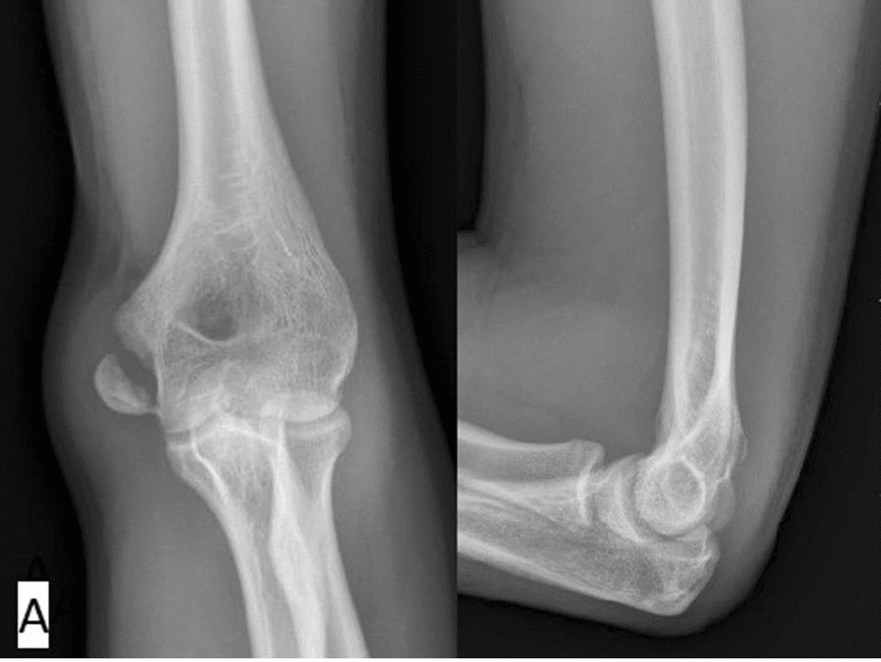
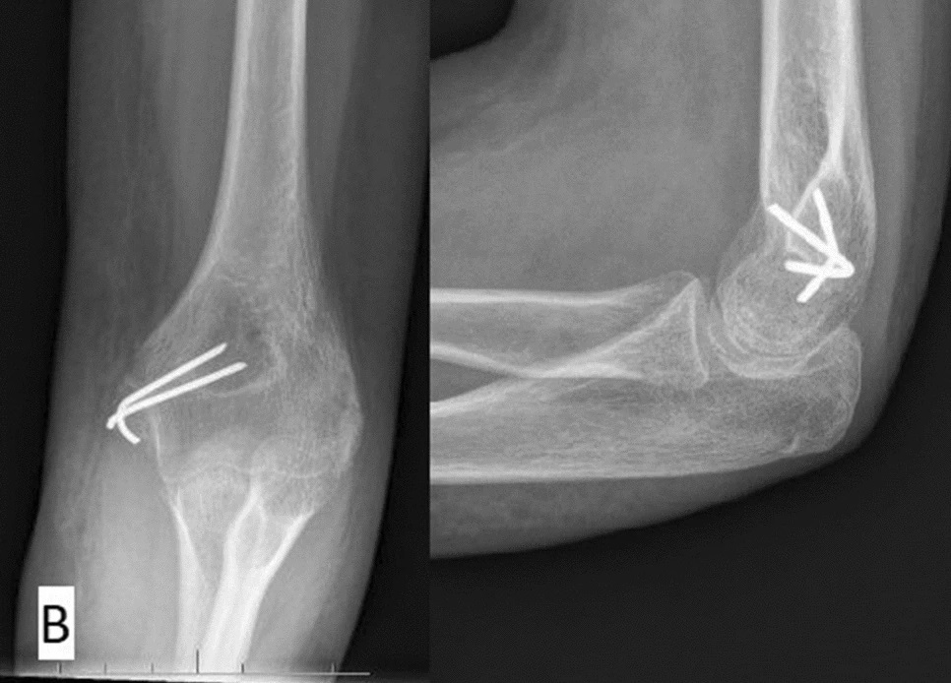
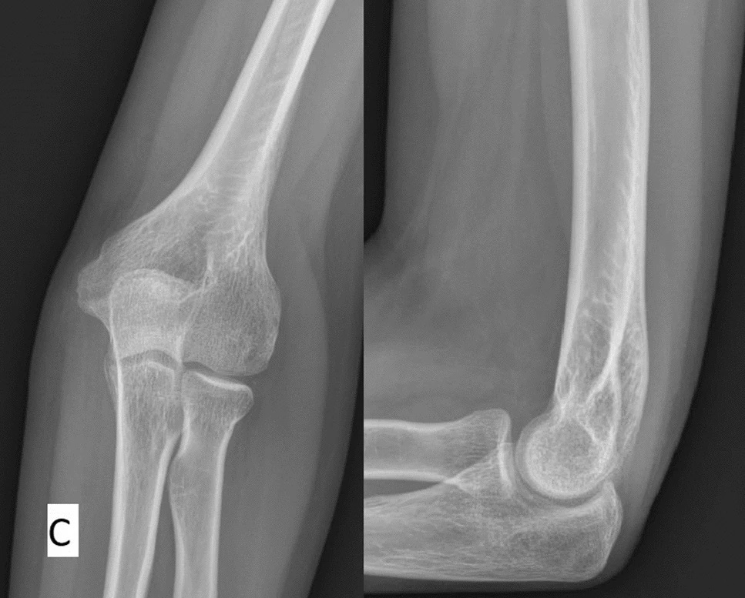
Medial epicondyle fractures in children
A retrospective cohort study of children operated with open reduction and internal fixation(ORIF) at Haukeland University Hospital between 2013-2023.
Morten Johanssen Stavland
University of Bergen
def009@uib.no
ABSTRACT
Medial epicondyle fractures in children are a subject of debate in orthopaedic surgery, particularly regarding the optimal treatment approach based on displacement distance. This study examines the frequency, outcomes, and complications of operative treatment for medial epicondyle fractures in children at Haukeland University Hospital over a 10-year period.
67 patients aged 6-16 years are included in the study. The mean displacement distance was 8 mm, with 43 fractures (64%) having a displacement between 5-9 mm. Simultaneous elbow luxation occurred in 37% of cases and was significantly associated with movement restriction at last follow-up (p=0.028). Complications were reported in 13% of the cases, with 3 patients requiring reoperation. At final follow-up, 28% of patients experienced restricted elbow mobility exceeding 10 degrees.
Operative treatment of medial epicondyle fractures at Haukeland University Hospital generally results in favourable outcomes with a low complication rate. Operator bias plays a role in measuring displacement distance on X-rays, which can influence the treatment the patient receives. Further prospective studies are needed to define clearer guidelines for operative versus non-operative management of medial epicondyle fractures in children.
Medial epicondyle fractures
Medial epicondyle fractures are elbow injuries that constitute 12-20% of elbow fractures in the paediatric population. These fractures occur when the growth plate near the inner part of the elbow breaks. It is commonly associated with elbow dislocations.
A lack of high-quality studies without significant limitations lay grounds for uncertainty of optimal treatment. A major question is at what displacement distance one should choose operative treatment, and at what displacement distance one should choose non-operative treatment.
Treatment options vary based on the severity and degree of bone displacement. Non-displaced or minimally displaced fractures may be managed with immobilization using a cast. Haukeland University Hospital guidelines recommend surgery with open reduction and internal fixation for displacement distances greater than 5 mm.
Complications can include nerve damage, persistent instability, reduced elbow mobility, and potential growth disturbances in severe cases.
Results and discussion
Over a 10-year period, Haukeland University Hospital has performed ORIF on 67 medial epicondyle fractures. Most of the fractures occurred during the summer months, suggesting a correlation with outdoor activities. Complications have been reported in 13.4% of the surgeries. Approximately 28% of patients exhibited a range of motion deficit exceeding 10 degrees at the final follow-up. Simultaneous elbow luxation occurred in 37% of cases and was significantly associated with movement restriction at last follow-up (p=0.028).
Operative treatment is associated with excellent outcomes regarding union of the fracture. However, findings in other studies indicate non-operative treatment may have similar efficacy as operative treatment for fractures with less than 10 mm displacement distance, even when resulting in a non-union. 73% of the medial epicondyle fractures in this study were displaced less than 10mm. Non-operative treatment could potentially be more cost-effective and timesaving, as well as reduce the patient's risk of operative complications. However, non-operative treatment may also increase the risk of complications associated with non-union of the medial epicondyle fragment.
Some studies indicate higher rates of stiffness in patients treated operatively than in patients treated non-operatively. A total of 25 out of 67 medial epicondyle fractures in this study had simultaneous luxation of the elbow joint. There was a statistically significant correlation between simultaneous luxation and restriction of elbow mobility at the last follow-up. It is possible that immobilization for four weeks may have had a greater impact on elbow mobility in patients with simultaneous luxation compared to those without. Elbow luxation likely results in a stiffer elbow due to more significant joint and capsular damage. In cases where operation indication is borderline, it may be more beneficial to treat fractures with simultaneous elbow luxation non-operatively to minimize the risk of elbow stiffness, or with screw osteosynthesis for shorter immobilization time in cast. Although restricted movement is not considered a complication in this study, 28,4% of patients had reduced mobility exceeding 10 degrees at last follow-up. This raises the question of whether conservative treatment or screw osteosyntheses with reduced cast-time, might be preferable to K-wire osteosynthesis and casting in such cases.
The radiographic modality used for diagnosing medial epicondyle fractures is primarily X-ray. Due to the immature skeletal development in children and lack of ossification, combined with challenges in X-ray projection, it can be difficult to measure fragment displacement distance accurately. Operator bias in radiologic measurements can result in errors exceeding 2 mm when assessed via X-ray. CT scans may reveal fractures not visible on X-rays with discrepancies of up to 10 mm. The average displacement distance among those undergoing ORIF in this study was 8 mm (SD=4). It is probable that several patients may swing above or below the threshold for operative indication due to these factors.
A: Isolated medial epicondyle fracture.
B: 4 weeks after surgery, K-wires to be removed in outpatient clinic.
C: 4 years after surgery.

