Slide 1
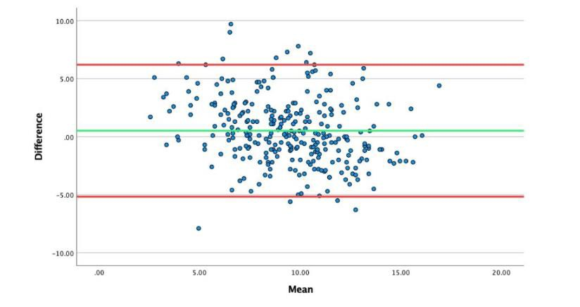
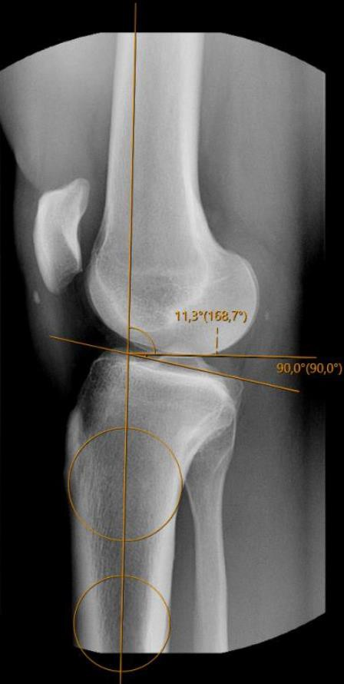
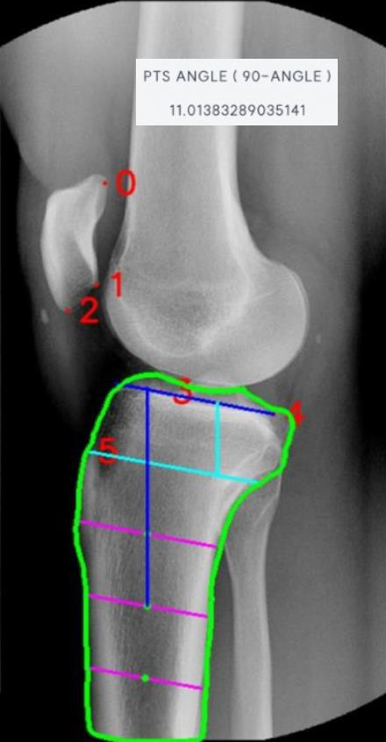

External validation of a novel landmark-based deep learning automated tibial slope measurement algorithm applied on short radiographs from ACL injured patients
Sanna Håland University of Bergen sanna.haland@student.uib.no
R. Kyle Martin, Sanna Håland, Sung Eun Kim, ByeongYeong Ryu, Jun Woo Nam, Du Hyun Ro, Andreas Persson, Eivind Inderhaug
Background
Deep learning algorithms can aid medical decision-making by performing routine tasks without any human bias.
Reading of standardized radiographs lend itself well for a computerized approach. Posterior tibial slope is increasingly recognized as a factor in lower leg biomechanics. Slope readings should therefore be readily available when considering knee ligament or knee replacement surgery.
Methods
A consecutive series of lateral knee radiographs from patients undergoing ACL-surgery were eligible for inclusion. Two independent experienced clinicians individually assessed the tibial slope measurement to establish the intra-reader reliability. Further all images were processed by the newly developed model for the automated readings. Intra-rater and inter-rater reliability were thereafter established between readers and between manual and the automated readings measured by inter- and intraclass correlation coefficients (ICC). Time consumption between methods were noted.
Extreme differences between the two methods were analysed for potential errors.
Results
Two-hundred and eighty-nine radiographs were included in the study and therefore analyzed both by the manual and the automated method. A mean tibial slope of 9.7° (SD 2.7°, Range 3.0° – 19.1°) was found. The interrater and intra-rater measurement between the independent measurers for the two-circle method was
0.86 and 0.92. Further, the intra-rater agreement of the model was 1.00, while an ICC between 0.73 and 0.8 was found for the inter-rater reliability (as comped to manual). Time consumption for a manual reading was 52.5 while automated readings took 28.2 seconds.
Purpose and aim
The current study aims to externally validate a deep learning model developed for posterior tibial slope readings by applying an independent dataset, not included in initial development, for testing of reliability of
the model – compared to human
performance testing. The hypothesis was that a computerized approach would yield a reliability that leveled human analyses.
Figure 3 – Bland Altman plot comparing manual measurements and Connecteve 3A measurements.
Conclusion
In this external validation of a newly developed model for automated readings of tibial slope measures – a perfect intra-rater reliability and a good inter-rater reliability was seen. Although the model needs some further refinement in reporting the tibial slope as compared to a gold standards manual measurement, it clearly demonstrates the elimination of human error with repeat readings and less time consumption as compared to human effort.
Figure 1 – Manual measurement of the slope applying the 2-circle method
Figure 2 – Automated measurement of the posterior tibial slope on a short lateral knee radiographs
ACKNOWLEDGEMENTS
I would like to thank my supervisor Eivind Inderhaug for his counselling in this
project. Also, I would like to thank Dr.Martin, University of Minnesota, University of
Seoul and Andreas Persson for the collaboration. In addition I would like to thank my research group STAR for their counselling.

