Slide 1
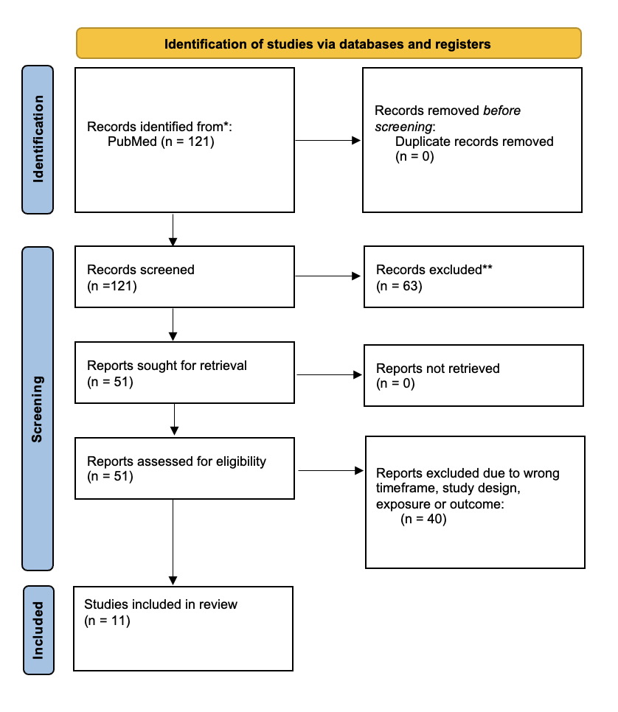
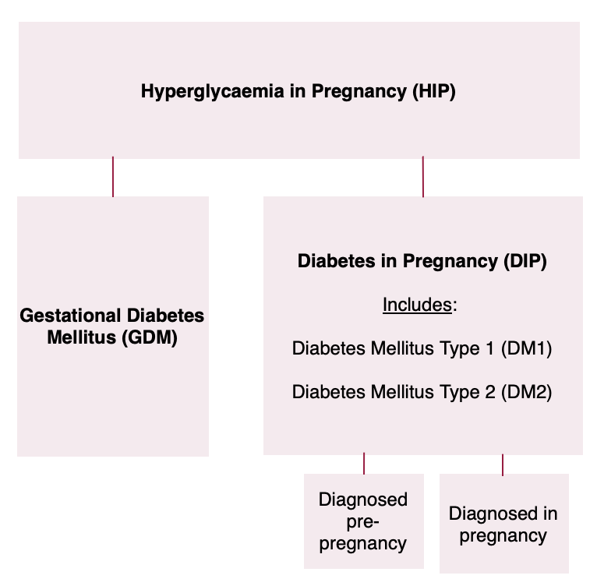
The Association Between Diabetes and Depression during Pregnancy
A Literature Review of Studies published between 2019 and 2023
Corinna Sandberg
University of Bergen
din012@uib.no
Abstract
This review included 11 studies published between 2019 and 2023, focusing on recent research investigating the association between diabetes and depression during pregnancy, with particular attention to gestational diabetes mellitus (GDM).
Background
Both depression and diabetes are increasingly common in pregnant women and can lead to serious complications that impact both maternal and fetal health.
Method
The IMRAD structure as recommended by the University of Bergen was used for a systematic assessment of relevant studies.
Results
Across 11 studies, seven identified a statistically significant association between depression and gestational diabetes mellitus (GDM), with rates of concurrent depression and GDM during pregnancy ranging from 6.3% to 36.2% across studies.
Conclusion
Despite variation in results and measurement discrepancies across studies, there appears to be a potential association, highlighting that better mental health assessment during pregnancy is vital. Improved screening could lead to earlier interventions, benefiting both maternal and fetal health. However, further research is necessary to draw significant conclusions.
Gratitude is extended to Professor Francisco Gomez Real
Professor at the University of Bergen, Faculty of Medicine, Departement of Clinical Medicine, PhD at Kvinneklinikken, Medical Doctor at Haukeland University Hospital.
PRISMA flow-chart over the data inclusion process.
Classification of hyperglycemia in pregnancy accoding to WHO and FIGO guidelines.

