Slide 1
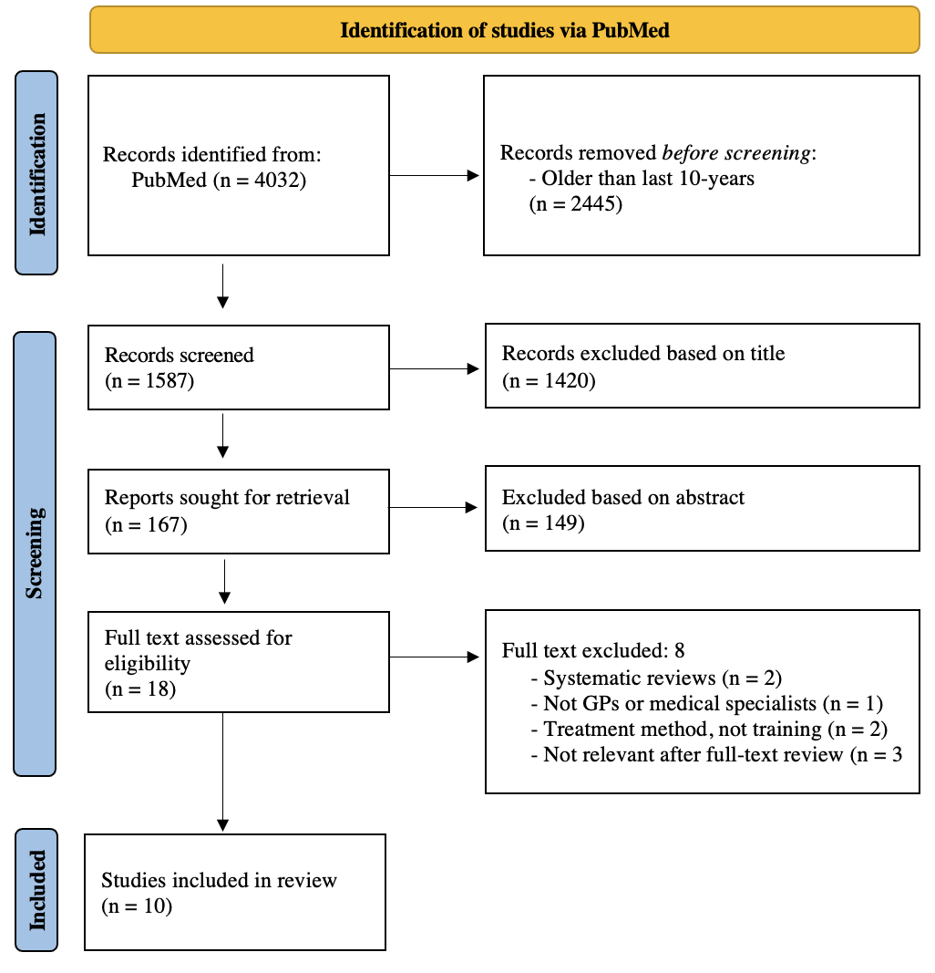
Children and adolescents with functional complaints:
Current Practices in Training Physicians to Address Patients with Functional Complaints: - A Literature Review
ABSTRACT
Introduction
A significant number of children and adolescents are experiencing functional complaints and disorders, resulting in an increased demand for health care services. This trend necessitates the allocation of additional resources and a deeper understanding of these conditions among healthcare providers. The present study aimed to systematically identify existing training programs and instructional methods for clinicians who work with patients experiencing functional complaints.
Method
PubMed was utilized as the primary database for collecting relevant articles. A total of 1,587 articles were initially reviewed based on their titles, leaving 167 articles selected for retrieval. Ultimately, only eighteen full-text articles were assessed for eligibility, resulting in ten articles deemed suitable for inclusion in this study.
Results
The existing literature on educational programs for clinicians managing patients with functional disorders has primarily concentrated on the adult patient-population, with no programs specifically targeting children or adolescents. Current training initiatives employ a range of instructional methods, including theoretical lectures, role play, audio-visual materials, and online components, to enhance physicians' confidence and understanding of various functional diagnoses.
Conclusion
There is an urgent need for further research and the development of educational programs for healthcare providers managing children and adolescents with functional complaints. Elements from the existing literature can inform the creation of such programs; however, it is essential to consider the differences in managing children compared to adults, which should be incorporated into the training curriculum.
Maja Myrhaugen Derås
Mari Austevoll
University of Bergen
mde030@uib.no

