Slide 1
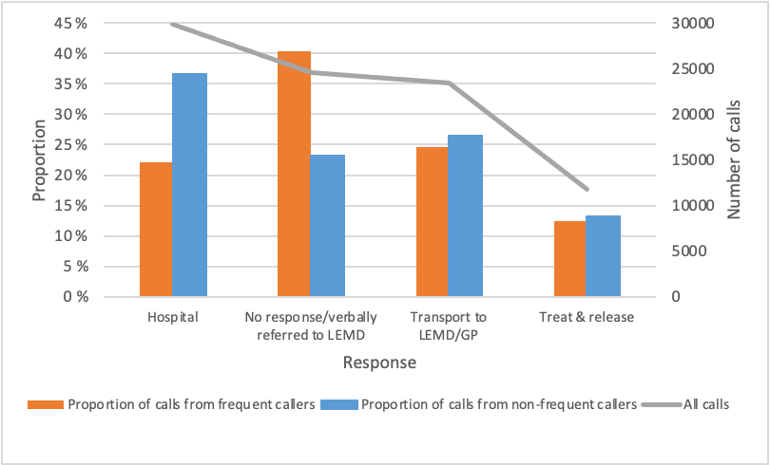
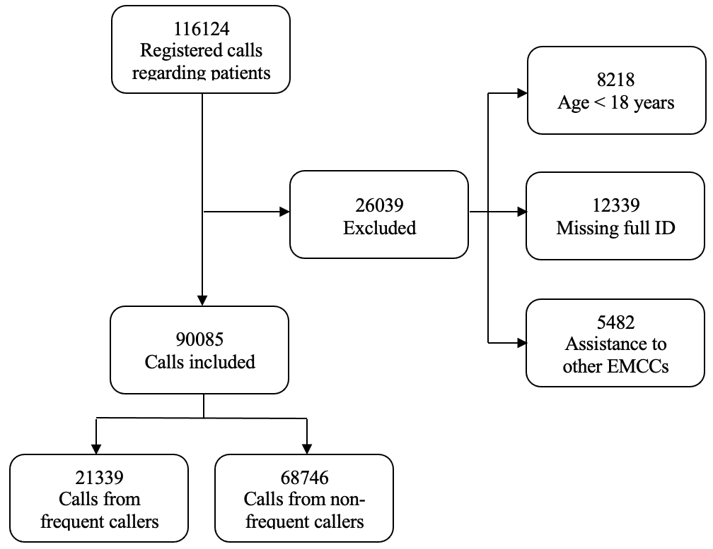
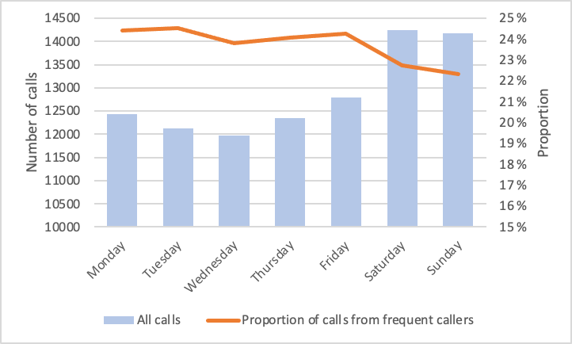
Analysis of frequent callers to the Norwegian national emergency medical number 113
Exploring the characteristics of both frequent callers and the nature of these calls to the Bergen emergency medical communication centre, over a period of three consecutive years
Sara Næss Viken University of Bergen
svi038@uib.no
ABSTRACT
Calling for help is the first link in the chain of survival, but few studies have looked into the challenge of frequent callers (FC) to the emergency medical communication centre (EMCC). They may need acute help, but often they don’t. This study aimed to explore the characteristics of both FC and the nature of these calls to the Bergen EMCC, over a period of three consecutive years.
Since FC may have a significant impact on the EMCC’s function and resources (time consumption and costs), we need more knowledge about who the FC are¹. By examining characteristics of this relatively small, but challenging group, we aimed to explore if there are common features that differ from the non-frequent callers. Maybe there are, or could be established, other services that would better cover the needs of these persons, and at the same time ease the pressure on the EMCC? This could optimise the EMCC’s function, and more importantly, improve the medical services for the FC.
Material & methods
The study was a retrospective analysis of all emergency calls to Bergen EMCC in the years of 2019-2021. Bergen is the second largest city in Norway, and the EMCC and ambulance services (EMS) are part of the specialist medical service, covering a population of 460.000. Bergen EMCC receives 60.000 emergency calls a year.
Figure 1 Flow-chart of inclusion process
Results
The analysis included nearly 50000 individuals who accounted for more than 90000 calls. Of those, 3.2% were FC, accounting for 23.7% of all calls. There were more men amongst the FC, and a lower proportion of calls registered with acute degree of urgency (p<0.05). The FC calls showed an even level of incidence through the week, accounting for the highest proportion of calls between 19:00 and 20:00.
Figure 2 Distribution of calls throughout the week: all calls distributed on the days of the week and the proportion of calls from FC on each day of the week.
Figure 3 Measures on calls: All calls, proportion of calls from FC and proportion of calls from non-FC given the different measures hospital, no response/verbally referred to LEMD, transport to LEMD/GP and treat & release.
Calls from FC had a higher proportion of “no response/verbally referred local emergency medical department”, and fewer transports to hospital than non-frequent callers. The most frequently used medical criterion on calls from FC was “mental health problems/suicide”.
Definition of frequent callers
FC were defined as individuals who were registered with ≥5 calls in 12 consecutive months during the three years.
Conclusion
Sometimes the FC have to call 113 because of acute need of health care service, but a large proportion of calls could possibly be handled in other parts of the healthcare system. This could free resources in the EMCC to help callers in need of acute help, as well as improve the medical services for the FC. This means that the EMCC would probably also benefit from occasionally analysing their own data and identify these patients. More research is needed to better characterise and predict who the FC are, and further be able to adjust the management of these patients to match their actual needs.
Analysed variables
We analysed routinely collected data from the electronic administrative system (AMIS) used in all EMCCs in Norway. The callers were characterised by sex and age. The calls were analysed for degree of urgency, chief complaint registered, response and time of call (weekday, hour of the day).
REFERENCES
Edwards MJ, Bassett G, Sinden L, Fothergill RT. Frequent callers to the ambulance service: patient profiling and impact of case management on patient utilisation of the ambulance service. Emerg Med J. May 2015;32(5):392-6. doi:10.1136/emermed-2013-203496
ACKNOWLEDGEMENTS
Ethics approval: The study was waived by the regional research ethics committee (REG Vest No. 594077) because it was viewed as a quality improvement. Such projects require acceptance from the involved hospital department and the hospital data protection officer, which was obtained.

