Slide 1
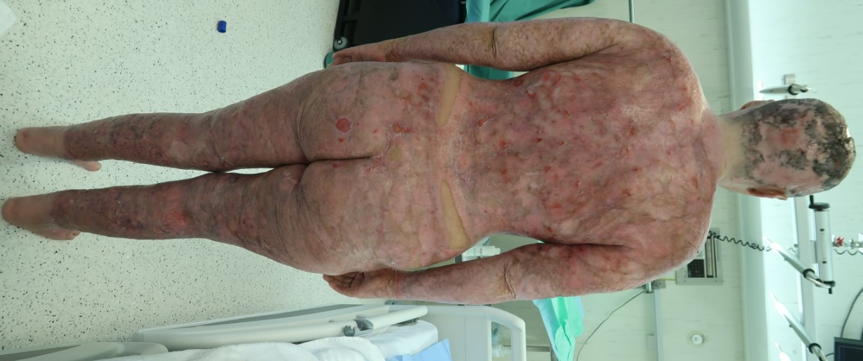
Utilizing a synthetic dermal substitute to temporize and stabilize a patient with extensive full thickness burns.
Synthetic dermal substitutes can be used to stabilize major burn patients and allow sufficient time for donor regeneration
Tobias Wikerholmen University of Bergen
twi014@uib.no
ABSTRACT
Major burns require major intervention, but options are limited as healthy donor skin is scarce in the most extensive burns. Skin cells cultured in vitro to become clinically administrable as thin layers of keratinocytes, or cultured epithelial autografts, have become a necessary step in large burns to expand donor availability to allow for epithelial coverage (1,2). Keratinocytes are harvested from minuscule amounts of the patient's own healthy skin. However, the technique of ex vivo skin culturing is time consuming, during which the wound bed needs temporization and coverage (3). In recent years, a new Biodegradable Temporizing Matrix (BTM) has become available for this very purpose. BTM is a synthetic, biodegradable scaffolding that facilitates the growth of a neodermis that can be left as wound coverage until autografts become available (4,5). In this case, we present a 28-year-old female with an 84% TBSA full-thickness burn, that underwent a staged reconstruction of skin, utilizing BTM extensively to temporize excised burn wounds and to restore a healthy neodermis. Wound closure and reestablished skin coverage was successfully achieved through usage of cultured epithelial autografts and split-thickness skin grafts. The young woman survived with a good cosmetic outcome, given the scope of the injury. The case exemplifies how wound temporization with BTM could provide a more reliable solution to achieve a stable wound coverage in major burn patients otherwise at high risk of mortality.
Introduction
In extensive burns, large open wounds and donor insufficiency then become major concerns. We need to buy time; we need to temporize the wound. One of the newest solutions to wound temporization is the Novosorb Biodegradable Temporising Matrix (BTM). BTM provides a temporary barrier against external contaminants but also acts as a scaffold for neodermis development. As a result, it buys time for donor site regeneration while simultaneously providing a much-needed substructure for serial grafting.
Method
The case report presented is a single patient, singe center study involving a patient admitted to Haukeland University Hospital with an LOS of 328 days. Information about patient characteristics, surgical procedures, infections, and outcomes were systematically assessed from the patient’s electronic journal and a first-hand caregiver role.
On admission. 84% full thickness burns covering all but the feet and groin areas
Conclusion and future implications
In major burns, after the initial removal of burnt skin, large wounds are left with insufficient healthy skin for transplantation. Skin transplanted from external patients, allografts, do not take and are as such poor long-term solutions. Here we show that patients with major burns can be managed through temporization with a dermal matrix (BTM) and subsequent grafting with CEA support. Our experience exemplifies how synthetic skin scaffolds such as BTMs can buy valuable time in the reconstructive process.
BTM covering excision wounds on the patient’s entire dorsal aspect
On discharge. Remnants of minor wounds left to heal by secondary intention.
REFERENCES
Rheinwald JG, Green H. Serial cultivation of strains of human epidermal keratinocytes: the formation of keratinizing colonies from single cells. Cell. 1975 Nov;6(3):331–43.
Lo CH, Chong E, Akbarzadeh S, Brown WA, Cleland H. A systematic review: Current trends and take rates of cultured epithelial autografts in the treatment of patients with burn injuries. Wound Repair Regen Off Publ Wound Heal Soc Eur Tissue Repair Soc. 2019 Nov;27(6):693–701.
Greenwood JE. A paradigm shift in practice-the benefits of early active wound temporisation rather than early skin grafting after burn eschar excision. Anaesth Intensive Care. 2020 Mar;48(2):93–100.
Wagstaff MJD, Schmitt BJ, Coghlan P, Finkemeyer JP, Caplash Y, Greenwood JE. A biodegradable polyurethane dermal matrix in reconstruction of free flap donor sites: a pilot study. Eplasty. 2015;15:e13.
Lo CH, Brown JN, Dantzer EJG, Maitz PKM, Vandervord JG, Wagstaff MJD, et al. Wound healing and dermal regeneration in severe burn patients treated with NovoSorb® Biodegradable Temporising Matrix: A prospective clinical study. Burns J Int Soc Burn Inj. 2022 May;48(3):529–38.
4. Solanki NS, York B, Gao Y, Baker P, Wong She RB. A consecutive case series of defects reconstructed using NovoSorbⓇ Biodegradable Temporising Matrix: Initial experience and early results. J Plast Reconstr Aesthetic Surg JPRAS. 2020;73(10):1845-1853. doi:10.1016/j.bjps.2020.05.067
ACKNOWLEDGEMENTS
The authors would like to thank our main supervisor, Stian Kreken Almeland, for his unmatched guidance, academic connections and unparalleled knowledge resulting in the production of this article. For their great counselling, unwavering patience, and around-the-clock availability we would like to thank Ragnvald Brekke. Our gratitude also extends to the patient which kindly accepted to have her case published in an open access per reviewed medical journal. A special thanks to the burn centre at Haukeland University Hospital for providing excellent services, patient records and photographs for presentation.

