Slide 1
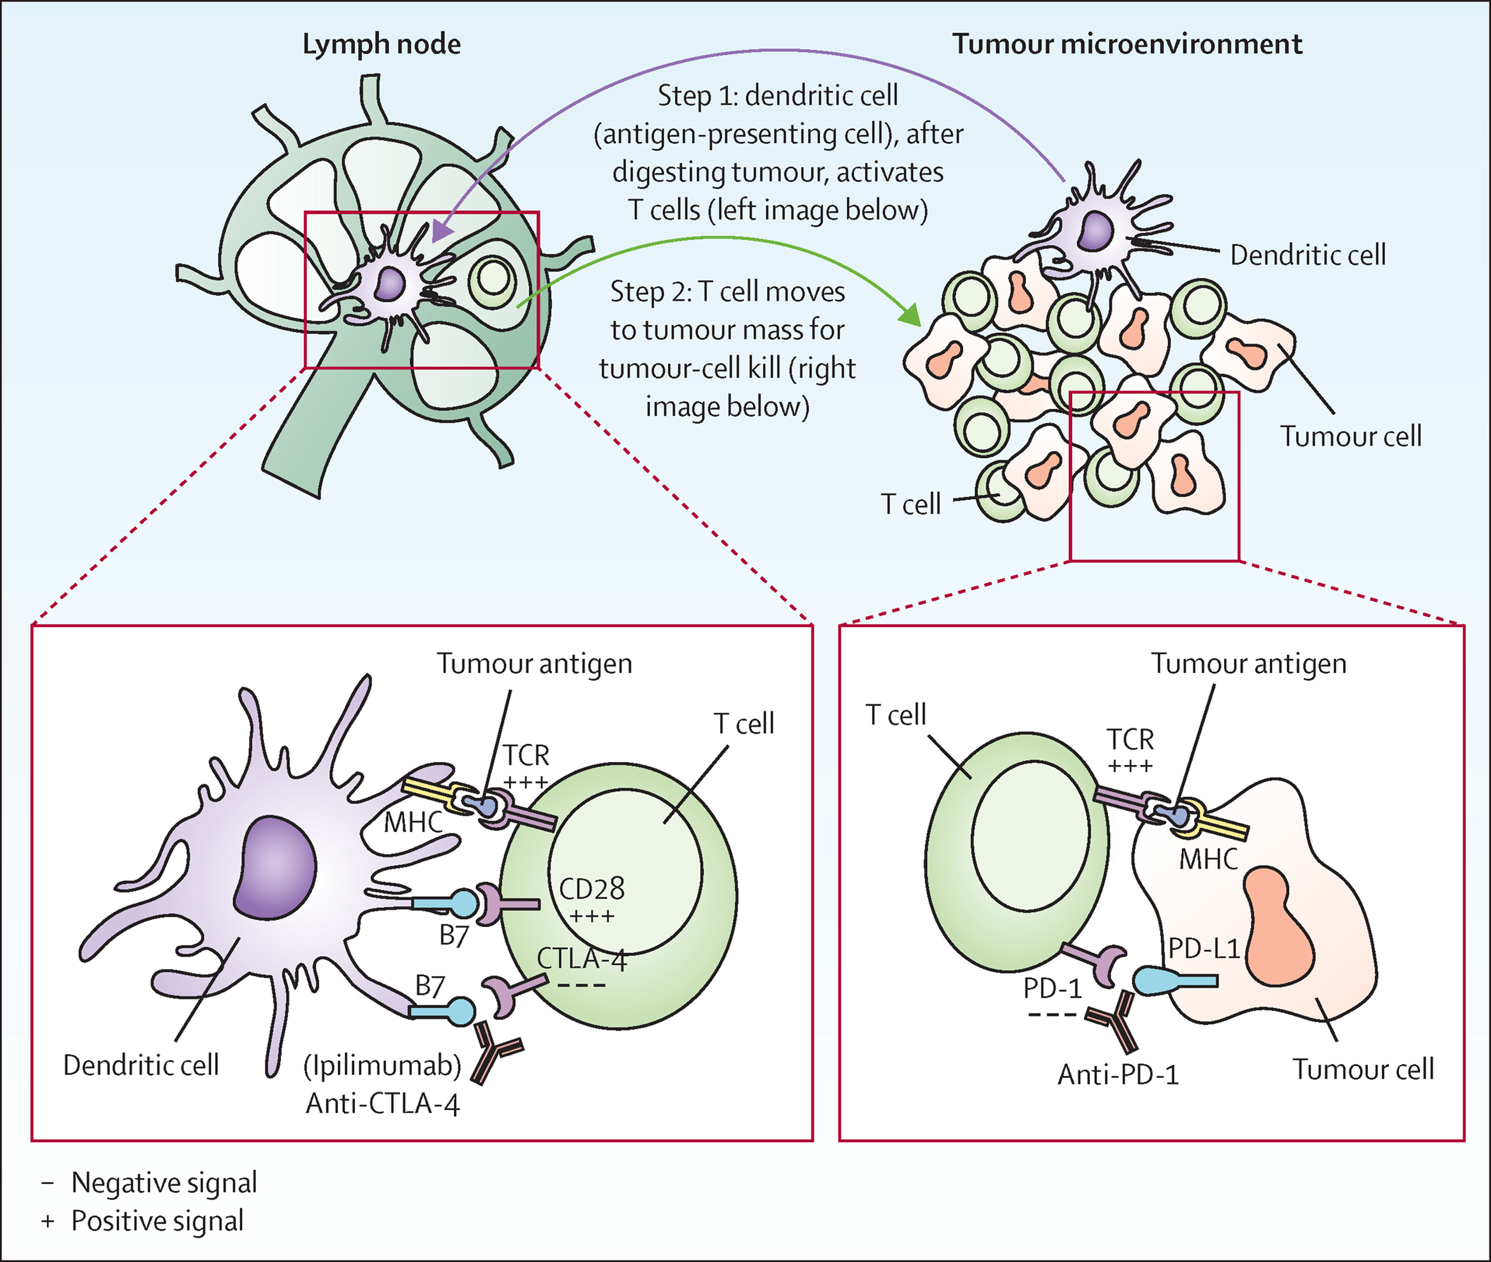
Severe adverse events in melanoma patients
Assessment of variables related to the risk of severe adverse events in cutaneous melanoma patients treated with immune checkpoint inhibitors
Kremena Trichkova University of Bergen
kremena.trichkova@uib.no
ABSTRACT
Malignant melanoma is a common and aggressive cancer with globally rising incidences. Immune checkpoint inhibitors (ICIs) have prolonged the survival of patients with advanced melanoma over the last decade, however, this improvement comes with a high risk of severe immune related adverse events (irAEs). This systematic review examines patient baseline characteristics (BCs) as predictive factors for developing severe gastrointestinal, hepatic, and pulmonary irAEs in patients treated with ipilimumab (anti-CTLA-4) and/ or nivolumab/ pembrolizumab (anti-PD-1).
A systematic literature search was conducted in the Ovid-databases MEDLINE and EMBASE on April 22, 2022, according to PRISMA guidelines. 13 of a total of 1694 articles were included in the final analysis. Individual and median frequencies of BCs and irAEs were calculated for the 22 treatment arms and three treatment groups: anti-CTLA-4 (n=2904), anti-PD-1 (n=1301) or combination therapy (n=822), with varying median frequencies of severe colitis, hepatitis and pneumonitis. Missing data preclude direct comparison of individual BCs and the association to specific irAEs between studies. By descriptive analysis, we could not identify any significant association between median age, gender distribution or ECOG status and severe colitis, hepatitis or pneumonitis for either of the three treatment groups. We urge for greater transparency and standardization in the reporting of patient specific irAEs.
Immune checkpoint inhibition with ipilumumab (anti-CTLA-4) in malignant melanoma
Gender distribution by treatment group
ACKNOWLEDGEMENTS
Image credit: The Lancet
Grade 3-4 immune related adverse events by treatment arm
Age distribution by treatment group
REFERENCES
Arnold et al., 2022; Cancer in Norway, 2022; Yu et al., 2019

