Slide 1
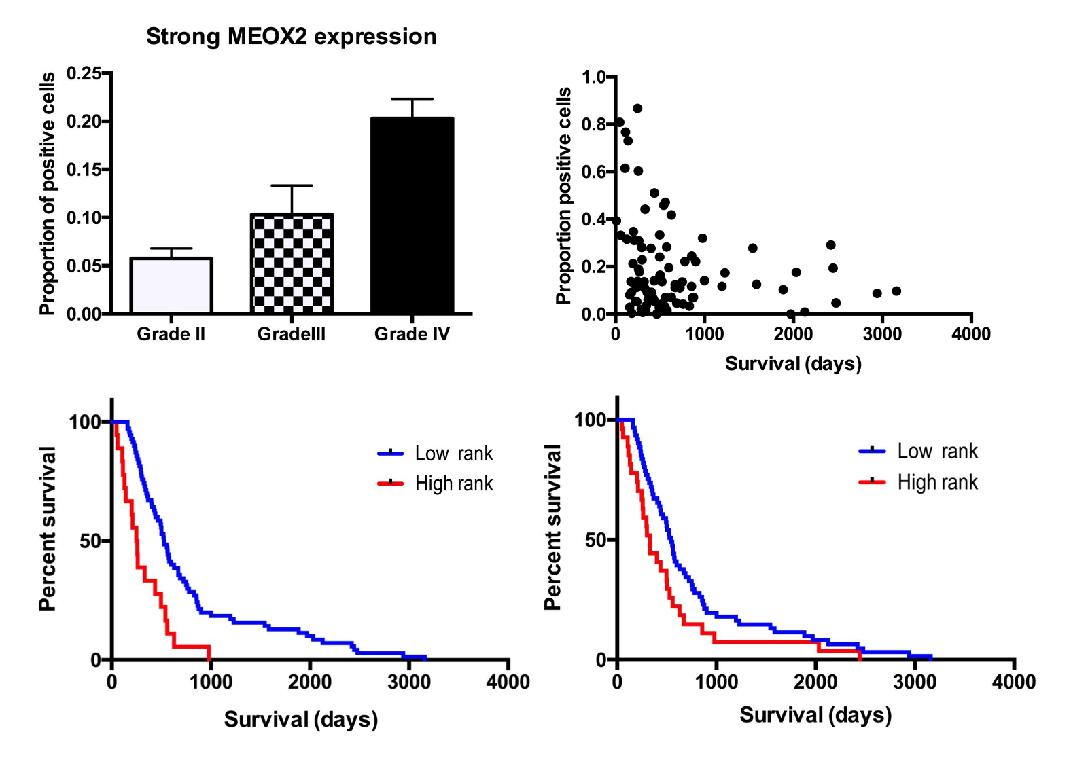
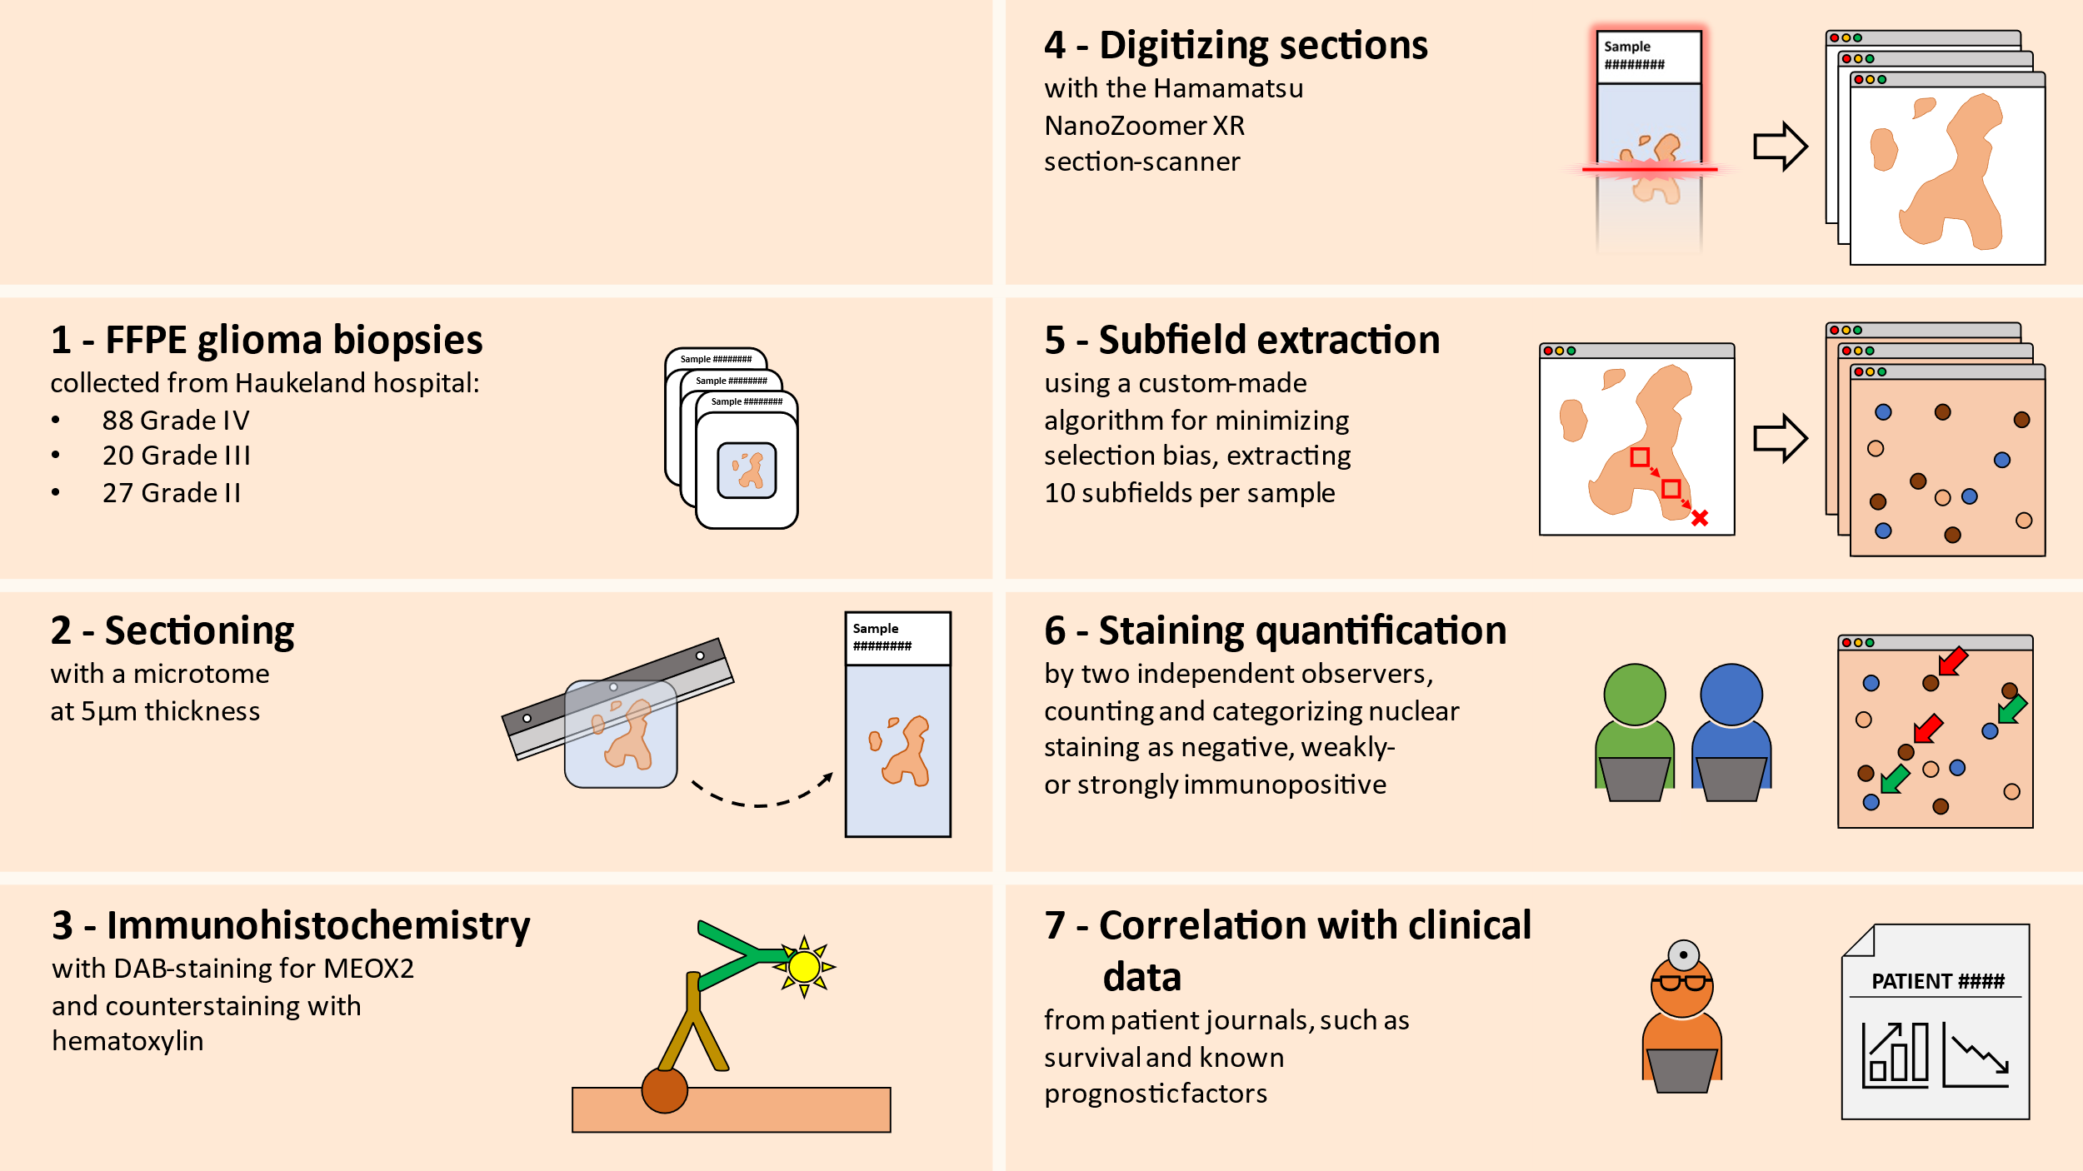
Expression and prognostic significance of the foetal transcription factor MEOX2 in grade II-IV gliomas
Anne Gulbrandsen University of Bergen
Anne.Gulbrandsen@uib.no
Gulbrandsen, A, Sørbø, ST, Miletic, H, Enger, PØ
Sander T Sørbø University of Bergen
Sander.Sorbo@uib.no
Introduction
Malignant gliomas are cancerous growths of the central nervous system (CNS). Their infiltrative growth makes radical surgery impossible, and virtually all patients
eventually succumb to the disease.
Whereas grade I gliomas are benign tumours with a generally favourable prognosis, grade II-IV gliomas are highly infiltrative tumours with progressively shorter survival at increasing grades(1).
The WHO classification system, previously based on histopathology, has been repeatedly revised to also include various molecular markers(2).
Experimental and clinical studies have inconclusively hinted that MEOX2 expression, a HOX-like gene (HOXL), correlates with reduced overall survival (OS) and promotes glioma growth (3-6).
Method
In short: Detect MEOX2 protein expression in glioma tumors with immunohistochemistry, and correlate expression with clinical data on outcome.
Results
We found that MEOX2 was expressed as a nuclear staining to a lesser or greater extent in virtually all samples included in this study. Samples ranged in terms of immunopositivity (Fig 1) from predominantly negative (left) to weakly positive (middle) to strongly positive (right). Quantification of all subfields yielded for each sample three ratios representing the total, averaged immunopositivity of the sample: the ratio of weakly positive cells in sample, strongly positive cells in sample, and total positive cells in sample (weakly + strongly).
Correlation analyses on MEOX2 protein expression and patient survival showed a negative correlation between percentage of strongly positive cells and survival
(r = -0,2413, p = 0,0227) in grade IV glioma patients
(Fig 2B). No significant correlation was found for the other ratios of immunopositivity and survival in grade IV gliomas, nor was there any correlation between immunopositivity and survival in grade II or III gliomas.
Plotting the ratio of strongly positive cells to glioma grade revealed a significant difference in expression across all grades (Fig 2A), with expression increasing with severity of the disease. A lesser difference between grades was found for the other ratios of expression. No correlation was found between expression levels of any ratio and age of patient.
Performing a survival analysis on MEOX2 expression in
grade IV patients revealed a significant difference between groups of high and low expression of strongly positive cells (Fig 2C), where patients of low expression outlive patients of high expression by 274 days on average (cut-off = 30%,
p < 0,0001). Additionally, we found that grade IV patients with less than 70% of total positive cells outlive those with higher expression by an average of 212 days (cut-off: 70%,
p = 0,0289)
Interestingly, the survival analyses on MEOX2 expression in lower grade gliomas show improved survival in groups of higher MEOX2 expression, although only significant for grade II gliomas.
Conclusion
We found a statistically significant correlation between MEOX2 expression and survival in grade IV glioma patients. The correlation was significant when cut-off values were set to a minimum of 20% or 30% of strongly positive cells, and 60% or 70% total positive cells. In all these cases, the groups of low expression outlived the groups of high expression. The ratio of strongly immunopositive cells turned out to be the most interesting indicator for MEOX2 protein expression, yielding the greatest and most significant difference in survival between high- and low expression groups, as well as showing a clear positive correlation between expression and increasing tumor grade.
Surprisingly, in grade II gliomas, the survival analysis of above vs below median expression of MEOX2 in the categories weakly and total positive found a positive correlation between MEOX2 expression and survival. This finding does not have much support in available research. The result may be affected by the small sample size, yet could also be a legitimate result as per the log-rank test.
Gain of chromosome 7 is part of the molecular signature of glioblastoma. Tachon et al. (2019) found compelling evidence of a strong association between amplification of MEOX2 and chr7 gain, and that MEOX2 mRNA level predicted overall survival more accurately than Chr7 gain/Chr10 loss (3). MEOX2 may thus indeed be an independent prognostic marker.
Fig 1 – Subfields extracted from samples displaying varying immunopositivity
A
B
C
D
Fig 2 – A) MEOX2 expression in glioma grade II – IV; B) Scatterplot of ratio of strongly positive cells and survival; C) Survival analysis of ratio of strongly positive cells in grade IV gliomas, with cut-off = 30%; D) Survival analysis of ratio of total positive cells in grade IV gliomas, with cut-off = 70%.
REFERENCES
Cancer Registry of Norway. Cancer in Norway 2021 - Cancer incidence, mortality, survival and prevalence in Norway. [Internet]. Oslo: Cancer Registry of Norway; 2022 p. 114. Available from: https://www.kreftregisteret.no/globalassets/cancer-in-norway/2021/cin_report.pdf
Scheithauer BW. Development of the WHO classification of tumors of the central nervous system: a historical perspective. Brain Pathol. 2009 Oct;19(4):551–64.
Tachon G, Masliantsev K, Rivet P, Petropoulos C, Godet J, Milin S, et al. Prognostic significance of MEOX2 in gliomas. Mod Pathol. 2019 Jun;32(6):774–86.
Schönrock A, Heinzelmann E, Steffl B, Demirdizen E, Narayanan A, Krunic D, et al. MEOX2 homeobox gene promotes growth of malignant gliomas. Neuro-Oncology. 2022 Nov 2;24(11):1911–24.
Leiss L, Mutlu E, Øyan A, Yan T, Tsinkalovsky O, Sleire L, et al. Tumour-associated glial host cells display a stem-like phenotype with a distinct gene expression profile and promote growth of GBM xenografts. BMC Cancer. 2017 Feb 7;17(1):108.
HOXL subclass homeoboxes | HUGO Gene Nomenclature Committee [Internet]. [cited 2023 Oct 3]. Available from: https://www.genenames.org/data/genegroup/#!/group/518

