Slide 1
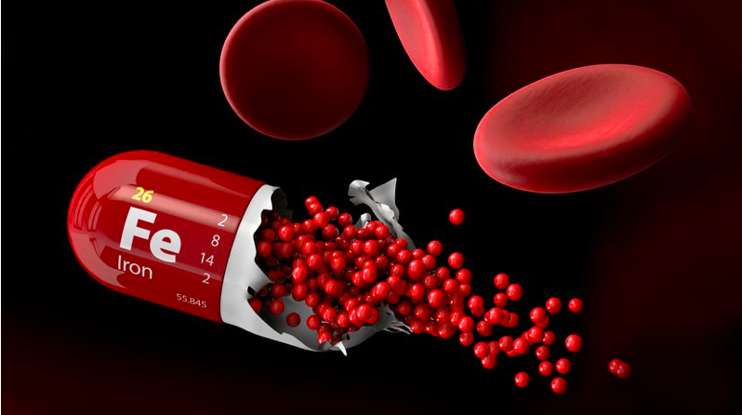
Iron Status and Physical Performance in Athletes
A systematic review about optimization of iron status in athletes.
Looking at factors that can affect iron status and potentially be beneficial for performance.
Andrea J.R Solberg University of Bergen
siw005@uib.no
ABSTRACT Adequate levels of iron in the blood are necessary for athletes, as iron-deficiency anemia can reduce physical performance. Several studies have investigated iron status and supplementation in iron-deficient athletes, and determined how physical strain can change iron balance and markers related to iron status. The question of how to influence and optimize iron status, as well as other markers that can affect iron metabolism, has been less thoroughly investigated.
Therefore, the aim of this review was to take a closer look at the importance of iron values, iron markers, and factors that can change iron metabolism for physical performance and the extent to which physical performance can be influenced in a positive or negative way..
Major findings include that iron supplementation had the best effect in athletes with the lowest iron status, and effects on physical performance were mostly achieved in those who were originally in a deficit. Iron supplementation could be beneficial for optimal erythropoietic response during altitude training, even in athletes with normal iron stores at baseline, but should be performed with caution. Alteration of the hepcidin response can affect the use of existing iron stores for erythropoiesis.
Energy intake, and the amount of carbohydrates available, may have an impact on the post-exercise hepcidin response. Optimal vitamin D and B12 levels can possibly contribute to improved iron status and, hence, the avoidance of anemia.
Background
The effects of iron deficiency anemia in sports are well studied. The effects of iron supplementation and optimization of iron status, in athletes without iron deficiency anemia, are less investigated.
Method
A systematic search of the PubMed database was performed, with the use of « iron» or «iron deficiency» or «hemoglobin» AND «athletes» AND «athletic performance» as a strategy of the search. After the search, 11 articles were included in the review after the application of inclusion and exclusion criteria.
Results Among the included studies, performance enhancing factors regarding iron status were mainly extracted, including both female and male athletes, predominantly endurance athletes.
The objectives for the studies varied between the effect of iron supplementation, hepcidin response under different circumstances, including the the influence of nutrition. Others looked at other vitamins that can affect iron status in a positive or negative way.
Conclusion
Effects of iron deficiency without anemia and suboptimal iron status in athletes remain largely unknown, and the protocol for optimizing athletes iron status is not set.
Iron supplementation hast the most pronounced impact on physical performance in athletes with lower ferritin levels.
Iron supplementation seems necessary for optimal erythropoietic response during altitude training. Supplementation should be undertaken with caution because of the possible increased hepcidin response. Hepcidin is a contributing factor that can affect the use of the existing iron the body, and can vary depending on different factors such as hypoxia, timing and nutrition status. Vitamin D and B12 levels can affect iron status.
REFERENCES Clenin, G.; Cordes, M.; Huber, A.; Schumacher, Y.O.; Noack, P.; Scales, J.; Kriemler, S. Iron deficiency in sports—Definition, influence on performance and therapy. Swiss Med. Wkly. 2015, 145, w14196. Dominguez, R.; Sanchez-Oliver, A.J.; Mata-Ordonez, F.; Feria-Madueno, A.; Grimaldi-Puyana, M.; Lopez-Samanes, A.; Perez-Lopez, A. Effects of an Acute Exercise Bout on Serum Hepcidin Levels. Nutrients 2018, 10, 209.
ACKNOWLEDGEMENTS I want to thank my supervisor Håkon Reikvam for close and good follow-up, as well as the push to get the article published in the journal «Life». Together, the work became more fun and inspiring for further scientific work.

