Slide 1
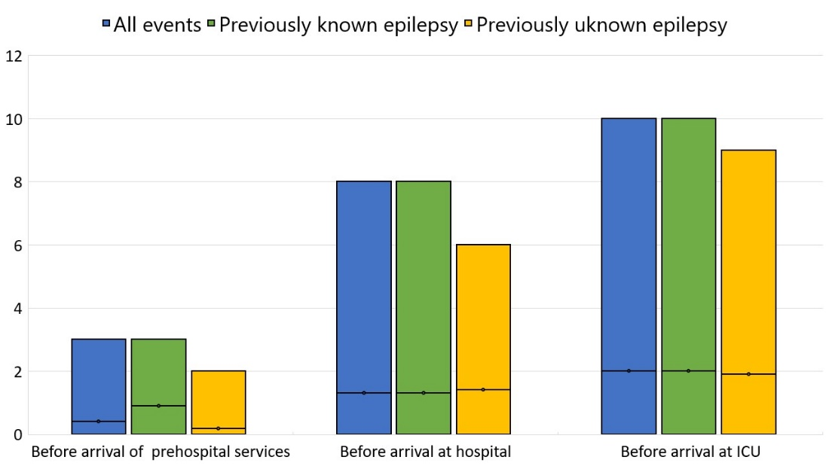
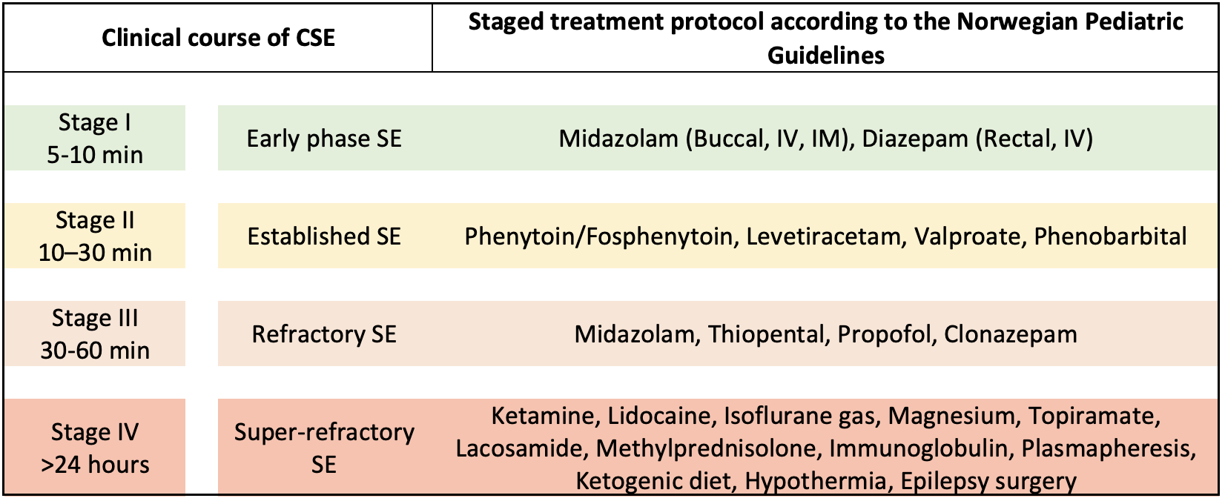
Refractory and Super-refractory Status Epilepticus in Children and Adolescents
Seline W. Hepsø University of Bergen
nem004@uib.no
Maya Lee
University of Bergen
duc007@uib.no
A Population Based Study from Western Norway
Seline W. Hepsø, Maya Lee, Kristoffer Noszka, Yvonne Wollertsen, Gunhild Holmaas, Erle Kristensen, Tom Eichele, Marte-Helene Bjørk, Silja T. Griffiths, Omar Hikmat
BACKGROUND
Refractory (RSE) and super-refractory status epilepticus (SRSE) are serious medical emergencies with significant morbidity and mortality. Prognosis and long-term outcome depend on timely management. We aimed to provide a detailed description of the clinical course of RSE/ SRSE in children and adolescents, assess the existing management guidelines, and identify potential biomarkers that could predict prognosis. In addition, we sought to study the epidemiology of RSE/SRSE, as data from comprehensive population-based studies is still limited in this age group.
RESULTS
43 patients with 52 episodes were identified.
Onset was associated with infection in 39/52 (57%)
Median time from SE onset to administration of the first rescue drug was 13 minutes (Figure 2)
Median time from first rescue drug to the second- and third-line treatment: 83 and 66 min. (Figure 2)
All survived at discharge from ICU
Incidence rate of RSE and SRSE episodes among children aged >1 month to <18 years was 3.13 per 100,000 per year.
Figure 2: Number of rescue medications which was administered before arrival of prehospital medical services, before arrival at hospital and before arrival at ICU, stratified in those with and without previous history of epilepsy.
Figure 1: Clinical stages of SE and recommended treatment according to the Norwegian pediatric guidelines.
METHODS
Retrospective population-based study
Patients who fulfilled the diagnostic criteria of RSE/SRSE, with age 1 month to 18 years and who were admitted to the intensive care unit at Haukeland University hospital in the period from 2012-2021
Detailed clinical and laboratory findings along with information on management and outcome were systematically collected and analyzed
Figure 3: Timeline of the major events during RSE/SRSE.
CONCLUSION Delays in treatment were observed in various stages of the clinical course of RSE/SRSE (Figure2, Figure 3). Improvement of treatment is needed as this may impact the progression to RSE/SRSE.
Treatment delays – how to improve:
Promt, timely escalation to 2nd-, 3rd - and 4th -line treatment
Prehospital access to 2nd-line treatment where there are long distances to nearest hospital
Better education in SE semiology for parents/caregivers and prehospital services
Individual treatment plans for those with known epilepsy/SE
ACKNOWLEDGEMENTS
The text in this poster is largely based upon the article “Refractory and Super-refractory Status Epilepticus in Children and Adolescents: a Population Based Study from Western Norway” by Seline W. Hepsø, Maya Lee, Kristoffer Noszka, Yvonne Wollertsen, Gunhild Holmaas, Erle Kristensen, Tom Eichele, Marte-Helene Bjørk, Silja T. Griffiths, Omar Hikmat

