Slide 1
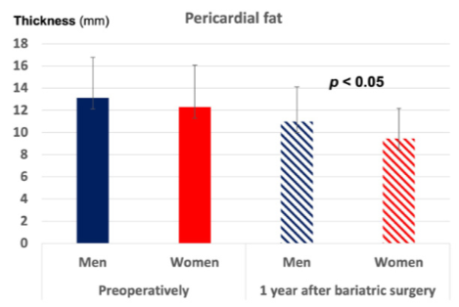
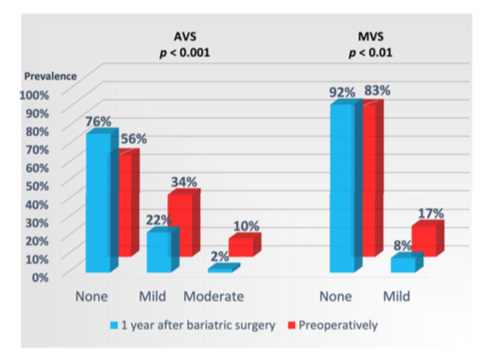
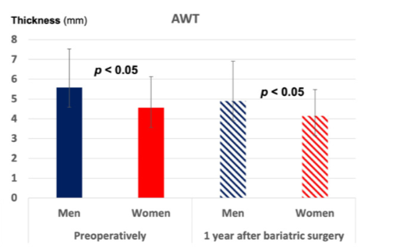
Markers of Subclinical Atherosclerosis in Severe Obesity and One Year after Bariatric Surgery
Nina Kovac University of Bergen
nko013@uib.no
Nina Kovac 1, Lisa M. D. Grymyr 1,2, Eva Gerdts 1, Saied Nadirpour 3, Bjørn G. Nedrebø 1,3, Johannes J. Hjertaas 3, Knut Matre 1 and Dana Cramariuc 1,2,*
ABSTRACT
Aortic valve sclerosis (AVS), mitral valve sclerosis (MVS), remodeling of major arteries, and increased pericardial fat are associated with subclinical atherosclerosis. We assessed these markers of atherosclerosis in severely obese patients before and 1 year after bariatric surgery. Eighty-seven severely obese patients (43 ± 10 years, preoperative body mass index [BMI] 41.8 ± 5 kg/m2) underwent echocardiography before and 1 year afterRoux-en-Y bypass surgery in the FatWest (Bariatric Surgery on the West Coast of Norway) study. We measured the end-diastolic aortic wall thickness (AWT), pericardial fat thickness at the right ventricular free wall, and AVS/MVS based on combined aortic leaflet thickness and hyperechoic valve lesions.
Markers of Atherosclerosis 1 Year after Bariatric Surgery
All echocardiographic markers of subclinical atherosclerosis decreased significantly 1 year after bariatric surgery, with the lowest 1-year prevalence in patients with a postoperative BMI below the median of 28.1 kg/m2.
Figure 2.
Pericardial fat thickness and AWT (in mm) in women and men preoperatively and 1 year Diabetic and hypertensive patients, as well as those with higher preoperative BMI
after bariatric surgery. The bars indicate the mean values, and the error bars the standard deviations. P values of significance for comparison between men and women at each study visit.
Discussion
Subclinical atherosclerosis is associated with left-sided heart valve sclerosis, increased amount of pericardial fat, and remodeling of the ascending aorta at conventional echocar- diography. The presence of these markers of subclinical atherosclerosis signals a high risk of CV events. We demonstrate in the current analysis that patients with severe obesity have a large prevalence of valve sclerosis for age in addition to a large amount of pericardial fat, and thickened aortic root wall, particularly in men and diabetic patients. This is to our best knowledge the first study to show that large weight loss 1 year after bariatric surgery partially reverses these markers of subclinical atherosclerosis, adding a pathophysiological explanation to the previously observed reduced incidence of acute myocardial infarction and coronary revascularization procedures up to 11 years after weight-reducing surgery in retrospective studies.
Conclusions
Echocardiographic markers of subclinical atherosclerosis are highly prevalent in severely obese subjects and decrease 1 year after bariatric surgery. The most pronounced reverse remodeling is achieved by younger patients that reach a 1-year BMI < 28 kg/m2. Women attain a greater reduction in the amount of pericardial fat than men, independent of traditional CV risk factors as well as their pre- and postoperative BMI.
Study Population
The FatWest (Bariatric Surgery on the West Coast of Norway) study recruited patients with severe obesity living on the West Coast of Norway and referred for a Roux-en-Y gastric bypass. Of these patients with a standard indication for bariatric surgery according to national guidelines, 123 were examined clinically by echocardiography and blood samples at study baseline (2–3 months before surgery) and 6 months, 1, 2 and 5 years postoperatively. From the baseline cohort, 95 patients presented at the 1-year postoperative visit. In these, echocardiographic assessment of markers of atherosclerosis at 1 year was not possible in eight patients (not measurable aortic wall thickness and/or AVS) resulting in a final population size of 87 patients.
Results
Postoperatively, patients experienced a reduction of 12.9 ± 3.9 kg/m2 in BMI, 0.5 ± 1.9 mm in AWT, 2.6 ± 2.3 mm in pericardial fat, and 45%/53% in AVS/MVS (p < 0.05). In multivariate regression analyses with adjustment for clinical and hemodynamic variables, less pericardial fat reduction was associated with male sex and higher 1-year blood pressure and BMI, and less AWT-reduction with higher age and 1-year BMI (p < 0.05). Persistent AVS and MVS were related to higher 1-year BMI and more advanced valve sclerosis preoperatively (p < 0.05). Conclusions: Markers of subclinical atherosclerosis decreases significantly 1 year after bariatric surgery, particularly in younger patients that achieve a BMI < 28 kg/m2 .
Figure 1. Prevalence of AVS and MVS preoperatively and 1 year after bariatric surgery. p values of
significance for reduction in AVS and MVS after surgery, respectively.

