Slide 1
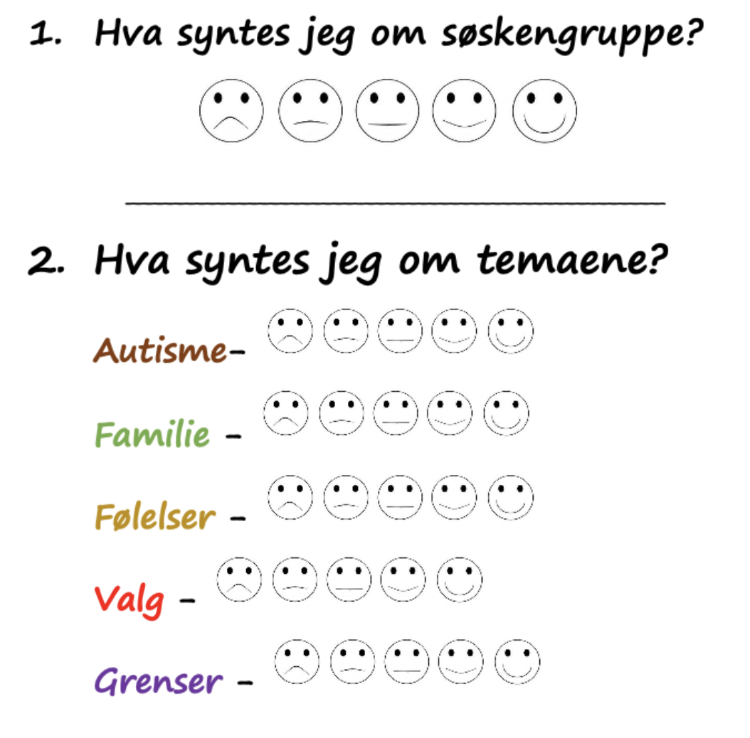
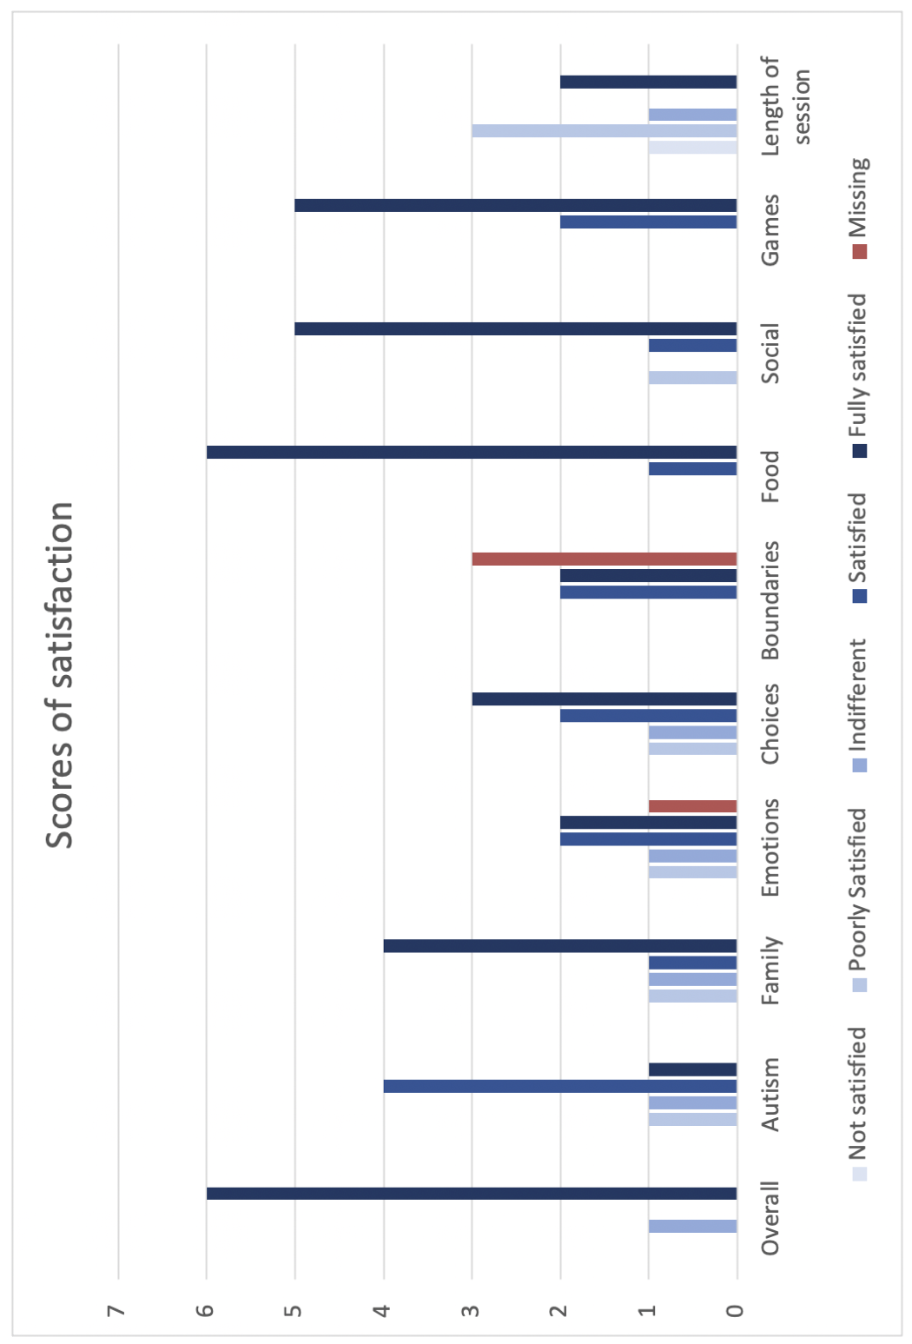
The forgotten relatives
Siblings of children with autism spectrum disorder – An evaluation of a health service provided intervention for siblings of children with autism spectrum disorder.
Sara Helen R. Hetlebakke University of Bergen
xib008@uib.no
Abstract and focus
The siblings of children with autism spectrum disorder (ASD) are often over-looked when considering next-of-kin impact, despite ASD being a life-long condition with known and variable burdens onto the family. This report aimed to better understand the dynamics of this sibling relationship and evaluate the effects and reception of a sibling support group. The support group sessions involved psychoeducation, food and a weekly game or activity.
The development of peer-network between the siblings in the group was a particularly interesting discovery from the intervention. This was reported by children, group supervisors and parents alike. Mutual understanding and shared experiences were mentioned as enlightening for the children, and an opportunity for continued relationships.
The value of playfulness and the peer community The food, peer-community and activities had the highest qualitative scores and positive feedback. Observations also showed an increasing intimacy and openness in the group, as they gradually shared their common sibling experiences.
Laughter and playfulness were major parts of building the safe space. This can be credited the meals and games on the program. The value of making room for play when designing these types of interventions was an important finding for future sibling groups. The children’s direct yield of psychoeducation during the sessions was more uncertain compared to the positive feedback on the social aspects of the group.
Method and data collection
A mixed-method design. We collected data from child and parent questionnaires in addition to personal observation during the sessions. The mix of self-report and observatory participation gave useful insight in the group dynamic, development and quality.
The sibling support groups yet to come We found that the sibling support group was unanimously well received amongst participants and parents, and learned what areas were most regarded. The group said they might also remain in contact for more long-term support. There is little research on the long-term effects of such intervention.
Recognizing the perspective and burden on these next-of-kin children is of great relevance and is likely to add protective factors to both the attending sibling, ASD-sibling and family dynamic all together.
ACKNOWLEDGEMENTS
The children attending the sessions, their parents and the group supervisors from BUP Bergen that allowed me to be a part of this wonderful learning experience and community. Thank you also to my two report supervisors for all help along the way.

