Slide 1
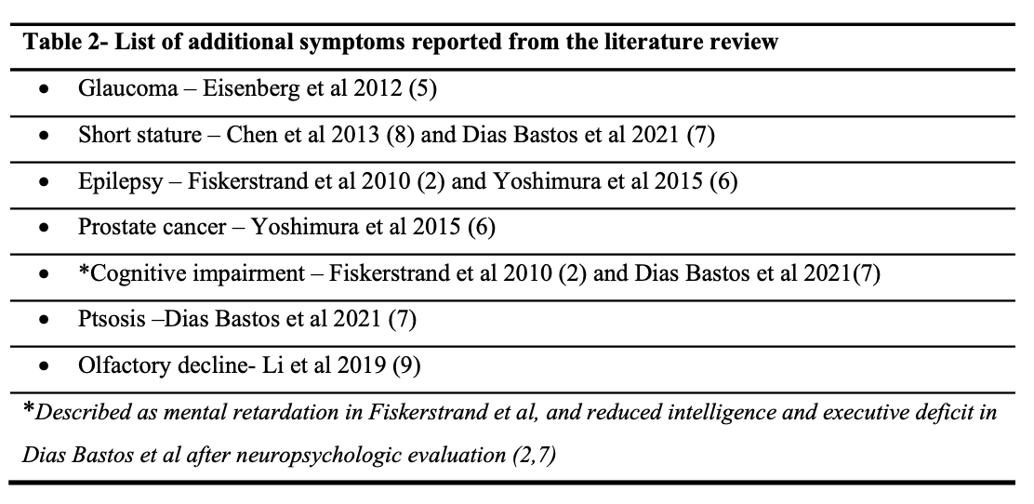
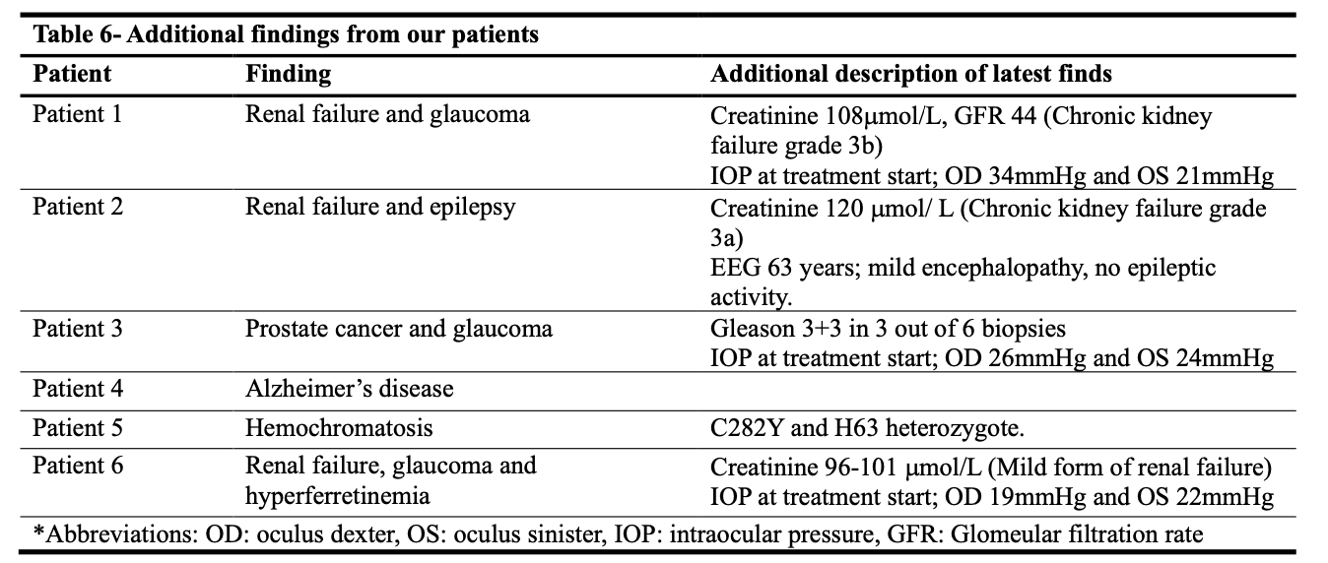
The natural history and clinical spectrum of PHARC:14 years after discovery
This study examines the clinical spectrum of six Norwegian PHARC patients and additional symptoms outside the main phenotype
Emma Mundal Braanen University of Bergen
muw006@uib.no
Veileder: Kristin Nielsen Varhaug
Biveileder: Christian A.Vedeler
What is PHARC ?
Bakground
PHARC is a rare multisystemic neurodegenerative disorder. Fourteen years ago, it was clinically described for the first time in a Norwegian family with Polyneuropathy, Hearing loss, Ataxia, Retinitis pigmentosa and Cataract. The disease was later genetically mapped to mutations in the ABHD12 gene. This gene encodes for an enzyme related to the endocannabinoid system, and PHARC is the first description of an inherited disease involved in this physiological system. Due to its recent discovery and complexity, there is a need for more knowledge to provide PHARC patients with the best health care.
Figure 1
P= Polyneuropathy
H= Hearing loss
A= Ataxia
R= Retinitis Pigmentosa
C= Cataract
Figure 2
Methods
Clinical data from six Norwegian PHARC patients was retrospectively obtained focusing on the natural history of the disease and additional symptoms outside the main phenotype.
For the literature review, a literature search was performed in the PubMed database without time limitation and finished in September 2023. The search terms “PHARC” OR “ABHD12” were used which generated 75 results. Titles and abstracts were reviewed, and full text obtained if relevant. For this purpose, the focus of relevance was case reports and papers describing clinical observations of PHARC patients. In total, 13 articles published from 2009- 2021 were reviewed. The main goal with the literature review was to obtain an overview of reported additional symptoms outside the main PHARC phenotype.
The figures are collected from Fiskerstrand T, H'mida-Ben Brahim D, Johansson S, M'zahem A, Haukanes BI, Drouot N et al. Mutations in ABHD12 cause the neurodegenerative disease PHARC: An inborn error of endocannabinoid metabolism. Am J Hum Genet. 2010;87(3):410-7. doi: 10.1016/j.ajhg.2010.08.002. (2)
Figure 1 shows the different elements of the main PHARC phenotype. Figure 2 exhibit that ABHD12 enzyme have been showed to be involved in hydrolysis of 2-AG in the brain of mice (2)
The figures were not included in our study, only for the purpose of the poster.
Results
Our cohort displayed progressive hearings loss, blindness, and a complex gait disturbance over time. 3 patients had additional findings of glaucoma. 3 patients developed chronic renal failure. 1 patient had epilepsy, 1 patient developed Alzheimer’s disease and 1 patient got diagnosed with prostate cancer. From the literature review, additional findings of glaucoma, short stature, epilepsy, prostate cancer, cognitive impairment, ptosis, and olfactory decline were reported.
The patient group comprise three male and three female patients diagnosed with PHARC
Conclusion
Although the cohort is too small to generate significant evidence to expand the clinical spectrum of PHARC, we present additional features of the rare disease worth keeping an eye on.
REFERENCES
Fiskerstrand T, Knappskog P, Majewski J, Wanders RJ, Boman H, Bindoff LA. A novel Refsum-like disorder that maps to chromosome 20. Neurology. 2009;72(1):20-7. doi: 10.1212/01.wnl.0000333664.90605.23.
Fiskerstrand T, H'mida-Ben Brahim D, Johansson S, M'zahem A, Haukanes BI, Drouot N et al. Mutations in ABHD12 cause the neurodegenerative disease PHARC: An inborn error of endocannabinoid metabolism. Am J Hum Genet. 2010;87(3):410-7. doi: 10.1016/j.ajhg.2010.08.002
5. Eisenberg T, Slim R, Mansour A , Nauck M, Nürnberg G, Nürnberg P et al. Targeted next-generation sequencing identifies a homozygous nonsense mutation in ABHD12, the gene underlying PHARC, in a family clinically diagnosed with Usher syndrome type 3. Orphanet J Rare Dis. 2012; 7:59, doi: 10.1186/1750-1172-7-59
6. Yoshimura H, Hashimoto T, Murata T, Fukushima K, Sugaya A, Nishio SY et al. Novel ABHD12 mutations in PHARC patients: the differential diagnosis of deafblindness. Ann Otol Rhinol Laryngol. 2015;124 Suppl 1:77S-83S. doi: 10.1177/0003489415574513.
7. Dias Bastos PA, Mendonça M, Lampreia T, Magriço M, Oliveira J, Barbosa R. PHARC Syndrome, a Rare Genetic Disorder-Case Report. Mov Disord Clin Pract. 2021;8(6):977-9. doi: 10.1002/mdc3.13266.
8. Chen DH, Naydenov A, Blankman JL, Mefford HC, Davis M, Sul Y et al. Two novel mutations in ABHD12: expansion of the mutation spectrum in PHARC and assessment of their functional effects. Hum Mutat. 2013;34(12):1672-8. doi: 10.1002/humu.22437
9. Li T, Feng Y, Liu Y, He C, Liu J, Chen H et al. A novel ABHD12 nonsense variant in Usher syndrome type 3 family with genotype-phenotype spectrum review. Gene. 2019; 704:113-20. doi: 10.1016/j.gene.2019.04.008.

