Slide 1
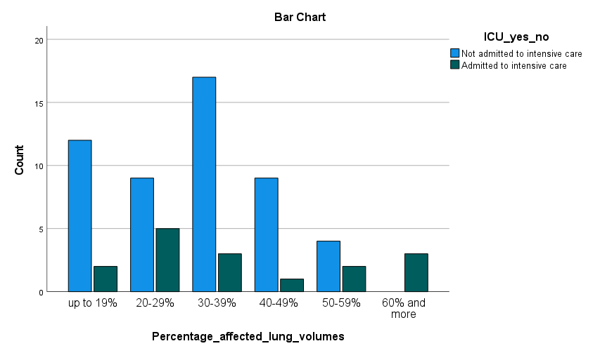
Volume assessment of affected lung parenchyma in Covid-19
CT volume assessment of affected lung parenchyma has according to some studies been useful to distinguish non-critically ill and critically ill patients with covid-19 disease. We carried out a retrospective study at Haraldsplass Deaconess Hospital in Bergen Norway to investigate if CT-volume assessment of affected lungs can aid in the prediction or prognostication in the earlier phases of Covid-19 disease.
Peder J. Bruun University of Bergen
pbr014@uib.no
Background and aim
Traditionally, a conventional chest radiograph is one of the first imaging modalities used in the diagnostics of pneumonia or flu-like illness with respiratory symptoms. However, it has been shown that the sensitivity of the chest radiograph in detecting severe Covid-19 disease is limited. Computed tomography (CT) on the other hand, has a very high sensitivity in detecting viral pneumonia in Covid-19 patients. Due to a lack of enough PCR testing machines in the early days of the SARS COV-2 pandemic, as well as the sudden increase of tests to be carried out, delays in test results were common.
Methods
This study is a retrospective study of patients admitted to Haraldsplass Deaconess Hospital between March 2020 until the end of 2021with a confirmed Covid-19 diagnosis by RT-PCR-testing. We included patients who underwent a chest-CT investigation during the admission. Patients were divided into two groups: critically ill which included patients who died due to Covid-19 or were admitted to the ICU, and non-critically ill for the others. Percentage of affected lung parenchyma was analysed by two observers using a semi-quantitative method. The volumes and basic demographic data were collected, and reliability between the observers was assessed. Statistical analyses were done in SPSS.
The lung images were analysed in a post processing software (GE AW server) using the thoracic VCAR software for parenchymal analysis.
Affected lung volumes and rate to ICU admissions specified.
The relationship between affected lung volumes and ICU admittance is shown in figure 1 This box- plot shows that there was significant overlap in lung volumes between the two groups below the 39% value, however, volumes> 40% were associated with ICU admittance. An independent t-test showed that there was a significant difference in lung volumes affected between the groups. The means of the patients admitted to the ICU was 38% (±19.3%), the means of the non- critical patients were 32% (±12.6%), p=0.003.
Clinical implications
Currently, CT volume assessments are not accurate enough to be recommended. However, we must not forget that the healthcare systems of many countries experienced a crisis during the first part of the Covid-19 pandemic, and CT scans did have a vital role in this early stage when PCR-testing was delayed. However, now that the pandemic has past, reverting to the traditional chest radiograph may be prudent
Numerous papers recommended the use of CT thorax for diagnosis, assessment of severity, triage, prognostication and follow up . In 2020, a study from Italy (Leonardi et al.) suggested using semiautomatic volume measurements as a mean of determining prognosis in critically ill Covid-19 patients. This study found a statistically significant correlation between the clinical severity and the percentage of affected lung volume on the quantitative measurements. We wished to assess if volume measurements performed on our CT and in a clinical setting could successfully recognize the patients most at risk, and if the cut-off given in the Italian study was applicable to our patient group.
Results
A total of 67 patients (41 males and 26 females) with a confirmed Covid-19 diagnosis was included in the study. Eleven patients were admitted to the ICU, and five died without being admitted to the ICU. The mean volume of affected lungs was 35 % in males and 31% in females. Lung volume affection over 60% led to ICU admittance, but lower values did not exclude ICU admittance. Depending on which cut-off value was used to distinguish the groups (20%-40%-60%) the sensitivity was 88%-79%-80%, but the specificity was low at 26%-24%-32%. The PPV was 24%-75%-100%, but the NPV was 88%- 38%-19%. Thus, a cut-off to distinguish the two groups could not be determined. Reliability between the two observers was good (ICC=0.8).
Conclusion
Semi-quantitative CT-volume assessment of affected lung parenchyma as a stand-alone criterion is not useful in distinguishing non-critically ill and critically ill patients with Covid-19 disease. The role of CT thorax and use of CT in future pandemics should revert to the pre-pandemic role. Extensive use of CT lungs for evaluating severity of disease is not advisable.
Figure 1

