Slide 1
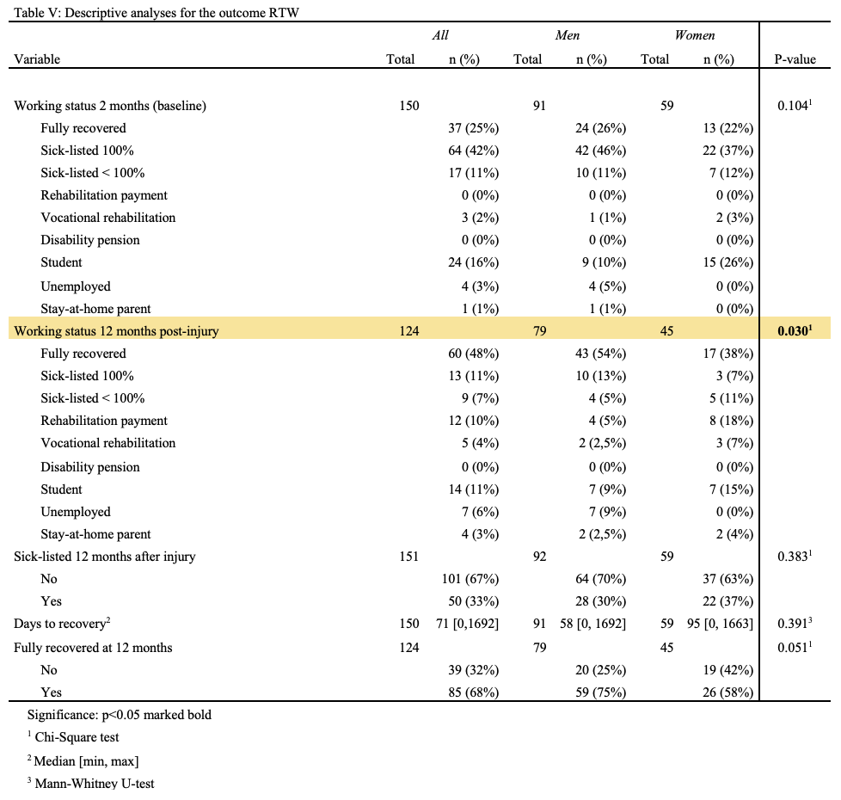
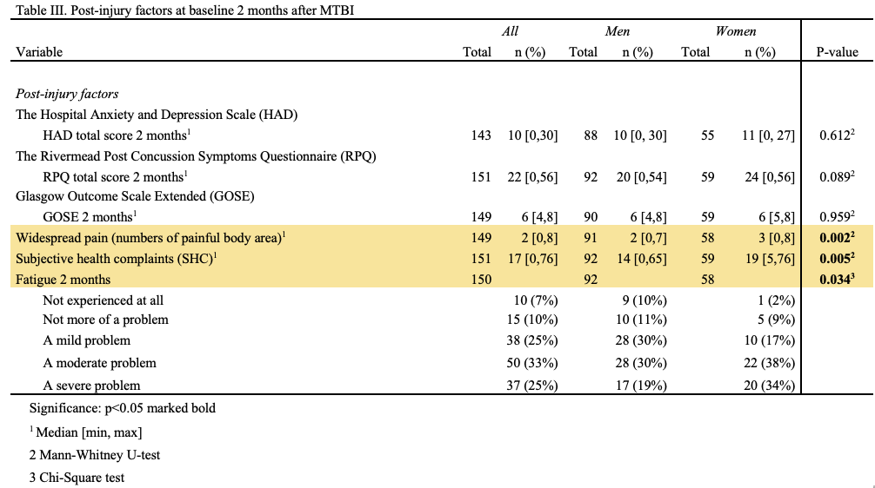
Sex differences in clinical characteristics and return to work after mild traumatic brain injury
A prospective cohort study on sex differences in RTW and clinical characteristics of patients with persistent symptoms after MTBI.
Ane Bakke Øvrevik University of Bergen
ane.ovrevik@student.uib.no
Method: A prospective cohort study of 151 patients with MTBI admitted to outpatient clinics 2 months after injury at two University Hospitals in Norway. Self-reported questionnaires were used to obtain demographic information, symptom profiles and information on RTW. Injury characteristics were obtained from hospital records. Sick leave data from one year before and one-year post-MTBI were obtained from The Norwegian Labour and Welfare Services (NAV).
ABSTRACT
Objective: To identify if there were sex differences in return to work (RTW) after mild traumatic brain injury (MTBI) for patients who either were at risk of being sick-listed or sick-listed with persistent post-concussion symptoms (PCS). In addition, this study examined other sex differences for pre-injury-, injury- and post-injury clinical variables.
Results: There was a significant difference in working status at 12 months (p = .03) between men and females. The data obtained from NAV, with all 151 participants, showed no significant difference in sick leave 12 months post-injury (p = .383), and neither did the variable fully recovered at 12 months post-injury (p = .051). The analyses on clinical variables showed that women had more subjective health complaints (p = .005), more fatigue 2 months post-injury (p = .034) and more widespread pain (p = .002). Analyses performed on injury-related variables showed that men had a higher occurrence of assault (p = .002), post-traumatic amnesia over an hour (p = .033), and they were more often affected by alcohol at the time of injury (p = .002).
Conclusion: The analyses executed in this study found that there may be a tendency for delayed RTW in women. Analyses performed on clinical variables found that women have different causes of injury, more widespread pain and subjective health complaint, which may have implications for follow-up and treatment after MTBI.
ACKNOWLEDGEMENTS
Eirik Vikane, Department of Physical Medicine and Rehabilitation, Haukeland University Hospital
Tonje Wåle Flørenes, Department of Physical Medicine and Rehabilitation, Haukeland University Hospital

