Slide 1
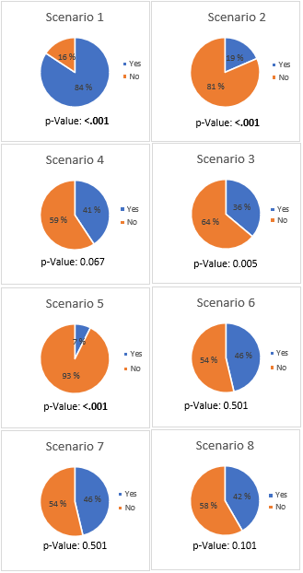
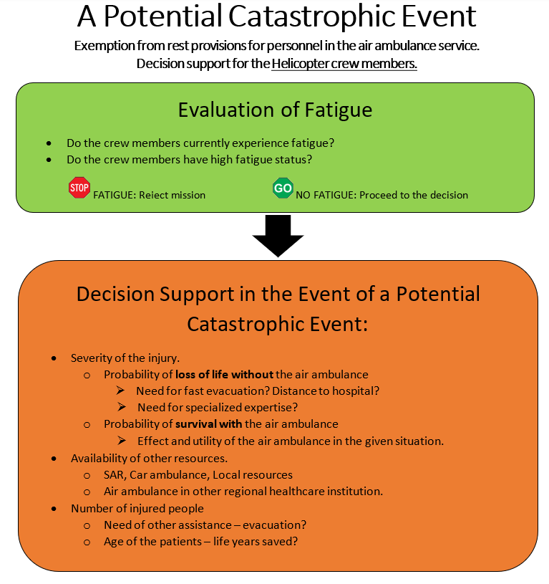
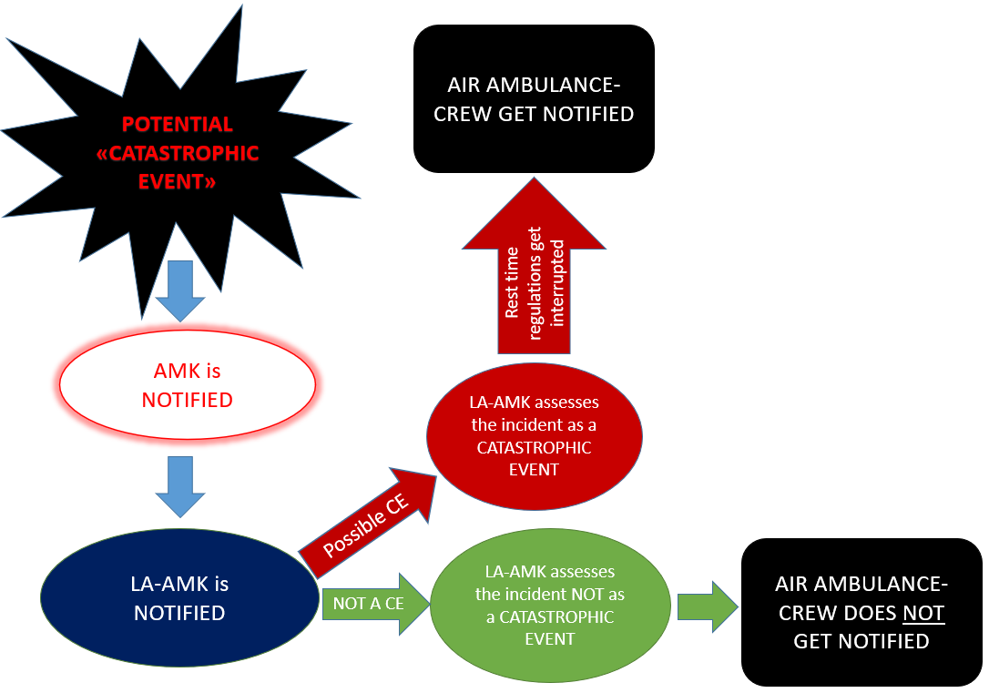
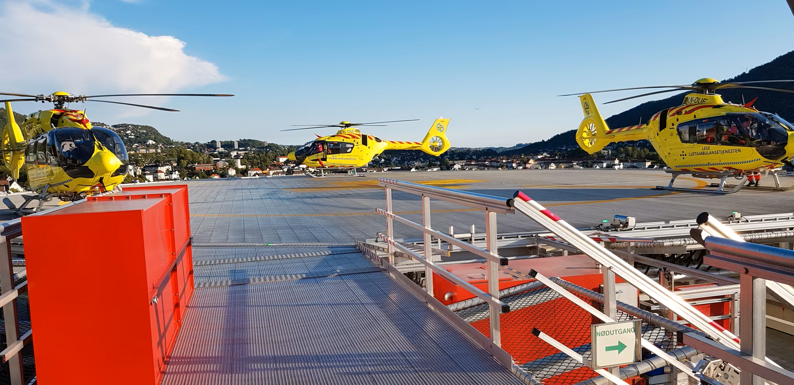
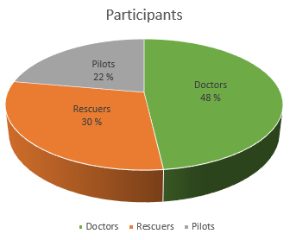
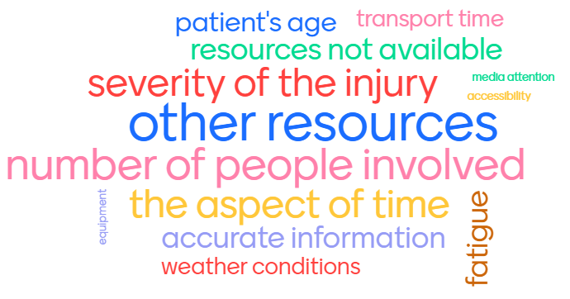
CATASTROPHIC EVENT
Asgeir Werner-Ristesund
asgeir.werner-ristesund@student.uib.no
Martin Førsvoll
martin.forsvoll@student.uib.no
Universitet i Bergen
“Exemption from rest provisions for personnel in the air ambulance service, and an overview of Norwegian air ambulance personnel opinion of CE”.
ABSTRACT
The Norwegian air ambulance is subject to strict aviation rules, which among other includes the regulations of mandatory passive time.
It is possible to dispense from the provisions of mandatory passive time, reserved for special occasions, known as “catastrophic events” (CE) (1).
The aim of this study was to evaluate whether Helicopter emergency medical service (HEMS) crew in Norway considered fictive scenarios to meet the requirements of CE.
We sent out a thoroughly prepared questionnaire, which included eight different scenarios, to all operators in helicopter crews in the Norwegian air ambulance.
The results indicate that there was a significant lack of agreement and high degree of subjectivity in assessing catastrophic events, with only scenario 3 out of 8 showing a notable level of agreement.
We have deemed it necessary to implement a common, national checklist as a decision support tool for all helicopter crews in the Norwegian air ambulance. To achieve this, we have proposed the development of a thoroughly processed decision support system.
Objective: A fictitious scenario After being on active duty for 13 hours, the HEMS crew stationed at an air ambulance base was about to declaring themselves unfit for flight. However, at that moment, they received a call from the HEMS dispatcher central, who conveyed the following message:
2 years old child with airways at risk in a chalet in the mountains.
The child’s face has turned blue.
It takes three hours to travel by car to the nearest hospital.
Flight time 25 min. Other air ambulance takes 30 min.
Will the crew classify this incident as a catastrophic event?
Method
A survey was distributed to HEMS crew in Norway, comprising eight fictional emergency medical scenarios with the potential for catastrophic event. Participants were required to categorize each scenario as CE or non-CE based on the presented factors. The scenario described above was included in the survey (scenario 8).
Results
Of all the eight scenarios, only three of them had a significant agreement in the decision-making. This was scenario 1, 2 and 5 respectively. The most important factor that created uncertainty was “severity of the injury”, then followed by “number of people involved”. Together they constitute more than two thirds of the percentage of the four different factors.
Our proposal: Decision support system
Participants opinion on CE
Displayed below are some of the factors that the participants deemed as most crucial in relation to CE:
Conclusion
The results of our research show that there is a high degree of subjectivity and lack of agreement in the assessment of a potential catastrophic event among air ambulance personnel in Norway.
To address this issue, we have proposed the development of a decision support system to assist air ambulance personnel in the assessment of potential catastrophic events.
We believe that the implementation of a decision support system has the potential to improve the overall effectiveness and safety of air ambulance operations in Norway
We recommend that future research be conducted to further explore the feasibility and potential benefits of a decision support system in the context of air ambulance operations
The study included a total of 108 participants, resulting in a response rate of 41.7% among the HEMS crew in Norway.
Photo: Jan Ove Berntsen
REFERENCES
1. Dreyer K, Jensen ÅC, Tveitane PM. Modul 6 Rekvirering, varsling, koordinering og flight following av luftambulansehelikopter [Report]. Bergen: Nasjonalt kompetansesenter for helsetjenestens kommunikasjonsberedskap; 2019 [cited 2023 10.02]. 2. edition:[Available from: https://kokom.no/wp-content/uploads/2019/09/20190607-Modul-6-Versjon-2-med-f%C3%B8lgebrev.pdf.
ACKNOWLEDGEMENTS
We would like to express our sincerest gratitude to Bård Einar Heradstveit for his guidance and support as the supervisor of our study.
We would also like to thank the Norwegian air ambulance for providing us with access to their resources and for their willingness to collaborate with us on this project. Their insights and feedback have been integral to our understanding of the practical implications of our research.

