Slide 1
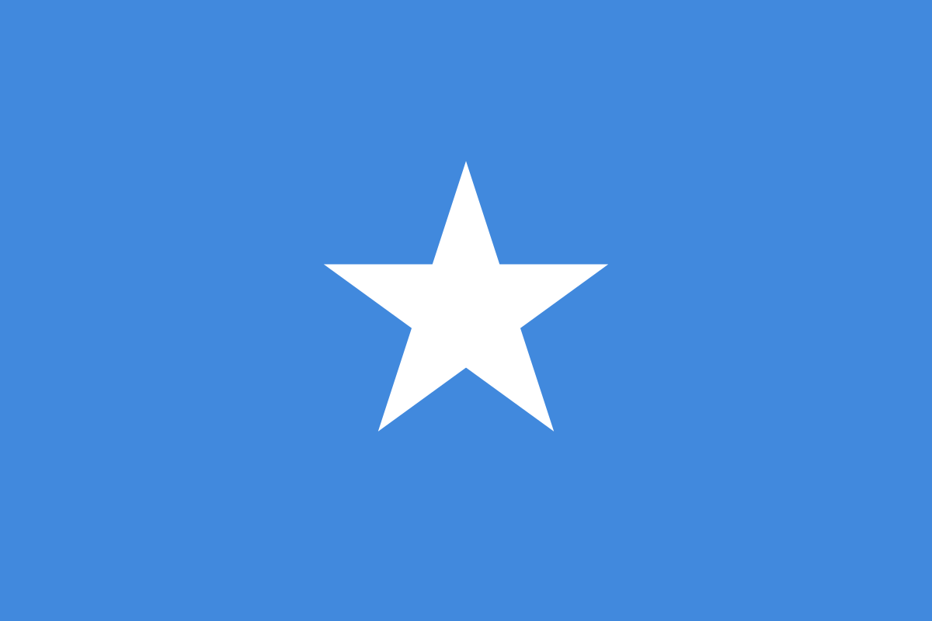
Cultural factors influencing COVID-19-related perceptions and behavior
Dette bildet av Ukjent forfatter er lisensiert under CC BY-SA
Dette bildet av Ukjent forfatter er lisensiert under CC BY-SA
Dette bildet av Ukjent forfatter er lisensiert under CC BY-SA
Solveig Vederhus and Eirik Myhre
University of Bergen
sve040@uib.no, emy009@uib.no
seen from immigrants’ own perspective. A qualitative study on three immigrant groups
Background
Cultural factors have been mentioned as a possible explanation for differences in COVID-19 disease burden and vaccination rates in immigrant populations compared to the general population. Yet, to date little scientific effort has been made to further explore what might lie in such a term. This study set out to explore the thoughts of immigrants themselves on what they might consider “cultural factors” that could influence COVID-19-related perceptions and behavior.
Methodology
18 immigrants residing in Norway with origins from three countries were recruited for qualitative interviews. Brief participant overview in figure 1.
Interviews were audio recorded, transcribed and analyzed using systematic text condensation.
Results
In the following section is summarized what participants considered cultural factors. Other system-related factors, socioeconomic factors and factors relating to being “between cultures” (transcultural factors) were also mentioned. See figure 2 for summary. These other factors are described more fully in the full article.
Religious traditions, rituals and gatherings
Somali described mourning rituals incompatible with pandemic guidelines. Poles described the catholic church as an important source of information and disinformation for many Poles.
Sense of community within the groups
Somali described a strong sense of duty toward each other, wanting to help both family, friends
.
Societal duty and responsibility
Sri Lankans understood societal duty and responsibility as part of their culture, wanting to adhere to rules and recommendations, citing a cultural focus on being perceived as “respectable citizens” in their social circles. Poles described countrymen not being used to engaging in local or larger society, and having a more individualistic tuning, not feeling duty towards other citizens.
Use of traditional medicine
Both Somali and Sri Lankans mentioned their groups commonly using traditional remedies for illness and fever, also during the pandemic.
Attitudes towards Norwegian healthcare
Poles spoke of low trust in Norwegian healthcare, with many preferring to consult private healthcare in Poland, to the often conservative approaches to i.e. antibiotics and surgery in Norway. Sri Lankans also noticed approaches different from their country of origin, but still spoke of good trust in Norwegian healthcare.
Personal socioeconomic
Education
Cultural
Social habits
Transcultural
Information from two countries
Language courses
System related
Work
Religion
Sense of community
Societal responsibility
Tradiditional medicine
Attitudes to healthcare
Mistrust & conspiracy
Integration level
Appropriateness of information
Discrimination
Access to health services
Poland – 7 participants
5 women + 2 men, ages 40-72
3 individual and 1 group interviews
Somalia – 6 participants
5 women + 1 man, ages 22-53
1 individual and 1 group interview
Sri Lanka – 5 participants
1 woman + 4 men, ages 40-53
1 group interview
Figure 2. Summary of results, including cultural and other factors.
Hospitality and social habits in the daily life
Somali described having a more social culture than Norwegians, with large gatherings in homes being common, and it taking a while for them to understand how that could spread the virus. Sri Lankans described social gatherings, but stopping them quickly during the pandemic. Poles spoke of a need to meet friends and family, and many not feeling the need to socially distance.
.
and even strangers. They also described a particularly strong duty to visit family and friends who get sick, which was often at odds with pandemic guidelines. The term “family” also to Somali had a broader sense than in Norwegian. Sri Lankans had a looser connection among themselves, but appreciated a sense of community through their organizing a Sri Lankan school. Poles described a more individualistic culture, with close family being most important.
Conclusion
Our results may serve as examples highlighted as relevant by the interviewed groups, but also as a reminder that relevant differences may exist for other immigrant groups as well. Rules and guidelines may hit harder and interfere more in the way of life of some communities than others. As such, cultural factors ought to be kept in mind when devising healthcare policies and guidelines, to create equitable a healthcare.
Figure 1. Participant overview.

