Slide 1
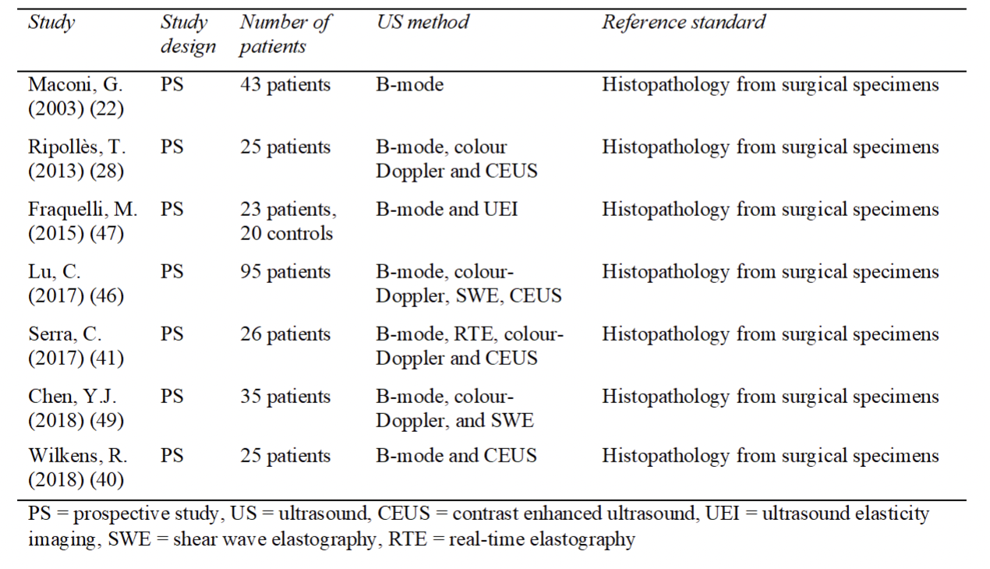
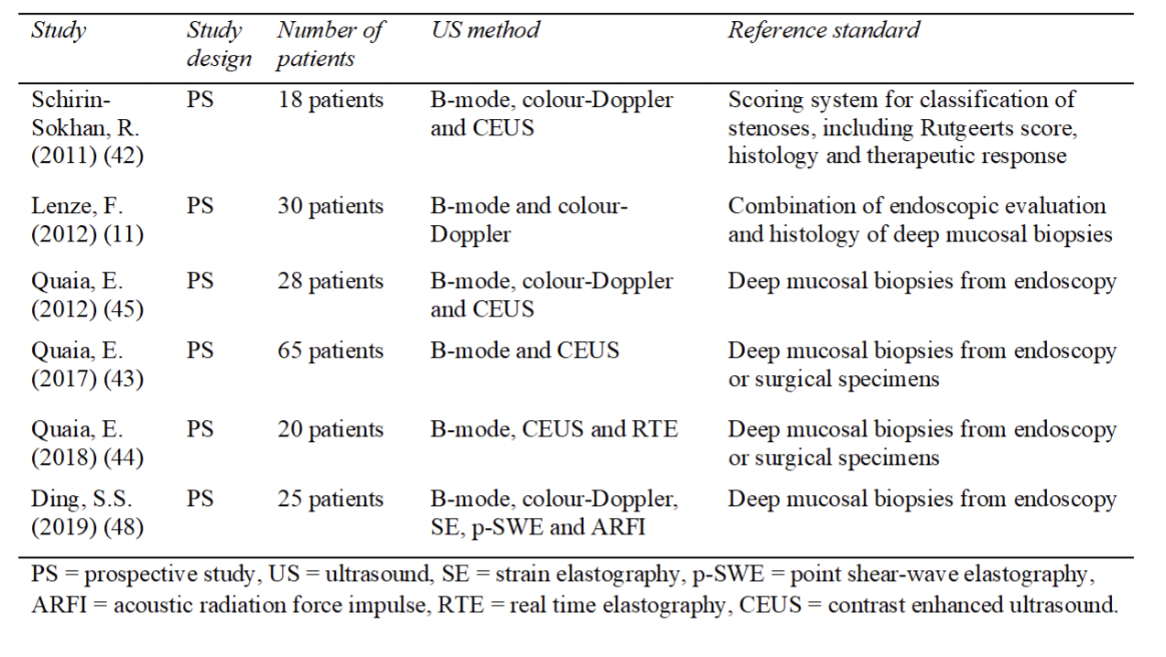
Kim Nylund, Fredrik Sævik, Gausalya Uthayakumar, Tonje Ueland University of Bergen
kim.nylund@uib.no, fredrik.savik@gmail.comgut011@uib.no, tue001@uib.no
Ultrasound techniques to differentiate between fibrosis and inflammation in Crohn's disease: a systematic review
The aim of this study is to systematically assess the quality and reliability of different ultrasound techniques to differentiate between inflammatory and fibrotic strictures in patients with Crohn’s disease
Bakground
Crohn’s disease (CD) is a chronic idiopathic inflammatory bowel disease that may affect different parts of the digestive tract, from the mouth to the anus. Most commonly it affects the terminal ileum and colon. CD is characterized by discontinuous areas of inflammation in the digestive tract. CD patients are phenotypically characterized according to the Montreal classification (1), where age at diagnosis, location and behaviour are characterized. Although the entire gastrointestinal (GI) tract may be affected, the majority of CD lesions are confined to the terminal ileum (30 %), colon (20 %), or ileocolonic (50 %) locations. Finally, 5-10 % of CD patients have proximal disease. Initially almost all patients have mostly inflammation in the bowel, but over time an increasing number of the patients develops stricturing and fistulating complications. The most common fistulating complication are perianal fistulas
Method
A systematic search in the PubMed database and the EMBASE database was performed to collect articles. The search gathered the latest articles which featured different ultrasound techniques in Crohn’s disease patients to differentiate between fibrosis and inflammation. To assess the quality of the articles chosen from the search the tool QUADAS-2 was used.
The search in both databases gave 1068 relevant articles. Only 13 articles were included in this systematic review. The included studies were divided into two groups based on the use of mucosal biopsies or surgical resected specimens as reference standard
Discussion
A total of thirteen studies from PubMed were included in this systematic review. According to the quality assessment, seven of the studies had low quality and five of the studies had moderate quality. Only one of the included studies had high quality. Nine of the studies had positive results while four of the studies had negative results.
The differentiation between inflammatory and fibrotic strictures is a problem that is difficult to study. It is difficult to design a study with a representative study population when assessing this problem. This is, among other reasons, due to the high risk of bias for patient selection in studies where all patients undergo surgery. Another reason is the low applicability in studies where mucosal biopsies are used as reference standard.
Conclusion
Ultrasonography may be a potential tool to aid differentiation between fibrosis and inflammation in Crohn’s disease in the future. However, the diagnostic accuracy is insufficient, and current evidence is scarce and has low quality. Further research aiming to solve methodological challenges and cut-off values is mandatory before possible implementation in clinic could be recommended.
Results
The search in both databases gave 1068 relevant articles. Only 13 articles were included in this systematic review. The included studies were divided into two groups based on the use of mucosal biopsies or surgical resected specimens as reference standard. Seven of the studies used surgical specimens, where one was considered high quality, four of them had moderate quality and two of them had low quality. Six of the studies used mucosal biopsy, and only one of these studies was considered moderate quality, whereas the other five had low quality. Nine of the studies had positive results, however, only three of these studies had moderate quality. Four of the studies had negative results, and three of these studies had moderate or high quality.
Diagnostics An increased fecal calprotectin is suggestive of inflammation in the GI tract. Ileocolonoscopy with inspection and biopsies of the colon and terminal ileum are necessary to establish the diagnosis of CD
Inflammation in the terminal ileum, longitudinal ulcers and skip lesions are typical macroscopic findings in patients with CD. Histology is important both for detecting CD, but also for evaluating the degree of inflammation and fibrosis. Granulomas in mucosal biopsies are also a clear indication of CD.

