Slide 1
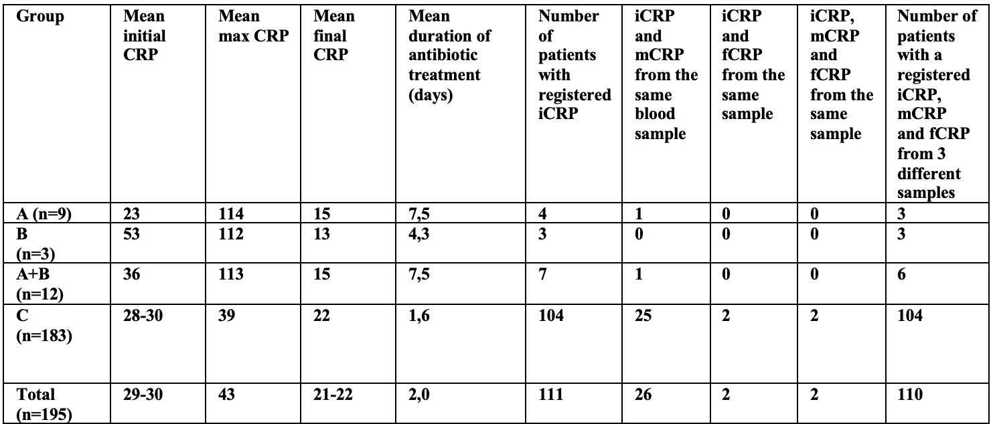
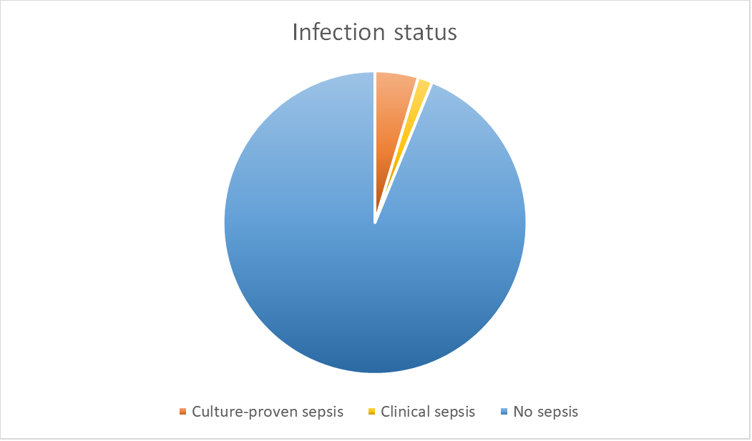
CRP and blood culture in the diagnosis of early onset sepsis in term-born neonates
1.University of Bergen
vsl004@uib.no
2. Department of Pediatrics and Adolescent Medicine, Haukeland University Hospital, Bergen, Norway
D
Vilde Heian Slettevold¹, Hallvard Reigstad, MD², Hans Jørgen Guthe MD, PhD²
BACKGROUND
Early onset sepsis (EOS) is usually defined as severe infection occurring within the first 72 hours of life (1). EOS is an important cause of neonatal morbidity and mortality in a global perspective (2). National Norwegian as well as international guidelines recommend antibiotic treatment in “high risk newborns” who either have pregnancy-related risk factors and/or clinical signs of infection such as respiratory distress, temperature lability, low blood pressure, regurgitation, irritability and poor feeding (3, 4, 5).
We investigated the relationship between CRP-values measured at the initial evaluation of patients with suspected early onset sepsis and culture-proven early onset sepsis.
METHODS
CRP values, blood culture results and other relevant data were collected from patients with a gestational age of 37 weeks or more admitted to the NICU at Haukeland University Hospital with suspected early onset sepsis during a three-year period.
CONCLUSION
This study suggests that CRP alone is not to be used as a diagnostic marker for EOS at the initial evaluation, and that a normal CRP-value at the initial evaluation of a patient with clinical signs of infection does not offer sufficient diagnostic support to withhold antibiotic treatment.
RESULTS Patients were divided into 3 subgroups according to infection status. Group A included patients with culture-proven sepsis (n=9), group B patients with clinical sepsis (n=3), and group C patients with a negative blood culture who did not display symptoms of clinical sepsis (n=183).
For patients who had one or several CRP-measurements taken before antibiotic treatment was initiated (n=111), we registered the last CRP-value before treatment was started as initial CRP (iCRP). The highest CRP-value throughout the treatment course was registered as maximum CRP (mCRP). The final CRP-measurement taken before antibiotic treatment was discontinued was registered as final CRP (fCRP).
By organizing the CRP-values this way, 3 CRP-measurements were recorded, iCRP (n=111), mCRP (n=190) and fCRP(n=188). CRP-values measured at the initial evaluation were not significantly higher in patients with culture-confirmed or clinical sepsis than in non-infected patients. The highest CRP-measurements during the treatment course were significantly higher in patients with culture-proven and/or clinical sepsis than in non-infected patients.
Table 1: Mean CRP and distribution of CRP-measurements by group
REFERENCES
1 JL Wynn, HR Wong, TP Shanley, MJ Bizzarro, L Saiman, RA Polin Time for a neonatal-specific consensus definition for sepsis Pediatr Crit Care Med, 15 (2014), pp. 523-528
2 Stoll BJ, Hansen NI, Sanchez PJ, Faix RG, Poindexter BB, Van Meurs KP, et al. Early onset neonatal sepsis: the burden of group B Streptococcal and E. coli disease continues. Pediatrics. 2011;127(5):817-26.
3 Helsebiblioteket, Pediatriveiledere, Nyfødtmedisin, Infeksjoner, 4.1 Neonatal sepsis:https://www.helsebiblioteket.no/pediatriveiledere?menuitemkeylev1=11574&menuitemkeylev2=12788&key=271194
4 Shane AL, Sanchez PJ, Stoll BJ. Neonatal sepsis. Lancet (London, England). 2017;390(10104):1770-80.
5 Caffrey Osvald E, Prentice P. NICE clinical guideline: antibiotics for the prevention and treatment of early-onset neonatal infection. Archives of disease in childhood Education and practice edition. 2014;99(3):98-100.
Figure 1: Distribution of infection status in the study population

