Slide 1
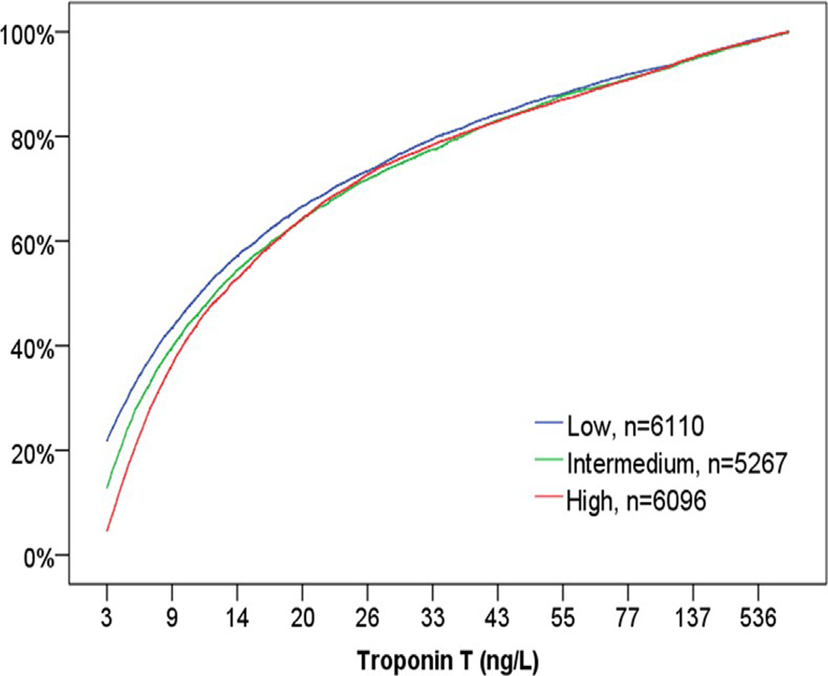
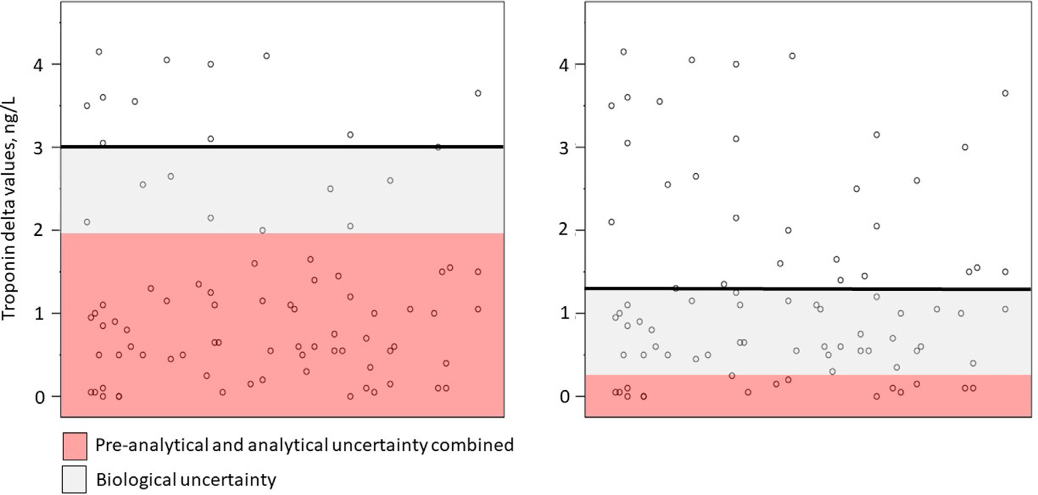
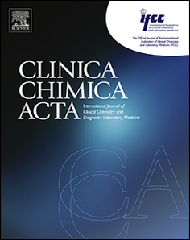
Analytical performance of cardiac troponin assays – Current status and future needs
Nasir Saeed University of Bergen
nah013@uib.no
Kristin M. Aakre^{1, 2, 3}, Nasir Saeed², Alan H.B. Wu⁴, Peter A Kavsak⁵
¹Department of Medical Biochemistry and Pharmacology, Haukeland University Hospital, Bergen, Norway. ²Department of Clinical Science, University of Bergen, Bergen, Norway. ³ Department of Heart Disease, Haukeland University Hospital, Bergen, Norway. ⁴University of California, San Francisco, CA, United States. ⁵Department of Pathology and Molecular Medicine, McMaster University, Hamilton, ON, Canada
Background
The hallmark of cardiomyocyte (myocardial) injury is the release of cardiac-specific troponin T and troponin I proteins into the systemic circulation
In the past decade a high-sensitivity cardiac troponin (hs-cTn) assay has been developed to detect very low concentrations of cardiac troponins
With the implementation of hs-cTn into the diagnostic definition of myocardial infarction (MI), clinicians and laboratory professionals signaled a clear clinical need for improved analytical quality in order to correctly classify patients with MI
This review summarizes the general recommendation for defining analytical performance of the cardiac troponin assay
Definition of a high-sensitivity cardiac troponin assay
Should measure quantitative concentrations in at least 50% of the healthy population
Show 10% “guideline acceptable” analytical variation (CVA) at the 99th percentile of the assay
Analytical performance
1. Analytical variation (CV_{A}): function of analytical performance
Pre-analytical variation
Analytical variation
Post-analytical variation
2. Biological variation
Intra-individual biological variation (CV_{I})
Inter-individual biological variation (CV_{G})
Reference Change Value (RCV) is a combination of the above = CV_{A} + CV_{I}
Fig. 1. Cumulative percentages of troponin results obtained from the Emergency Department (ED) at Haukeland University Hospital using three different reagent lots. The median concentrations of results in the low range (≤20 ng/L) were 5.53 ng/L (low lot), 6.52 ng/l (intermedium lot) and 7.60 (high lot). Lot variation mainly affected low concentrations as percentage below 5 ng/L (LoD) ranged from 18% to 31% while percentage below 52 ng/L (cut off for rule-in) ranged from 86% to 88%.
Fig. 2. This figure models how pre-analytical, analytical and biological uncertainty influence the magnitude of detectable troponin deltas. Both panels show the same distribution of 88 different troponin delta values. The gray area denotes the within-subject biological variation, i.e. physiological variations around a homeostatic set point, which are similar regardless of analytical perfomance. The red area shows the combined pre-analytical and analytical uncertainty and the horizontal line represent the reference change value above which a delta value may be measured with a certain level of confidence. In this particular example the percentage of delta values above the limit improves from 13% (panel on left side) to 32% (panel on right side) when the pre-analytical and analytical uncertainty is reduced. All numbers are examples. (For interpretation of the references to colour in this figure legend, the reader is referred to the web version of this article.)
Conclusions
The analytical performance of hs-cTn assays should be based on the clinical use of the test and different performance specifications (PS) are necessary for diagnosis of non-ST-elevation MI (NSTEMI) and chronic myocardial injury. PS for NSTEMI may be based on clinical outcome studies, and current data show that the performance for most assays are sufficient for early and rapid identification of NSTEMI. The efficiency of the protocols, the number of non-coronary chest pain patients eligible for rule-out, is affected by even slight biases in calibrator and reagent lots. When hs-cTn assays are used for risk estimation, long-term biological variation data is most useful for determining the analytical performance needed. A further improvement in analytical performance of the troponin assays may open new opportunities for improved efficiency in the ED, better risk estimation and long-term monitoring of chronic myocardial injury, with significant research possibilities in various populations.
This review has been published in Clinica Chimica Acta 509 (2020) 149-155
Disclosures
Dr Aakre has received honorarium from Roche Diagnostics and Siemens Healthcare Diagnostics. Mr Saeed has no disclosures. Dr Wu received grants/reagents/consultant/advisor/ honoraria from Abbott, Siemens, Roche, ET Healthcare, and Konica Minolta. UCSF has a patent with DR. Wu on high sensitivity troponin assays. Dr. Kavsak has received grants/reagents/consultant/advisor/ honoraria from several diagnostic companies who manufacture cardiac troponin assays, including Abbott Laboratories, Abbott Point of Care, Beckman Coulter, Ortho Clinical Diagnostics, Randox Laboratories, Roche Diagnostics and Siemens Healthcare Diagnostics. McMaster University has filed patents with Dr. Kavsak listed as an inventor in the acute cardiovascular biomarker field.
Notes:
150 dpi minimum

