Slide 1
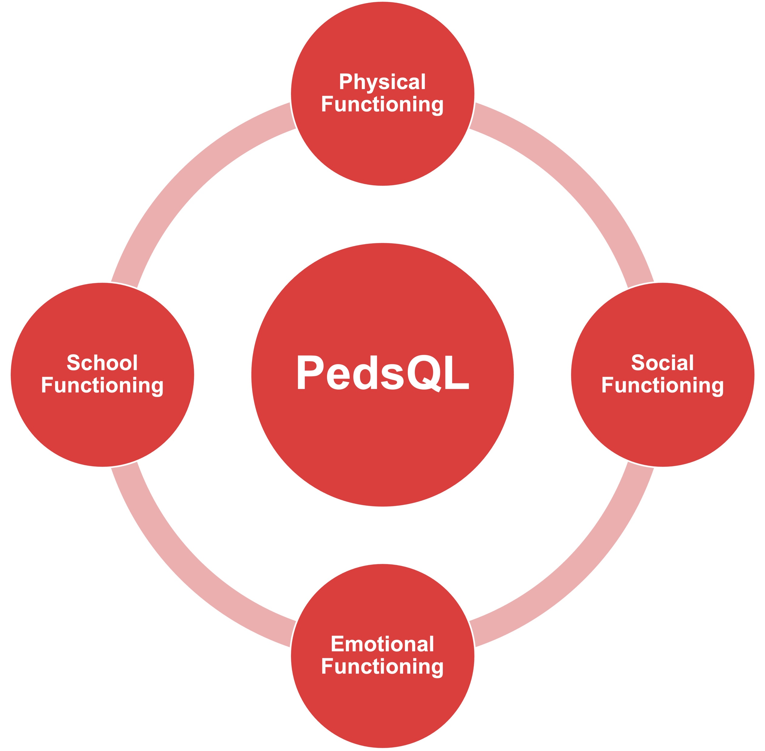
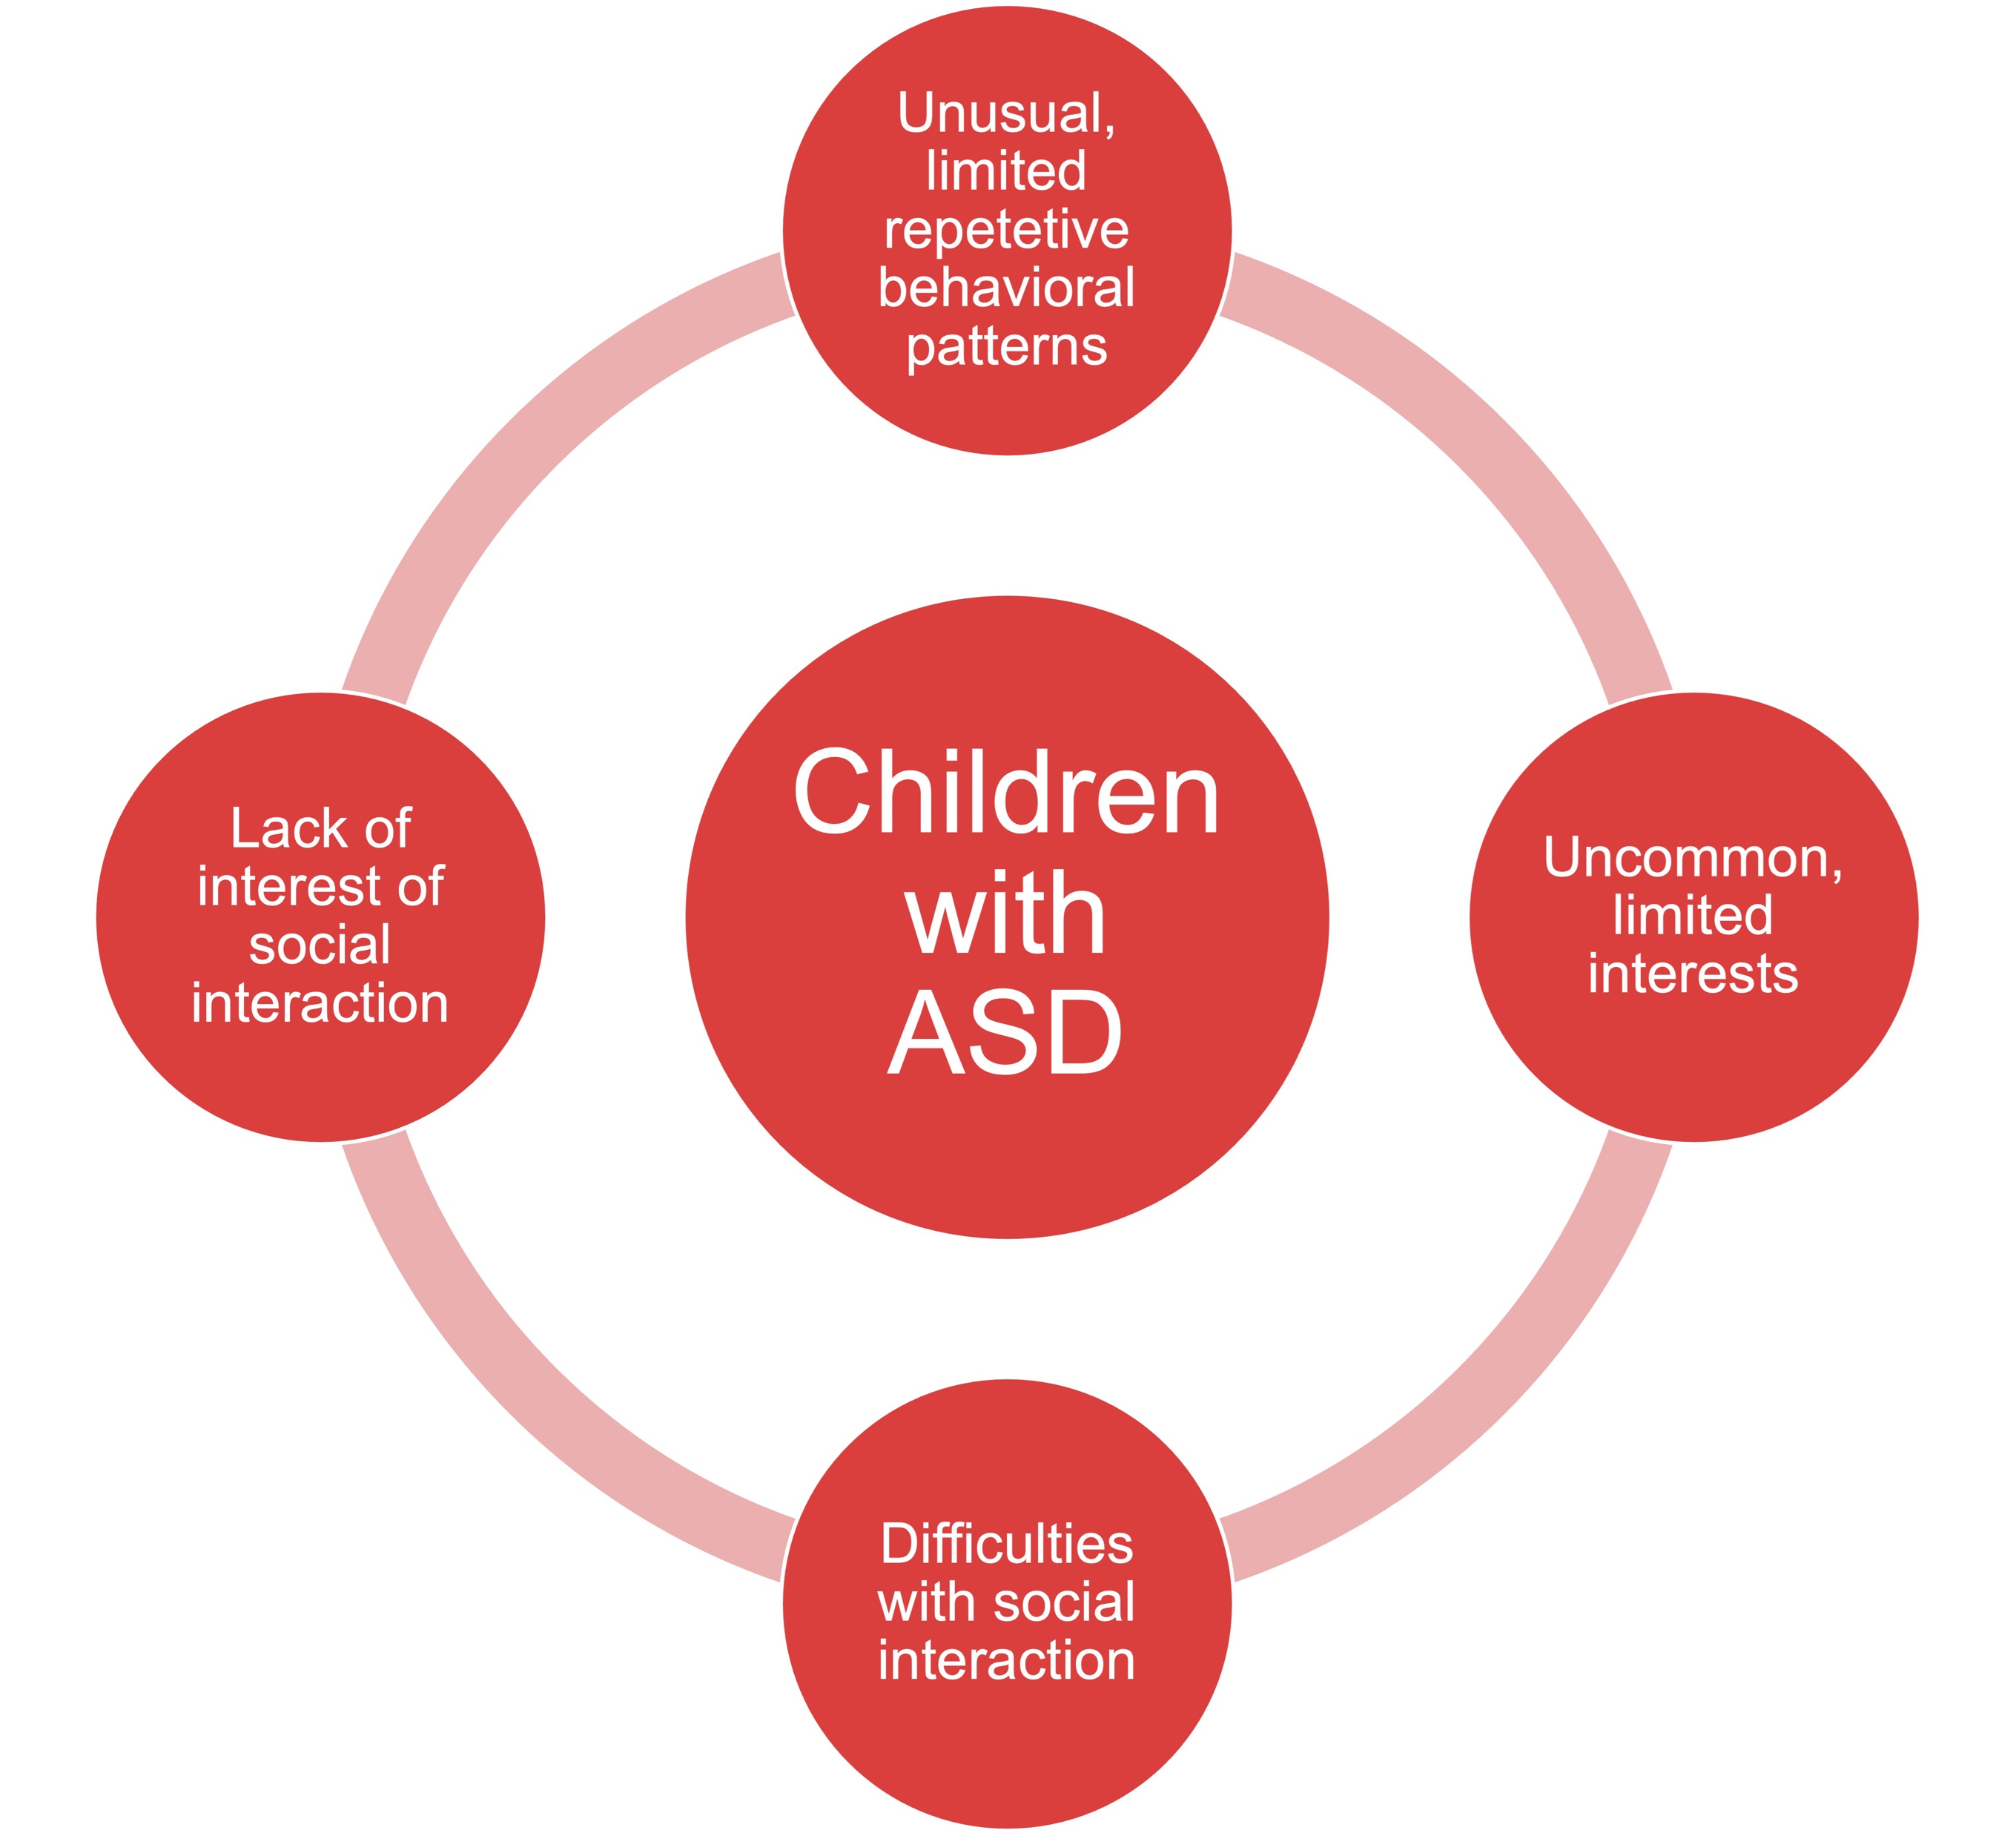
Quality of Life in children with Autism Spectrum Disorder
QoL studies gives insight in a patient's general happiness and daily function. This is used to determine symptom burden and effect of treatment. Autistic childrens’ QoL is measured using the same tools as typically developing children. This study argues that this is illogical.
Ingrid Rønning University of Bergen
yef008@uib.no
ABSTRACT
Autistic children is a heterogenous group of children, whose common denominator is neurological developmental disturbances with three core symptoms; lack of interest of, and difficulties with social interaction, unusual, limited, repetitive behavioral patterns and uncommon, limited interests.
Quality of life is an important measurement in children because they have many compounded needs, which are easily forgotten as they become patients. It also makes it possible to objectively trace their QoL for a longer period of time.
Autistic childrens’ QoL is measured in the same way as typically developing children even though the two groups have different challenges, needs and priorities.
This study identifies which QoL scales that are used, what these scales measure, and examines the content validity of their elements.
What is Quality of Life?
The World Health Organization defines QoL as “an individual’s perception of their position in life in the context of the culture and value systems in which they live and in relation to their goals, expectations, standards and concerns”.
Quality of Life is highly subjective, and one must therefore at least be willing to tailor the questionnaire to the patient group.
Method The quality of life scales was found searching PubMed for articles regarding QoL and autistic children. Articles regarding their siblings and parents were eliminated from the study, as were all articles unavailable in English.
Conclusion If we are to continue doing research on QoL in autistic children, we must develop a new questionnaire. Use of questionnaires made for typically developing children, on autistic children, testifies to a lack of understanding of what makes a child autistic. This results in misconceptions about their happiness and illogical conclusions.
The most used QoL questionnaire vs. the ASD core symptoms
ACKNOWLEDGEMENTS
A thousand thank yous to Maj Britt Rocio Posserud for all the help and inspiration

