Slide 1
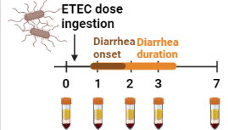
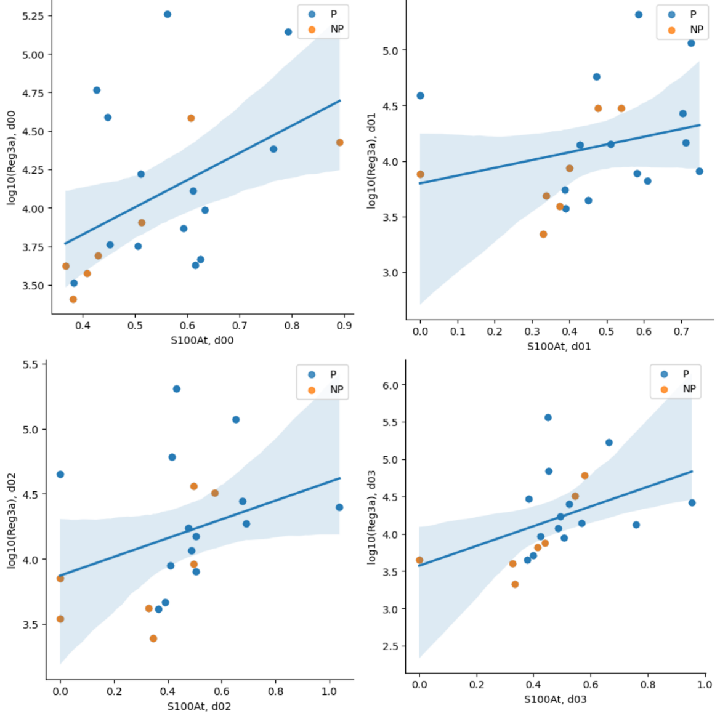
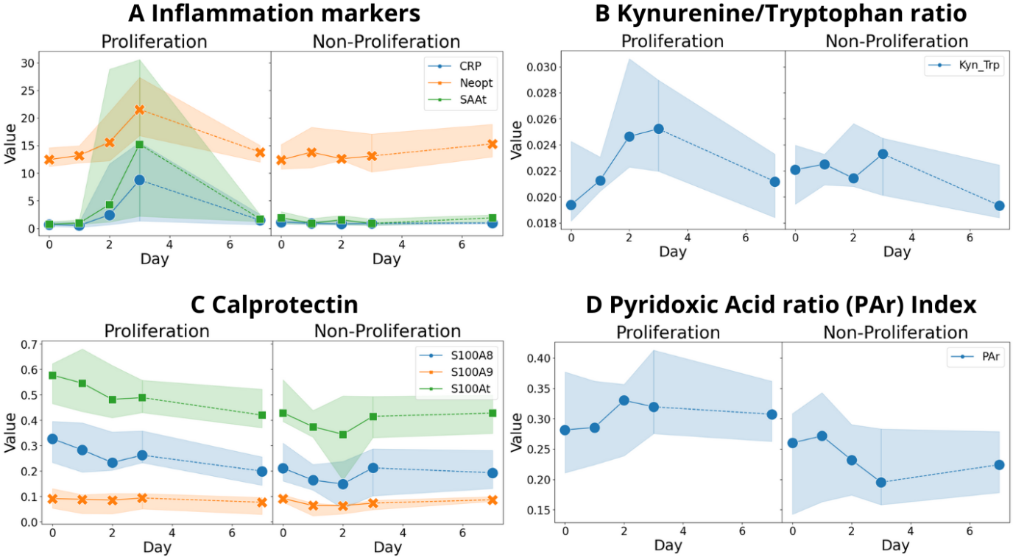
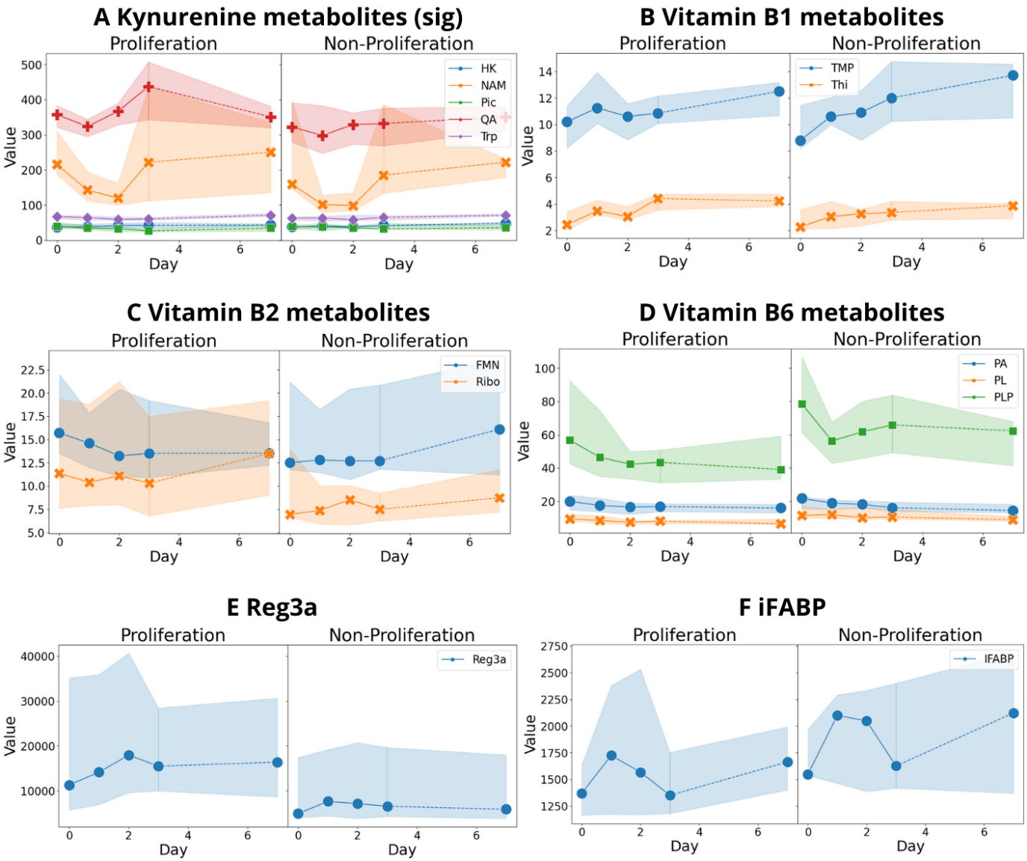

Plasma markers of inflammation and kynurenine and vitamin B metabolites during human experimental enterotoxigenic Escherichia coli infection
Sehee Rim¹, Oda Barth Vedøy¹, Ingeborg Brønstad¹, Hans Steinsland^{2,3}, Kurt Hanevik^{1,4}
1 Department of Clinical Science, Faculty of Medicine, University of Bergen, Bergen, Norway; 2 Centre for Intervention Science in Maternal and Child Health, Centre for International Health, Department of Global Health and Primary Care, University of Bergen, Bergen, Norway; 3 Department of Biomedicine, University of Bergen, Bergen, Norway; 4 Norwegian National Advisory Unit on Tropical Infectious Diseases, Department of Medicine, Haukeland University Hospital, Bergen, Norway
Background
Enterotoxigenic Escherichia coli (ETEC)
Important cause of children’s and travelers’ diarrhea with no licensed vaccine
High prevalence in low- and middle-income countries
Main goal
Explore how ETEC affects host defenses by analyzing plasma markers of inflammation and mucosal injury and metabolites of kynurenine pathway and vitamin B during experimental ETEC infection
Method
Plasma samples, 21 volunteers
Before and day 1, 2, 3, 7 after dose ingestion
27 markers quantified with mass spectrometry platforms at BeVital and ELISA assays
Volunteers grouped into the proliferation group and non-proliferation group depending on the max ETEC colonization levels, cut-off set at 0.99%
Key takeaways
1 Non-invasive ETEC-infection induces:
Inflammation
Mucosal injury
Reduced vitamin B6
Perturbation in kynurenine pathway
2 Several metabolites with immunological and antibacterial functions altered in the group with substantial ETEC colonization
3 These findings will improve our understanding of:
host defenses against ETEC
Long-term negative health outcomes after ETEC-infection
Result
Proliferation group (N=14)
Inflammation markers
↑ CRP, serum amyloid A (SAA), neopterin, kynurenine/tryptophan, Reg3a
↓ Calprotectin, higher in the proliferation group
Vitamin B6 metabolites
↓ Pyridoxal 5'-phosphate (PLP) and pyridoxal (PL)
Most peaks reached on day 3
Non-proliferation group (N=7)
Higher calprotectin
Higher vitamin B6 metabolites (PL, PLP)
Correlations
CRP, SAA correlated with max colonization levels
Calprotectin correlated with Reg3a
Several kynurenine metabolites correlated with inflammation markers

