Slide 1
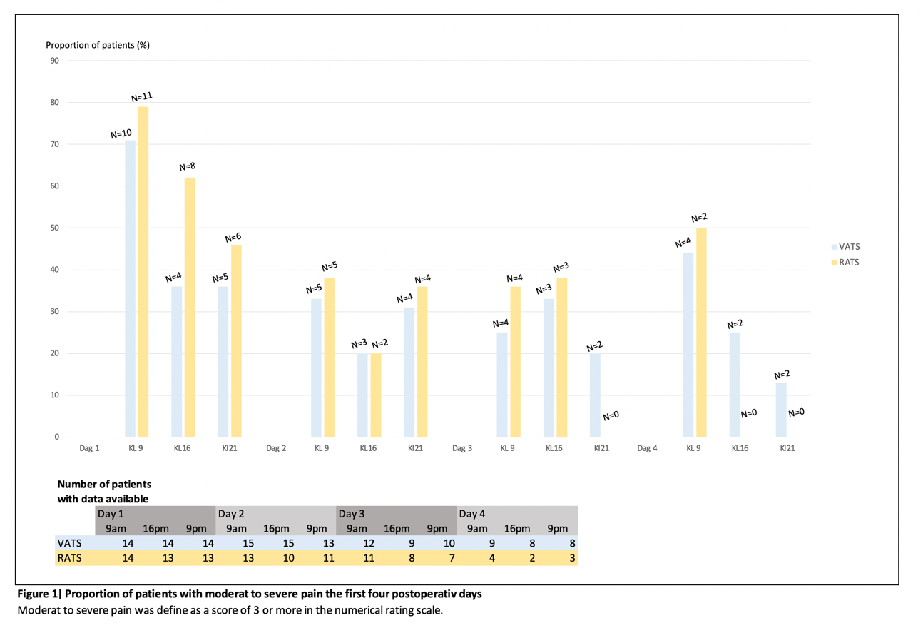
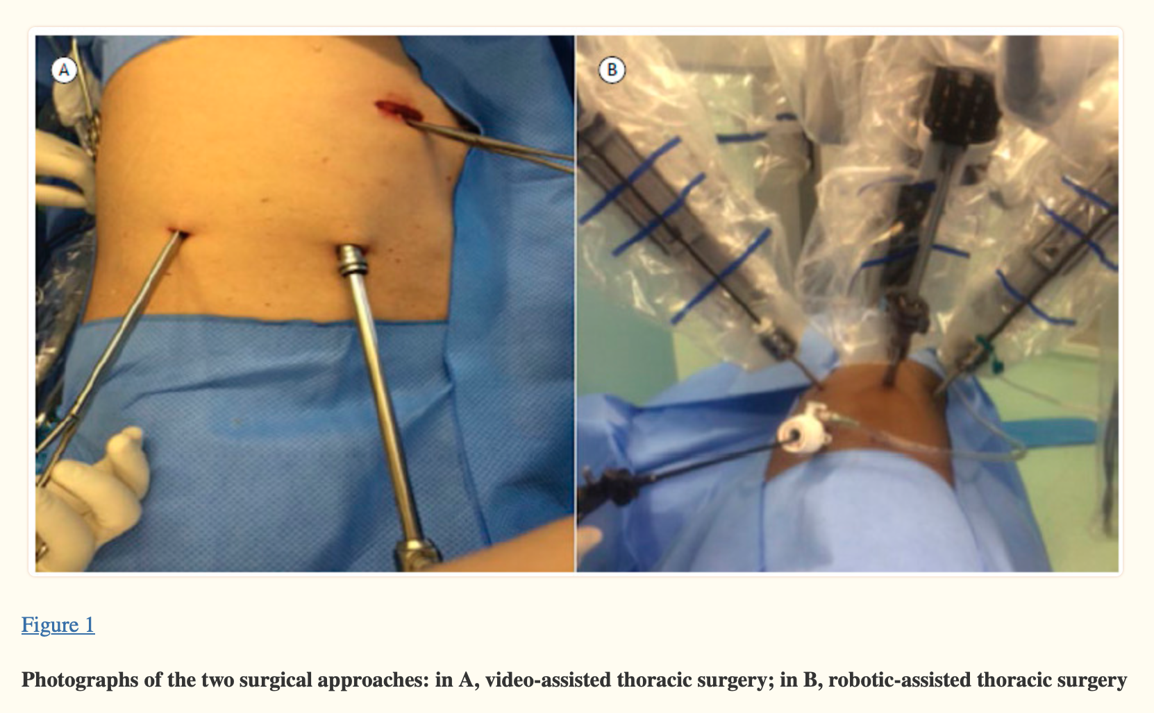
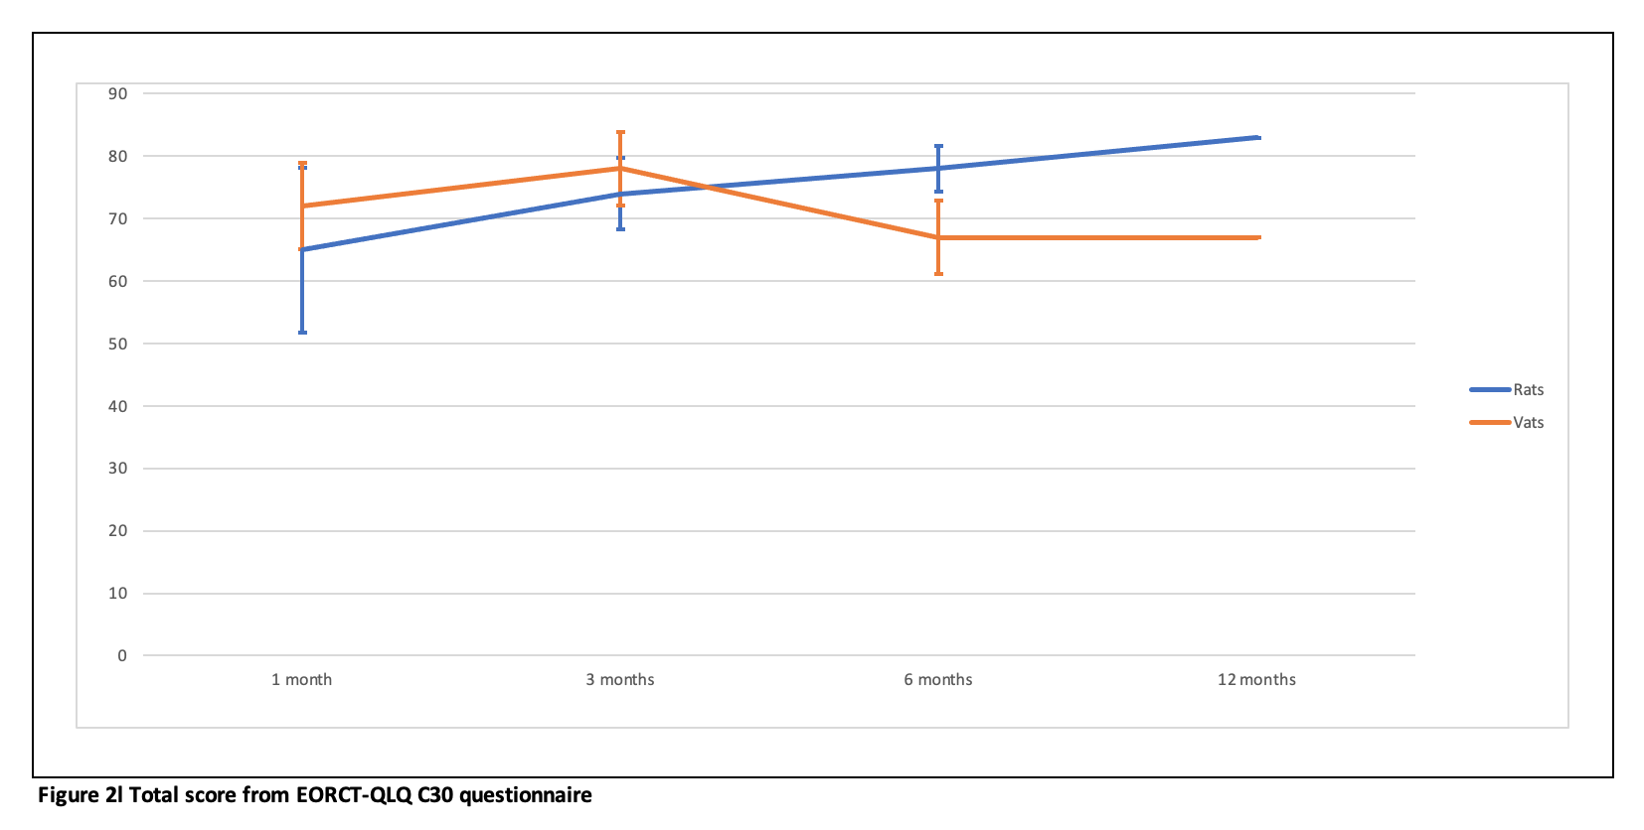
Comparing VATS and RATS for NSCLC Treatment
Randomized study on the use of video-assisted and robot-assisted thoracoscopic surgery for lung cancer
Pettersen E.H, Moeschinger A.T, Salminen P, Hjelmeland B, Haaverstad R
Background
VATS and RATS has come as an alternative to open thoracotomy for early NSCLC. VATS has advantages over open thoracotomy, while RATS offers better visual fields. We aimed to compare the outcomes, surgical radicality, and quality of life between VATS and RATS.
Methods We conducted a double-blinded, randomized trail on patients with clinical stage I-IIA non-small cell lunge cancer. Data was collected preoperatively, perioperatively, and postoperatively. 30 patients are so far included in the trail.
Results
Operating time and surgical equipment costs were significantly higher in the RATS group. The RATS group showed a significantly improved overall quality of life six months postoperatively, but also reported higher pain medication use one month postoperatively. No significant difference were found for postoperative pain, lymph node dissection, and tumor upstaging.
Conclution The study suggests that VATS and RATS are equally safe for treating NSCLC. RATS had a longer operating time and higher costs, but patients had somewhat higher quality of life six months postoperatively. The study requires further investigations due to the small sample size.
Objective
The primary aim was to evaluate the assessment of lymph node dissection and eventual upstaging, postoperative pain, and long-term quality of life.
The secondary objective was to examine the rates of perioperative complications, including conversions to thoracotomy, drainage time, as well as postoperative hospital stay, operations costs, and duration of surgery.

