Slide 1
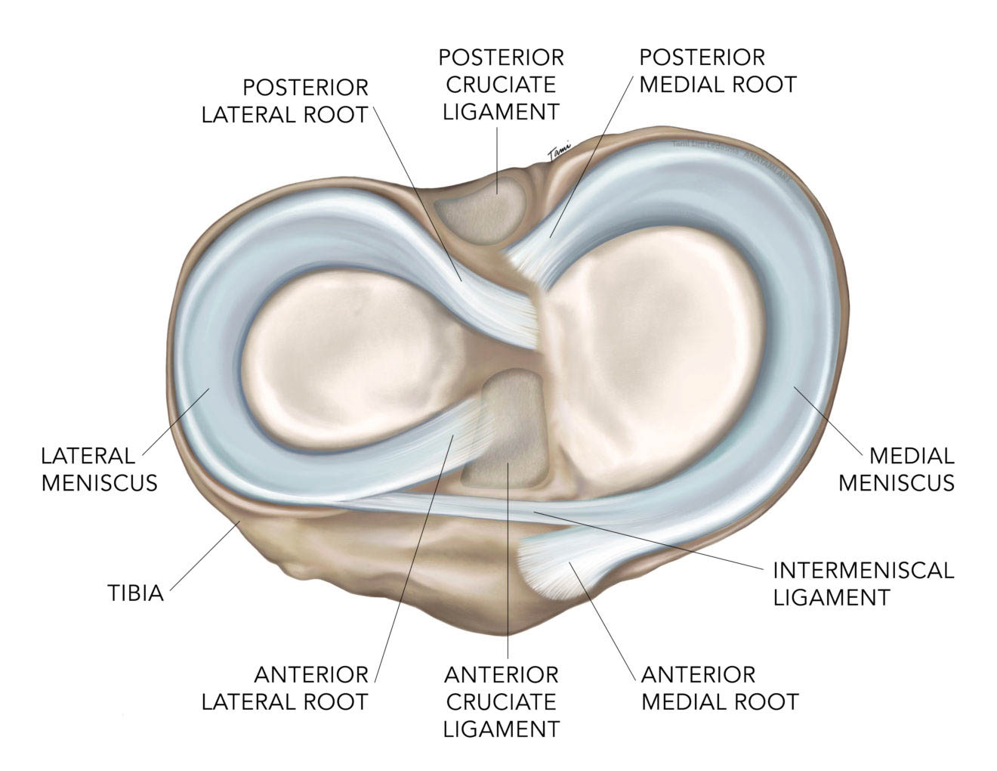
Is there a difference between degenerative and traumatic
medial meniscal posterior root tears?
A review of current literature
Kristine Mundal University of Bergen
kristine.mundal@gmail.com
A review of current literature
ABSTRACT
Background: The meniscal roots are responsible for the stability of the menisci and support even distribution of forces at the articular cartilage across the knee joint. An injury to the meniscal root can lead to meniscal extrusion and progression of development of osteoarthritis. A medial meniscal posterior root tear (MMPRT) is often thought to have a degenerative pathogenesis. Common risks include female gender, higher age, obesity, and varus alignment. The current literature focuses mostly on these injuries, but there is mention of cases where the patients have a solely a traumatic injury.
Purpose/hypothesis: Our hypothesis is that patients with a traumatic origin, are different from the patients with a mainly degenerative origin.
Study design: Systematic review; Level of evidence, 5
Methods: In this systematic review, we reviewed 660 articles from a database, using the MESH-term “meniscal root tear”. Further we pooled MMPRT-patients with a traumatic injury mechanism from these articles, to compare demographic details, injury mechanisms and concomitant injuries with other articles concerning MMPRT.
Results: A total of 113 patients were included in this review. The study population had a lower mean age (27.1) and a higher share of men (64%) than most reports on MMPRTs. Also, this review, shows how most patients with a traumatic MMPRTs also suffer from concomitant injuries (68%).
Conclusion: The findings support our hypothesis that traumatic MMPRTs differ from the MMPRTs with a degenerative origin. These patients don’t have the risk factors for MMPRT found in current literature and is probably more like the LMPRT injury group. These findings might help clinicians to distinguish which MMPRT-patients that are good candidates for surgical treatment.
.
Figure 1: Flow chart for inclusion of data for review
Key numbers:
Number of patients: 113
Female – 19%
Male – 64%
Mean age – 27.1
Main injury mechanism: Sporting events
Concomitant injuries - 68%
Isolated MMPRT – 26%
Most common concomitant injury – Ligament injuries, including ACL and/or PCL
Reading title, abstract, methods and patient demographics
87
Reading full text and reference lists
83
Exclusion after answer from corresponding authors and evaluation of exclusion criteria
25
Search in database: Web of Science
660
Final result:
113 patients
25 articles
573 excluded
5 excluded
1 included
58 excluded
Table 2: Distribution of Schenck classification and other concomitant injuries across trauma groups¹
Injury mechanism | High energy/trauma injury | Sports trauma | Fall injury | Various trauma | Unknown trauma | Total
Concomitant injuries
KD1 | 4 | 27 | 4 | 3 | 4 | 42
KD2 | 0 | 0 | 0 | 0 | 1 | 1
KD3 | 5 | 5 | 1 | 0 | 3 | 14
KD4 | 0 | 0 | 0 | 0 | 7 | 7
KD5 | 1 | 1 | 0 | 0 | 8 | 10
Other concomitant injuries* | 0 | 9 | 1 | 3 | 0 | 13
No concomitant injuries | 0 | 18 | 3 | 8 | 0 | 29
Unknown | 0 | 5 | 0 | 1 | 1 | 7
Inclusion
Traumatic origin
Detailed patient demographics
Exclusion
Signs of osteoarthritis (OA)
Kellgren-Lawrence > 1
Outerbridge > 2
.
*Other concomitant injuries included injuries such as fractures, LMPRT and chondral lesions.
References:
1. Goebel CP, Domes C. Classifications in Brief: The Schenck Classification of Knee Dislocations. Clin Orthop Relat Res. 2020;478(6):1368-1372. doi:10.1097/CORR.0000000000001186

