Slide 1
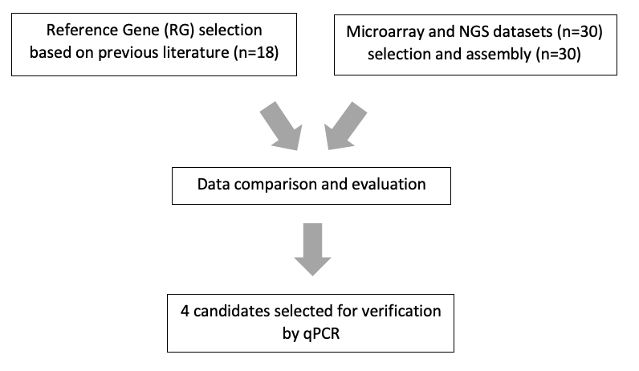
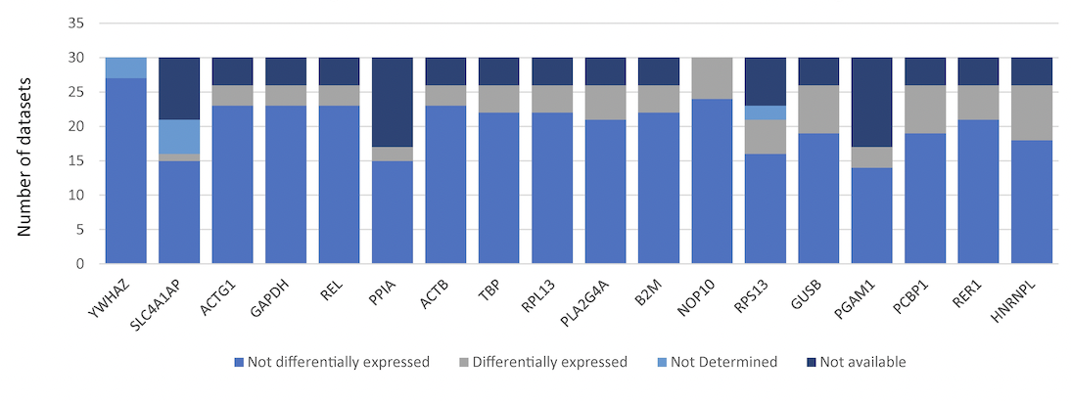
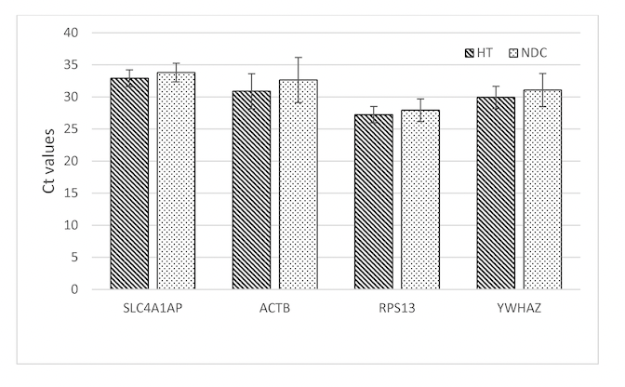
Variable expression of housekeeping genes
Philipp Strauss, Håvard Mikkelsen and Jessica Furriol
Håvard Mikkelsen University of Bergen
hmi008@uib.no
Introduction
Housekeeping genes, or reference genes (RGs) are widely used to normalize qPCR data. A variety of studies indicate that the expression of several traditional RGs shows considerable variability. [1-3].
We selected eighteen commonly used RGs, screened them in 30 expression datasets and selected 4 to validate by qPCR in non-cancerous kidney biopsies cohort with the aim to identify RGs appropriate for the normalization of RNA data from human non-cancerous kidney samples.
Conclusion
In non-cancerous kidney biopsies, we propose that expression of YWHAZ as a stable single gene or the combination of YWHAZ and SLC4A1AP genes might be of particular interest for normalization purposes, especially in qPCR experiments.
REFERENCES
Caracausi M, Piovesan A, Antonaros F, Strippoli P, Vitale L, Pelleri MC. Systematic identification of human housekeeping genes possibly useful as references in gene expression studies. Molecular medicine reports. 2017;16(3):2397-410.
Wang Z, Lyu Z, Pan L, Zeng G, Randhawa P. Defining housekeeping genes suitable for RNA-seq analysis of the human allograft kidney biopsy tissue. BMC medical genomics. 2019;12(1):86.
Jung M, Ramankulov A, Roigas J, Johannsen M, Ringsdorf M, Kristiansen G, et al. In search of suitable reference genes for gene expression studies of human renal cell carcinoma by real-time PCR. BMC molecular biology. 2007;8:47.

