Slide 1
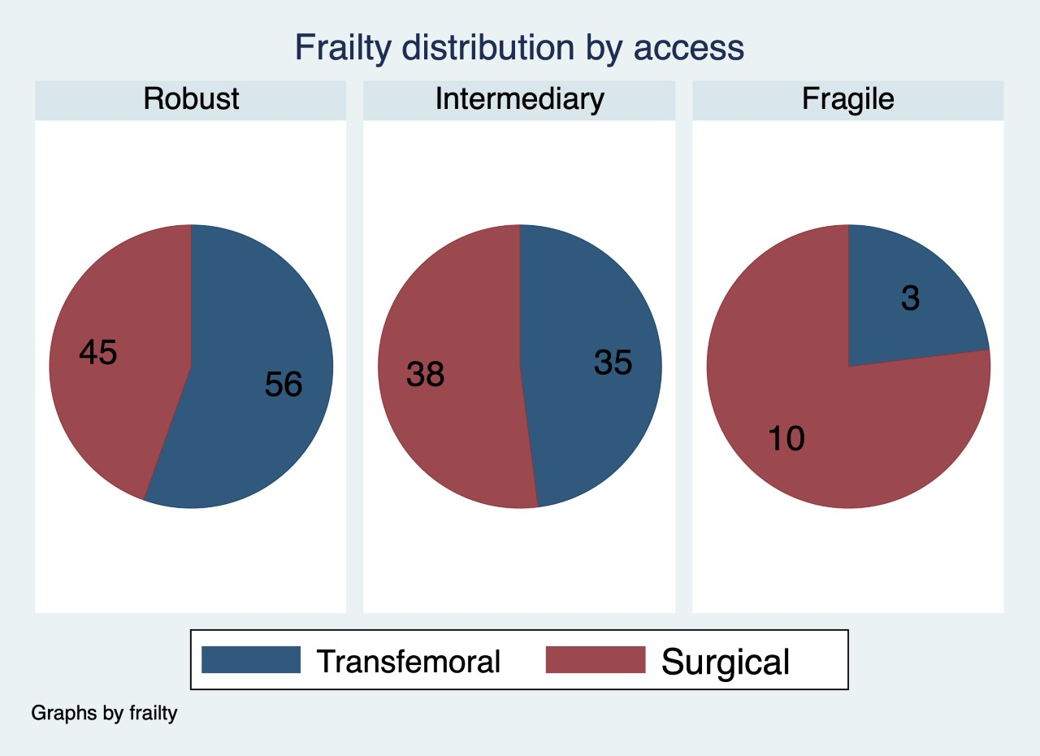
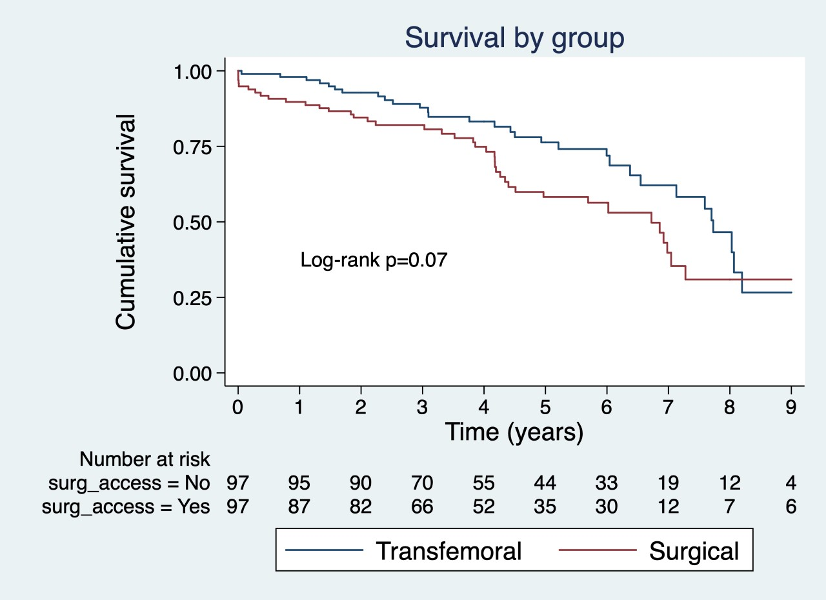
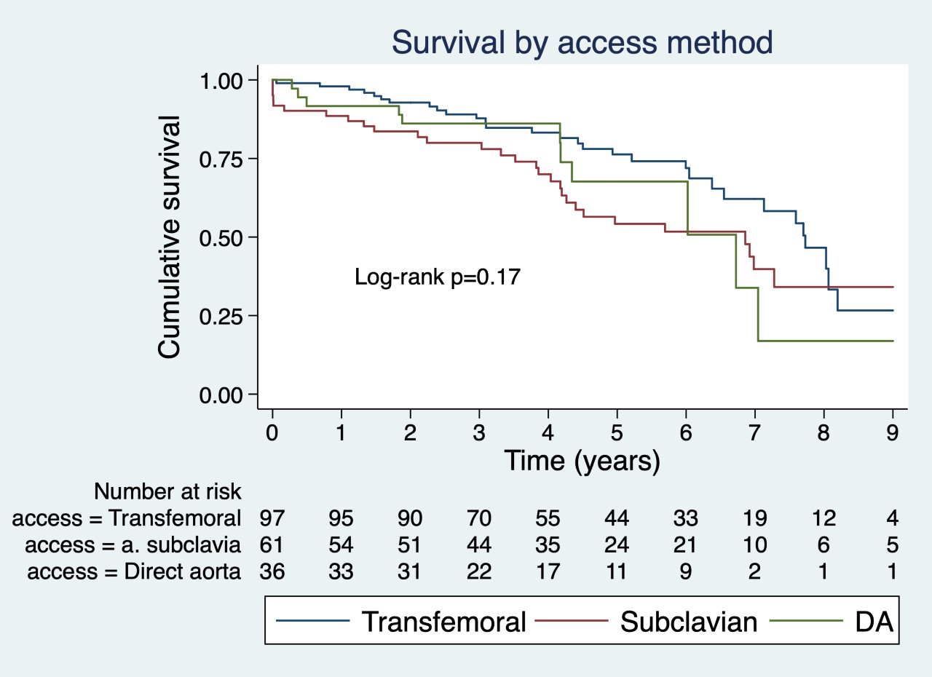
Mortality not increased in TAVI with surgical access
Hanne Knappskog¹, Svein Rotevatn^{2,3}, Kjetil H. Løland^{2,3}, Rune Haaverstad^{1,4}, Vegard S. Ellensen⁴ ¹ Faculty of Medicine, University of Bergen, Norway ² Section of Invasive Cardiology, Dept. of Heart Disease, Haukeland University Hospital, Norway
³ Norwegian Registry of Invasive Cardiology ⁴ Section of Cardiothoracic Surgery, Dept. of Heart Disease, Haukeland University Hospital, Norway
hanne.knappskog@student.uib.no
Background and aim
TAVI is increasingly used to treat severe aortic stenosis. Transfemoral approach is dominant, but some patients are unsuitable.
Surgical access using the left subclavian artery or a direct aorta (DA) strategy are established alternatives in a hybrid approach after multi-disciplinary team (MDT) discussion.
Methods and material A total of 194 patients were included divided in two groups. 97 TAVI-procedures with surgical approach from 2013-2020 and a control group of 97 age-, sex- and procedural year matched transfemoral patients. Minimum follow-up was one year.
Data was retrieved from the national Norwegian Registry of Invasive Cardiology (NORIC) and survival data from the Norwegian National Population Register.
Results Surgical patients had higher incidence of preoperative atrial fibrillation (p=.01), smoking (p<.01), COPD (p=.05) and a tendency of increased frailty. Surgical patients had increased occurrence of postoperative bleeding (p<.01).
Mortality was not increased in the surgical group compared to the transfemoral (p=.07).
There was no difference in survival between subclavian and direct aortic access.
Conclusions For selected TAVI patients with severe iliofemoral vascular disease, surgical access proves to be a good alternative after careful MDT evaluation.
Long-term mortality was similar in both groups, but surgical access was associated with an increased frequency of perioperative complications.
This alternative provides causal treatment for patients with a considerable comorbid burden, otherwise treated palliatively.
The aim of the study was to investigate morbidity and mortality after TAVI with surgical access compared to transfemoral access.

