Slide 1
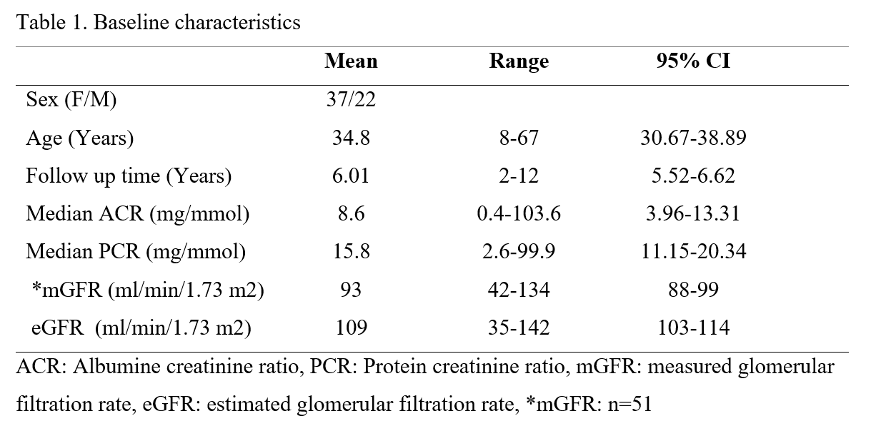
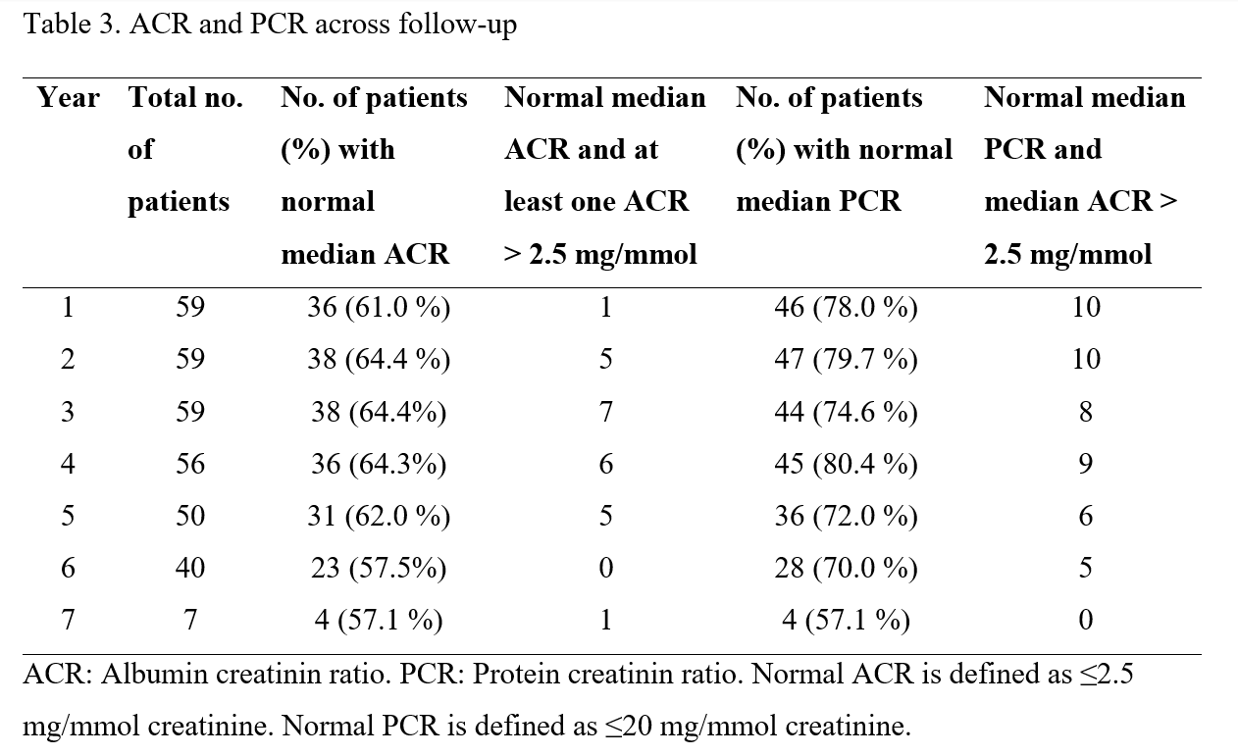
Clinical impact of median urine albumin creatinine ratio in the evaluation of early nephropathy
A study evaluating the methodological importance of three-morning urine samples to assess albuminuria and proteinuria. José Haugen Kadio¹ , Camilla Tøndel² , Einar Svarstad³, Rannveig Skrunes⁴
José Haugen Kadio University of Bergen
jka017@uib.no
Background:
Urine Albumin-Creatinine Ratio (ACR) and Protein-Creatinine Ratio (PCR) are diagnostic measurements used to monitor the progression of chronic kidney disease (CKD). Fabry disease is an X-linked lysosomal storage disease where monitoring of low-range albuminuria may have significant importance in clinical care and evaluation of different treatment modalities. Purpose:
To evaluate the impact of using the median of three-morning urine samples versus one single morning urine sample in assessing albuminuria and proteinuria. Study design:
Methodological Retrospective Cohort Study
Methods:
59 patients with Fabry disease were included in the study based on follow up over time with minimum three urine triplets analysed for albuminuria and proteinuria in the time period 2009 to 2023. A total of 330 triplets, each consisting of three morning void urine samples, i.e 990 urin samples analysed with ACR- and PCR at Haukeland University Hospital made the data set with normal range cut-off for ACR and PCR of ≤2,5 mg/mmol creatinine and ≤20 mg/mmol creatinine, respectively. Results:
Median ACR was ≤2.5 mg/mmolcreatinine in 206 of 330 cases. In the normal 206 urine triplets, 25 sets (12.1 %) contained one sample with an ACR>2.5 mg/mmol creatinine. Median PCR was ≤20 mg/mmolcreatinine in 250 cases, and in 48 (19.2%) cases with a normal median PCR, the median ACR was> 2.5 mg/mmol creatinine.
Conclusion:
Basing albuminuria measurement only on one pathological morning urine sample may lead to false positive results for ACR. Median ACR is a more sensitive and specific marker for early nephropathy than median PCR.
:
Figure 1. Median ACR mg/mmol creatinine during follow-up. High is defined as a median ACR of > 2.5 mg/mmol creatinine. Normal is defined as a median ACR of ≤2.5 mg/mmol creatinine.
.

