Slide 1
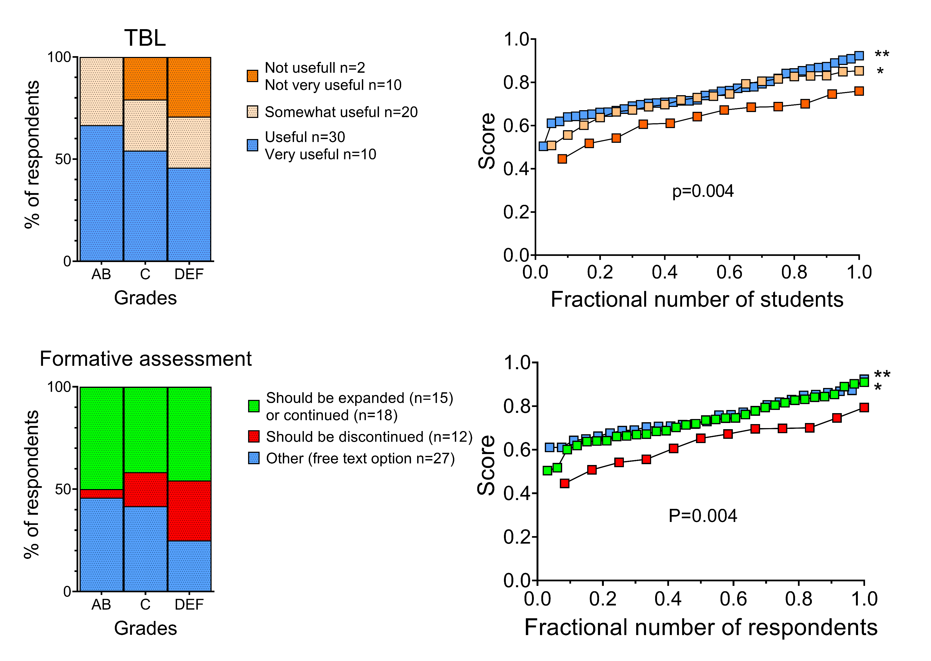
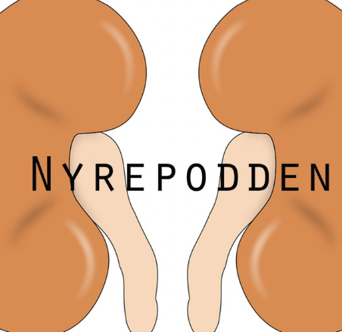
How do medical students best learn renal physiology?
Sigrid Hovdenakk University of Bergen sigrid.hovdenakk@student.uib.no
Sofie Fagervoll Heltne
University of Bergen sofie.heltne@student.uib.no
A quantitative study of the relationship between perceived learning outcomes, time spent on various learning resources and exam results.
Background: Medical students are under pressure to acquire knowledge and skills in many fields, which means they need to prioritize their time and study effort wisely. Renal physiology is a particular important subject due to the increasing number of patients with chronic renal diseases and decreasing recruitment to nephrology fellowship positions. The relationship between amount of time invested in studying, students’ usefulness ranking of different learning resources and academic performance is meagerly investigated which motivated us to perform the present study.
Methods: We designed a survey for a cross-sectional study including 207 medical students from the University of Bergen, Norway. We asked about preference in learning resources, time spent learning renal physiology, the impact of podcast as a learning tool, factors important for learning and the difficulty of renal physiology compared to other topics and correlated the responses with academic performance.
ABSTRACT
Results: The response rate in the study was 38% (n=72). The overall most popular instructional material were asynchronous videos with 96% of the responders rating it as “somewhat useful”, “useful” or very “useful”. 92% of high-performers and middle-performers and 83% of low-performers reported renal physiology lab as very useful or useful. The corresponding ratings for Team Based Learning (TBL) were 90% and 71%, interactive lessons 79% and 54%, renal podcast 75% and 88%, other online resources 60% and 75% and textbook 52% and 21% respectively. The students who reported TBL as very useful or useful or had a positive attitude to formative assessment performed better on summative assessment (p=0,004). Academic performance did not correlate with time students spent preparing for tuition (p=0,66).
Conclusion/ Take home message:
Students in favor of active teaching methods were rewarded by better academic performance.
We did not see any significant correlation between time spent preparing for teaching and exam score.
The use of textbook was not rewarded by higher exam scores and was the least popular learning resource.
Podcast was popular within all grade groups and recommended as a learning resource for more topics than currently available.

