Slide 1
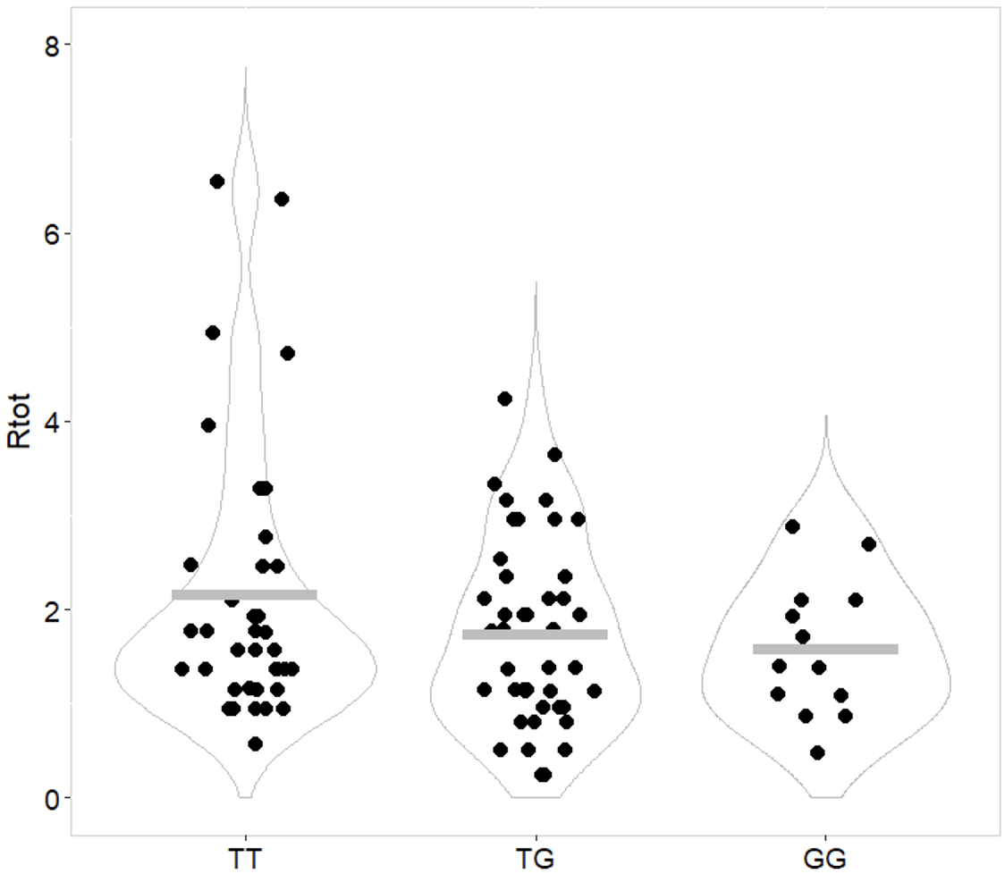
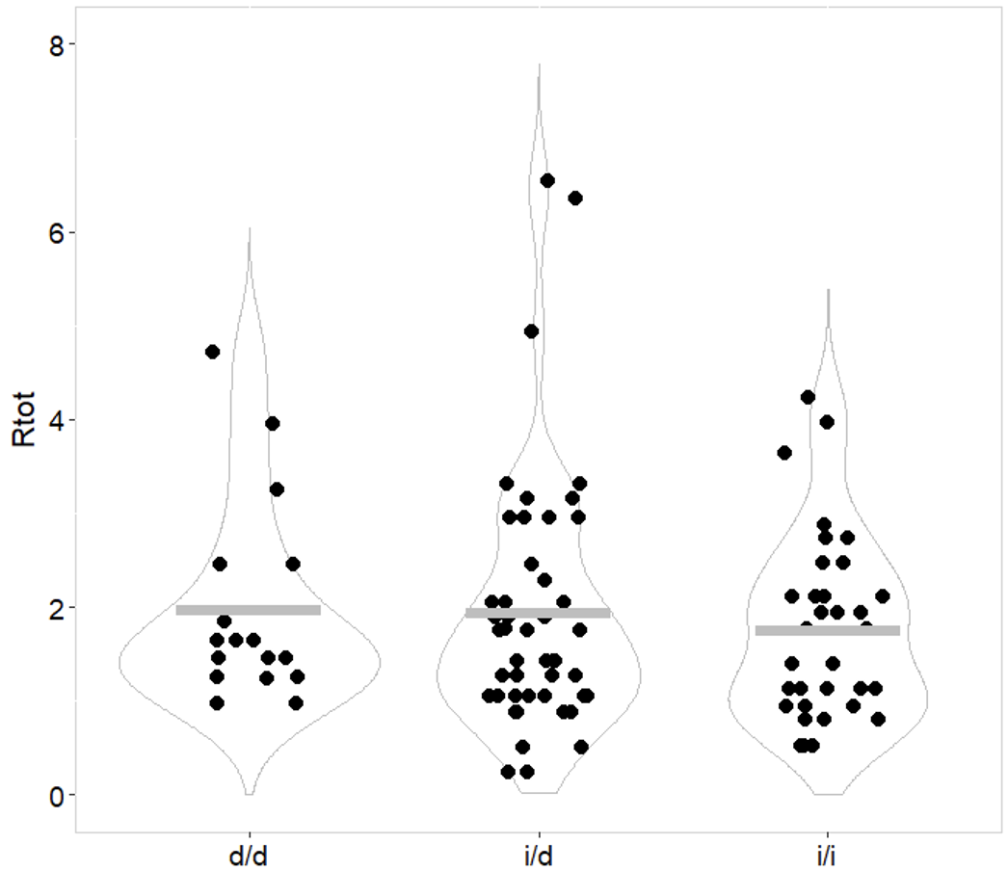
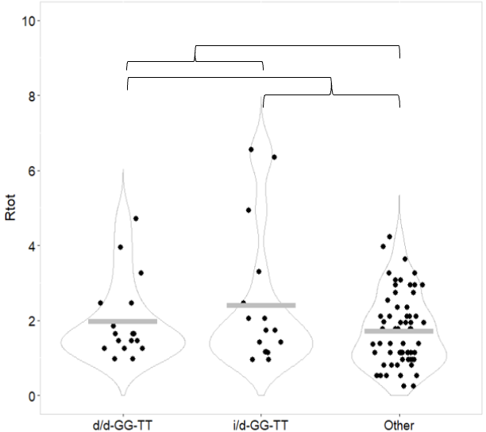
MDM2-polymorphisms and bone marrow recovery in breast cancer patients during neoadjuvant chemotherapy
Nora D. Hatletvedt^{1,2}, Christina Engebrethsen^{1,2,}, Per E. Lønning^{1,2}, Hans P. Eikesdal^{1,2}, Liv B. Gansmo^{1,2}, Stian Knappskog^{1,2}
¹K.G. Jebsen Center for Genome Directed Cancer Therapy, Department of Clinical Science, University of Bergen, Bergen, Norway. ²Department of Oncology, Haukeland University Hospital, Bergen, Norway.
Background
Figure 2: Chemotherapy schedule and blood sampling. Patients received neoadjuvant chemotherapy with four cycles of epirubicin (orange boxes) followed by four cycles of docetaxel (blue boxes). Blood samples (red drops) were drawn prior to each chemotherapy cycle. The ratio of neutrophile cell count and total leukocyte cell count during epirubicin treatment was calculated as the ratio of values from blood sample 5 divided by values from blood sample 1 (R_{epi}). The ratio for treatment with docetaxel (R_{doc}) was defined as sample 8/sample 5, while the ratio for the complete treatment (R_{tot}) was defined as sample 8/sample 1.
Murine Double Minute 2 (MDM2) is an ubiquitin ligase, regulating cellular levels of the p53 protein encoded by TP53, a major tumour suppressor gene (1).
Several functional polymorphisms have been identified in the MDM2 promoters. Three of the most studied polymorphisms in relation to disease are MDM2 SNP309 T>G (rs2279744), SNP285 G>C (rs117039649) and del1518 ins/del40 (rs3730485).
The SNP309 G-allele has been linked to increased risk of various cancer forms. The SNP285 C-allele has been linked to reduced cancer risk. The results for del1518 have been less conclusive (2-9).
MDM2 polymorphisms have been shown to impact on non-malignant phenotypes such as trisomy 21 (12), fertility (13), missed abortion (14), and rheumatoid arthritis (15,16).
We aimed to determine the effect of MDM2 polymorphisms on bone marrow recovery during neoadjuvant chemotherapy treatment in patients with primary breast cancer.
Results
Mutation frequencies:
The observed minor allele frequencies were: MDM2 SNP309 (0.36), SNP285 (0.05) and del1518 (0.37). The genotype distributions were as expected based on previous findings and were in Hardy-Weinberg equilibrium for all three polymorphisms.
MDM2 SNP309:
We found a significant association linking carriers of the SNP309 G-allele to lower R_{tot} of neutrophils through the course of neoadjuvant treatment, as compared to those carrying the T-allele (R_{tot} p = 0.035) (figure 3).
MDM2 del1518:
We found patients harboring the del-allele to have a higher R_{tot}, indicating better bone marrow function as compared to those with the ins-allele (p = 0.049) (figure 3).
MDM2 SNP285:
For SNP285 only genotypes GG (n=98) and GC (n=10) were represented in our dataset. No significant differences were observed when comparing either R_{tot}, R_{epi} or R_{doc} for neutrophils between patients with these two genotypes.
MDM2 del1518:
We found patients harboring the del-allele to have a higher R_{tot}, indicating better bone marrow function as compared to those with the ins-allele (p = 0.049) (figure 3).
Combinatorial MDM2 polymorphism genotypes
We found patients carrying genotype SNP309TT / del1518 del-del to have a significantly higher R_{tot} than patients harboring the remaining genotypes (p = 0.036). Further, adding the patients with SNP309TT and del1518 ins-del, to the test group, we found that this subgroup had a particularly good sustained neutrophil count throughout the treatment as compared to the rest (R_{tot} p = 0.005).
A: SNP309
p = 0.035
B: del1518
p = 0.049
Figure 1: Schematic overview of the MDM2 promoter regions, with the functional MDM2 polymorphisms indicated in red. MDM2 del1518 is a 40 bp deletion located in promoter P1, and MDM2 SNP285 and MDM2 SNP309 are located in promoter P2.
Figure 4: Dot plot illustrating ratios of neutrophil counts post-treatment / pre-treatment (R_{tot}) for breast cancer patients undergoing neoadjuvant chemotherapy, stratified by combinatorial MDM2 polymorphism genotypes. d/d-GG-TT = patients with del1518 deletion/deletion, SNP285GG and SNP309TT genotypes. i/d-GG-TT = patients with del1518 insertion/deletion, SNP285GG and SNP309TT genotypes. Grey bars indicate mean value in each group. P-value calculated by Mann-Whitney tests for two groups.
Combinatorial MDM2 polymorphism genotypes
Materials and Methods
p = 0.005
p = 0.036
All patient samples were drawn from the Dose Dense Protocol (DDP) at Haukeland University Hospital, Bergen, Norway (NCT00496795). The trial included 109 patients with non-inflammatory, primary breast cancers with a tumor size >4 cm and/or N2-3 regional lymph node metastases.
Blood samples for standard clinical biochemical analyses and differential leukocyte count were drawn prior to each chemotherapy cycle.
All patients were genotyped for MDM2 SNPs 285 and 309 by LightSNiP technology (TIB-Molbiol). Del1518 status was determined by PCR of the MDM2 promoter P1 using the VWR Taq Polymerase system (VWR).
Bone marrow function was assessed based on either neutrophile cell count or total leukocyte cell count, as ratios comparing levels measured post- and pre-treatment.
Calculated ratios of neutrophils and total leukocyte count (R_{tot}, R_{epi}, R_{doc}) with respect to genotypes (3 groups) were tested by the Jonckheere-Terpstra test for ranked alternatives, while dominant and recessive models (2 groups) were tested by Mann-Whitney U test.
Figure 3: Dot plot illustrating ratios of neutrophil counts post-treatment / pre-treatment (R_{tot}) for breast cancer patients undergoing neoadjuvant chemotherapy. Grey bars indicate mean value in each group. P-value calculated by Jonckheere-Terpstra test for ranked groups. A: R_{tot} stratified by MDM2 SNP309 genotypes (TT vs. TG vs. GG). B: R_{tot} stratified by MDM2 del1518 genotypes (d/d vs. i/d vs. i/i). d/d = homozygous deletion genotype, i/d = heterozygous genotype, i/i = homozygous insertion genotype.
Conclusion
References
The MDM2 SNP309 T-allele and the del1518 del-allele was associated with a better sustained bone marrow function during dose-dense neoadjuvant chemotherapy in primary breast cancer patients.
Assessing combinatorial MDM2 polymorphism genotypes, the subgroup of patients harbouring the SNP309TT in combination with at least one del1518 del-allele had the best sustained bone marrow function.
Junttila MR and Evan GI. Nat Rev Cancer. 2009 Nov;9(11):821–9.
Bond GL, et al. Cell. 2004 Nov 24;119(5):591–602.
Economopoulos KP and Sergentanis TN. Breast Cancer Res Treat. 2010 Feb;120(1):211–6.
Hu Z, et al. Cancer Epidemiol Biomark Prev Publ Am Assoc Cancer Res Cosponsored Am Soc Prev Oncol. 2007 Dec;16(12):2717–23.
Knappskog S, et al. Cancer Cell. 2011 Feb 15;19(2):273–82.
Knappskog S, et al. Eur J Cancer Oxf Engl 1990. 2012 Sep;48(13):1988–96.
Gansmo LB, et al. BMC Cancer. 2017 Feb 3;17(1):97.
Dong D, et al. Gene. 2012 Apr 10;497(1):66–70.
Gansmo LB, et al. Oncotarget. 2016 May 10;7(19):28637–46.
Boquett JA, et al. Dis Markers. 2013;34(1):41–9.
Chan Y, et al. PLoS ONE. 2016 Nov 29;11(11):e0167147.
Fang Y, et al. Hum Reprod Oxf Engl. 2011 May;26(5):1252–8.
Gansmo LB, et al. Gene. 2021 Aug 15;793:145747.
Assmann G, et al. Clin Exp Rheumatol. 2009;27(4):615-9

