Slide 1
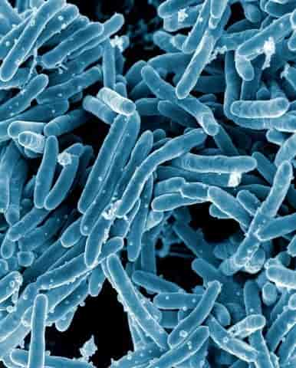
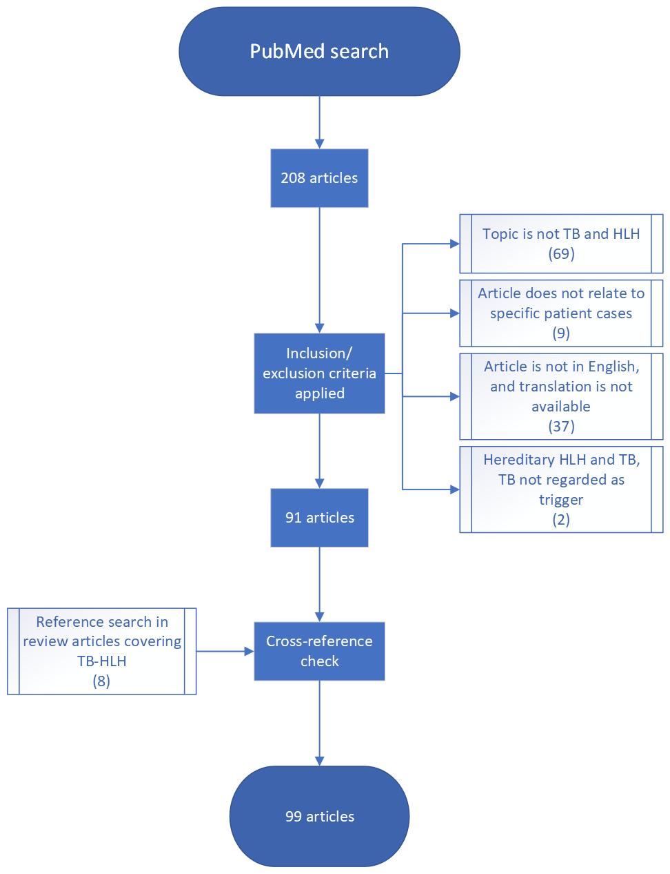
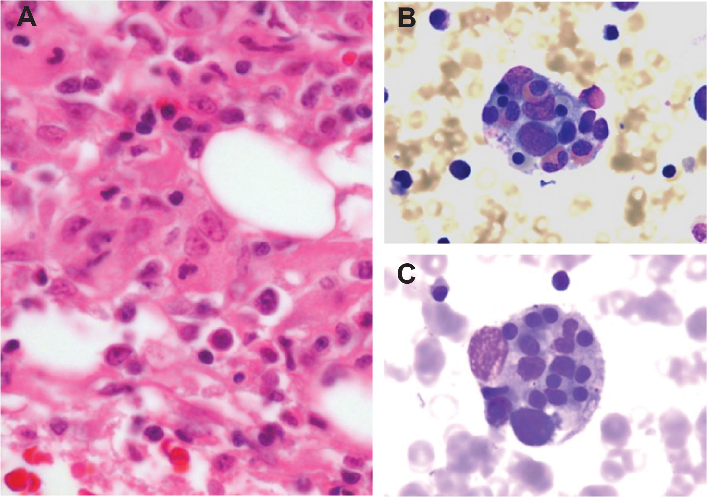
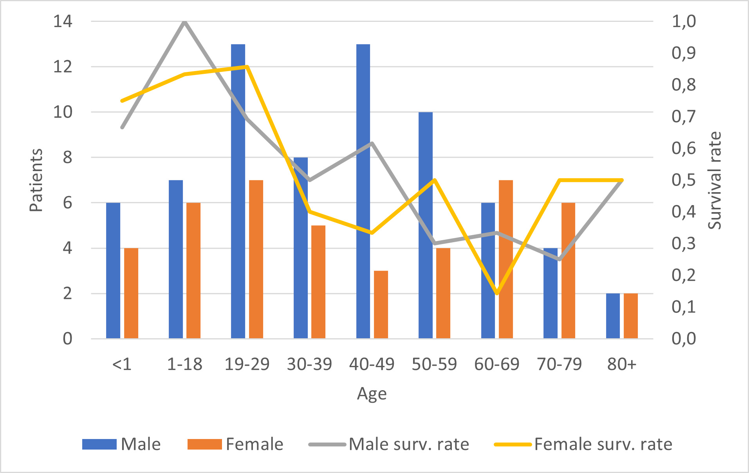
Hemophagocytic Hemophagocytosis and Tuberculosis
A review of current literature and knowledge of this rare entity.
Trym Fauchald University of Bergen
tfa013@uib.no
Background
Hemophagocytic Lymphohistiocytosis (HLH) is a condition of immune dysregulation and hyperinflammation, with a rapid disease progression leading to organ failure and death. Classified as familial or sporadic, it is characterized by fever, cytopenias, organomegaly, hyperferritinemia, hypofibrinogenemia, hypertriglyceridemia, and hemophagocytosis in the reticuloendothelial system (1). While there are many triggers of HLH, including malignancy, rheumatologic conditions and infections – most often viral – Mycobacterium tuberculosis (MTB) remains a rare, but deadly trigger of HLH carrying a mortality rate around 50% (2).
Method
A systematic search on PubMed, with a subsequent review of relevant literature was performed, resulting in 116 cases described in English since infection-associated HLH was first described in 1979 (3).
Result
The gender distribution correlated with that of TB-infections in general, a larger proportion of the patients being male. The age range was 12 days to 83 years old. About half of patients had one or more comorbidities mentioned. Most patients received both tuberculostatic and immune targeted medications. The overall survival rate was 55%.
Conclusion
HLH in the setting of TB is still difficult to diagnose and treat. Both entities often present with unspecific findings. Clinicians’ awareness of the characteristics of these diseases and ability to perform targeted diagnostic workup is paramount for survival. TB should be considered a possible trigger of HLH given its high mortality rate, requiring targeted treatment.
Figure 2: Search and selection process
Tuberculosis
National Institute of Allergy and Infectious Diseases, National Institutes of Health/NIH.
Figure 1: Histopathology of HLH (4)
Figure 3: Age and gender distribution
REFERENCES
1. Jordan MB, Allen CE, Weitzman S, Filipovich AH, McClain KL. How I treat hemophagocytic lymphohistiocytosis. Blood. 2011;118(15):4041-52.
2. Brastianos PK, Swanson JW, Torbenson M, Sperati J, Karakousis PC. Tuberculosis-associated haemophagocytic syndrome. Lancet Infect Dis. 2006;6(7):447-54.
3. Risdall RJ, McKenna RW, Nesbit ME, Krivit W, Balfour HH, Jr., Simmons RL, et al. Virus-associated hemophagocytic syndrome: a benign histiocytic proliferation distinct from malignant histiocytosis. Cancer. 1979;44(3):993-1002.
4. Paolino J, Berliner N, Degar B. Hemophagocytic lymphohistiocytosis as an etiology of bone marrow failure. Frontiers in Oncology. 2022;12.
ACKNOWLEDGEMENTS
I would like to thank, Håkon Reikvam for his recommendations, guidance, and supervision throughout this work.

