Slide 1
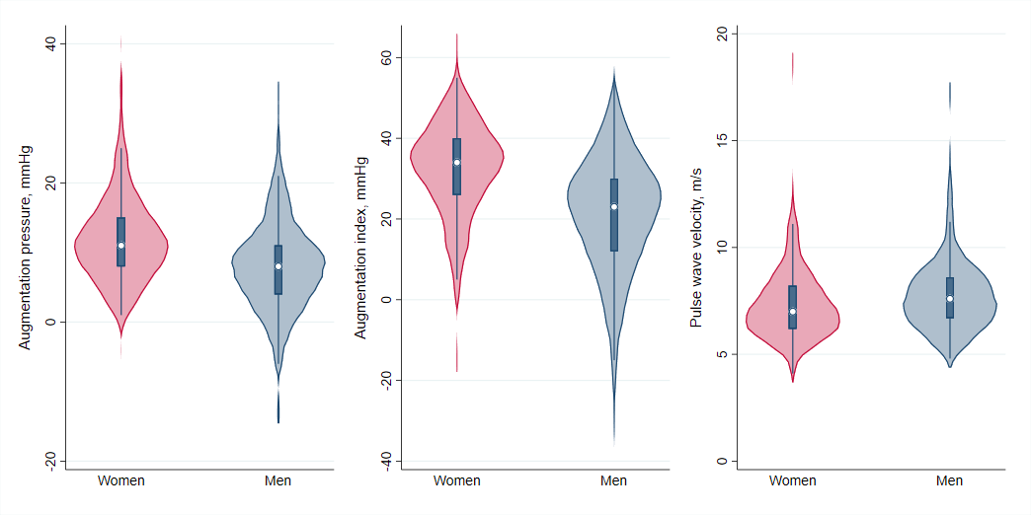
Sex differences in arterial function in obesity:
The FATCOR study
John G. Eikås,¹ Eva Gerdts,^{1,2} Hilde Halland,^{1,3} Helga Midtbø,^{1,2} Dana Cramariuc,^{1,2} Ester A. Kringeland²
¹Department of Clinical Science, University of Bergen, Bergen, Norway, and ²Department of Heart Disease, Haukeland University Hospital, Bergen, Norway, and ³Emergency Care Clinic, Haukeland University Hospital, Bergen, Norway
Background
Results
Obesity has been associated with increased arterial stiffness. Sex-differences in arterial stiffness in obesity have been less explored.
We compared arterial stiffness by different measures between women and men with obesity and without established clinical cardiovascular disease participating in the FAT associated dysfunction (FATCOR) study.
Cross-sectional analysis in 323 women and 225 men, mean age 48±9 years and mean body mass index (BMI) 31.9±4.1 kg/m².
Arterial function was assessed by applanation tonometry as aortic augmentation pressure (AP), augmentation index (AIx), and carotid-femoral pulse wave velocity (cf-PWV).
Covariables of arterial function were identified in linear regression analyses in the total cohort and in sex-specific analyses. Multivariable models were adjusted for sex, age, BMI, 24-hours systolic blood pressure (BP), heart rate, diabetes, and current smoking.
In the total study cohort, women had higher AP (β=0.41) and AIx (β=0.48), and lower cf-PWV (β=0.16) than men, independent of confounders (all p<0.001) (Table) (Figure).
In sex-specific analyses, higher AP was associated with higher age and BP, and lower heart rate in women (all p<0.001), and with higher age, and systolic BP in men (all p<0.001). Similarly, higher AIx was related to higher age and BP, and lower BMI and heart rate in women (all p<0.05), and with higher age in men (all p<0.001). Higher cf-PWV correlated with higher age, and BP in women (all p<0.005), and with higher age, BP, heart rate, and non-smoking in men (all p<0.05).
When replacing BMI with waist-hip ratio, higher waist-hip ratio was associated with higher cf-PWV in men only (p<0.05).
Figure. Measures of arterial stiffness in women and men
Purpose
Methods
Table. Baseline characteristics of the study population
 | Women (351) | Men (233) | p-value
Age, years | 48 ± 9 | 47 ± 9 | 0.158
BMI, kg/m² | 32.2 ± 4.4 | 31.6 ± 3.6 | 0.035
Waist-hip ratio | 0.90 ± 0.07 | 0.99 ± 0.07 | <0.001
Obese, n (%) | 204 (63) | 140 (62) | 0.447
AP, mmHg | 12 ± 6.4 | 8 ± 6.5 | <0.001
AIx, % | 33 ± 11 | 21 ± 15 | <0.001
PWV, m/s | 7.3 ± 1.6 | 7.8 ± 1.7 | <0.001
24-h systolic BP, mmHg | 119 ± 12 | 124 ± 11 | <0.001
Hypertension, n (%) | 185 (59) | 158 (73) | <0.001
Heart rate, beats/min | 69 ± 10 | 66 ± 11 | <0.001
Diabetes, n (%) | 34 (12) | 24 (12) | 0.537
Smoking habit, n (%) | 36 (12) | 30 (14) | 0.279
Violin plot. The white dot marks the median and the blue bar in the center of violin marks the interquartile range. The light red and light blue colored areas demonstrate distribution of data in women and men, respectively.
Conclusion
Among subjects with increased BMI, AP and AIx were higher in women, and cf-PWV was higher in men. Age and 24-hours systolic BP were the main factors associated with arterial stiffness in both sexes, while measures for adiposity had little impact on arterial stiffness.
BMI, body mass index; AP, augmentation pressure; AIx, augmentation index; PWV, pulse wave velocity; 24-h systolic BP, 24-hours systolic blood pressure;
Contact information: jei033@uib.no
Notes:
745 (20%) (277 (13 %) kvinner og 468 (30 %) av men (p<0.001)) ble ekskludert ved baseline grunnet høyt blodtrykk.
19 % av dem med høyt blodtrykk ved baseline fikk blodtrykksbehandling.

