Slide 1
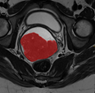
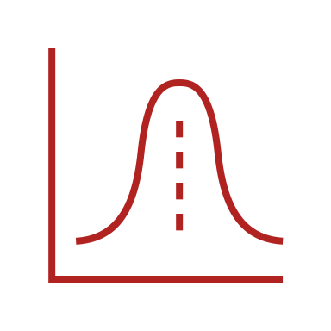
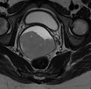
The prognostic value of MRI radiomic profiling in cervical cancer – a systematic literature review
Agnes J. Eide University of Bergen
agnes.eide@student.uib.no
AIM OF STUDY
The purpose of this literature review is to give an overview on the reported potential role of MRI-based radiomic profiling for better pretherapeutic prognostication and tailoring of therapy in uterine cervical cancer. Furthermore, the study aims to discuss present methodological challenges related to radiomic tumor profiling in oncology today.
MATERIAL AND METHODS
Keywords used: “cervical cancer” OR “cervical tumor” AND “radiomic” OR “radiomics” OR “texture”.
All original studies after 2020 were included. After primary screening, the reports were assessed for eligibility according to the following inclusion criteria:
cervical cancer histopathologically confirmed
pre-treatment imaging
MRI-based radiomics
number of patients ≥200
FIGO 2018 staging
After study selection, the methodological quality was assessed using the radiomic quality score (RQS).
Records published after 2020 identified through database search:
PubMed (n = 337)
Records removed before screening:
Duplicate records removed
(n = 163)
IDENTIFICATION
WHAT IS RADIOMICS?
Radiomics is an emerging field of research in cancer imaging, aiming to find associations between:
Quantitative tumor metrics, extracted from medical images
Clinicopathological patient data
These high-dimensional metrics, called radiomic features, capture tumor features such as heterogeneity and shape, that may be associated with the pathophysiology of tumor tissue¹.
The concept of radiomics proposes that medical images depict pathophysiologic features that cannot be assessed by the naked eye during traditional reading of diagnostic imaging².
Radiomic features can provide potential useful data to support clinical decisions.
Records excluded based on title and abstract review
(n = 154)
Records screened
(n = 174)
SCREENING
Reports assessed for eligibility
(n = 20)
Reports excluded
(n=11)
INCLUDED
Studies included in review
(n = 9)
Radiomic workflow
RESULTS
9 studies were included.
The mean RQS was 15 (42%) [range 13-16 (36-44%)].
Clinical endpoints of the included studies:
4 studies reported on radiomic model performance for prognostic factors
3 studies reported on prediction of survival
1 study reported on identification of treatment candidates
1 study reported on prediction of recurrence
IMAGE ACQUISITION
TUMOR SEGMENTATION
RADIOMIC FEATURE EXTRACTION
MODEL BUILDING AND ANALYSIS
Histogram features
Shape-based features
Texture features
Figure 1: The radiomics workflow. After image acquisition and segmentation, radiomic features are extracted. Machine learning and statistical methods are applied in radiomic model building and analysis, for prediction of desired clinical endpoint.
CONCLUSION
Radiomics shows potential for prognostication in cervical cancer, as the included studies have demonstrated. Nonetheless, the early phases and insufficient methodological quality suggest that radiomic models are not currently ready to be used in clinical decision making.
REFERENCES
1: Manganaro L, Nicolino GM, Dolciami M, Martorana F, Stathis A, Colombo I, et al. Radiomics in cervical and endometrial cancer. Br J Radiol. 2021;94(1125):20201314
2: van Timmeren JE, Cester D, Tanadini-Lang S, Alkadhi H, Baessler B. Radiomics in medical imaging—“how-to” guide and critical reflection. Insights into Imaging. 2020;11(1):91

