Slide 1
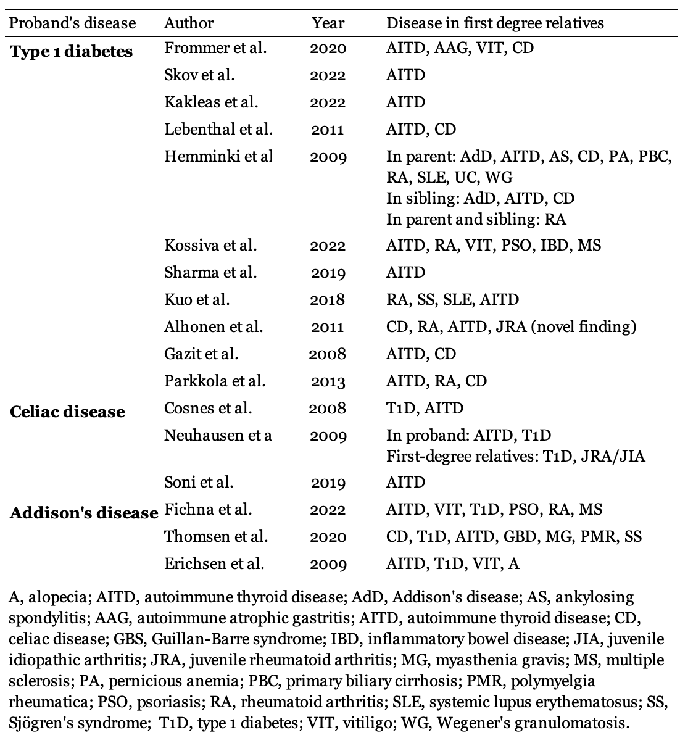
The Heritability of Autoimmune Diseases
- Lessons from studies of Type 1 Diabetes Mellitus, Celiac Disease, and Addison’s Disease
Alexandra C H Dahlberg University of Bergen
alexandra.dahlberg@student.uib.no
ABSTRACT
It is assumed that autoimmune diseases have a common genetic cause. This study aims to highlight the research regarding the hereditary patterns of autoimmune diseases through a literature review.
The study found evidence for widespread familial clustering of different autoimmune manifestations across all three diseases.
Type 1 diabetes mellitus had by far the most research available, therefore, there was a large number of autoimmune diseases in first-degree relatives of type 1 diabetes patients. The most prominent autoimmune diseases in first-degree relatives to type 1 diabetes patients were autoimmune thyroid disease, celiac disease, and rheumatoid arthritis. Celiac disease in the proband was associated with type 1 diabetes mellitus and autoimmune thyroid disease in first-degree relatives. In comparison, there was evidence to support the association between Addison’s disease in proband and type 1 diabetes mellitus and vitiligo in first-degree relatives, by the majority of the studies on the disease. The results strongly indicate a connection between several autoimmune diseases, implying the presence of autoimmune heritability.
Background
Autoimmune diseases (ADs) are a heterogeneous group, that includes diseases such as type 1 diabetes mellitus (T1D), celiac disease (CD), autoimmune thyroid disease (AITD), multiple sclerosis (MS), and Addison’s disease (AdD). The individual ADs range from ultrarare to common but aggregated they affect an estimated 8-9% of the population [1]. Despite the heterogeneous clinical aspects of ADs, they have in common a similar pathological immune reaction against oneself. The current paradigm of the field is that the etiology of ADs is a combination of genetic and environmental factors.
Methodology
A systematic search was conducted for this literature review. To restrict the data, three specific ADs were chosen, T1D, CD and AdD. The initial search in PubMed yielded 196 results, but after a thorough examination, only 17 studies were included.
Results
The results are presented in Table 01. The studies included support the notion of autoimmune heritability patterns.
Discussion
This study found evidence of a substantial overlap between ADs. However, some were more prominent for specific ADs.
For example, many of the studies included with probands with T1D found evidence to suggest similar hereditary patterns to AITD and CD, as they were often found to be significantly aggregated in first-degree relatives of those patients. Interestingly, some of the studies found evidence to support similar hereditary patterns for T1D and rheumatoid arthritis, which only one of the studies with CD or AdD as probands shared. This might suggest that rheumatoid arthritis is more clustered with T1D than the other two ADs included in this literature review.
Surprisingly, T1D and AITD also emerged more prominently in the studies with CD as the proband disease. This does suggest a clustering of these three diseases, as the studies with T1D as a proband disease showed similar results. For AdD, all three studies in this literature review had in common associations with T1D and AITD. Interestingly, two of the three studies also found that first-degree relatives to the proband had an aggregated amount of vitiligo, in comparison with the comparison populations of the studies.
The findings of this review also support that the three ADs in the focus of this study share hereditary patterns, which can be seen by the evidence found that support the presence of CD and AdD in first-degree relatives of probands with T1D, T1D in first- degree relatives of probands with CD, and T1D as well as CD in first-degree relatives of probands with AdD.
Table 01. Summarization of the results.
REFERENCES
[1] Cooper, G.S., M.L. Bynum, and E.C. Somers, Recent insights in the epidemiology of autoimmune diseases: improved prevalence estimates and understanding of clustering of diseases. J Autoimmun, 2009. 33(3-4): p. 197-207.
ACKNOWLEDGEMENTS
Advisors: Stefan Johansson, Professor at the University of Bergen, Department of Clinical Science, and Eirik Bratland, Researcher at the Department of Clinical Science

