Slide 1
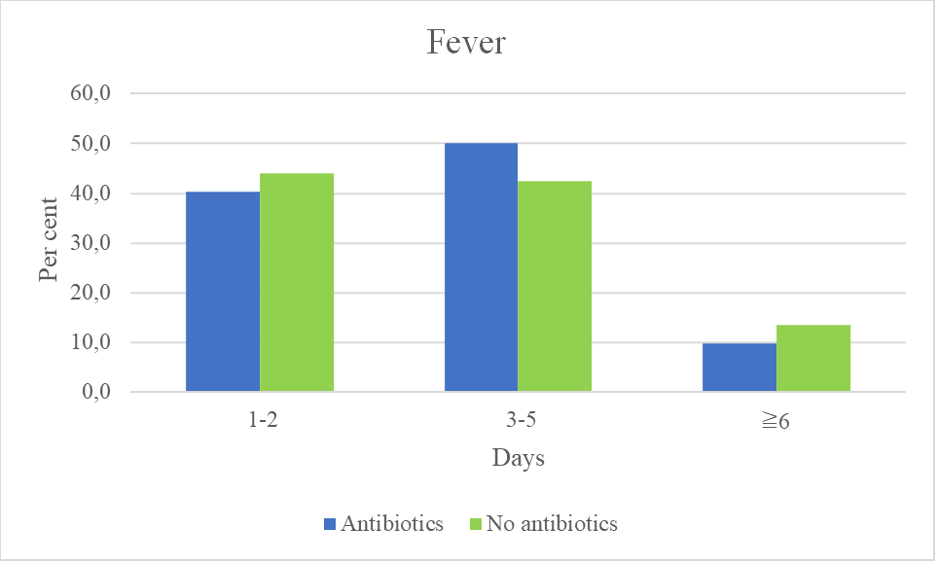
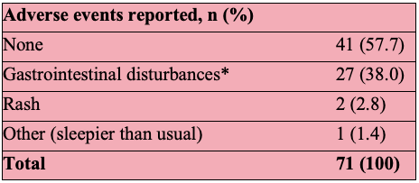
Outcomes of antibiotic treatment for respiratory infections in children
We found no difference in symptom duration when children were prescribed antibiotics for fever or respiratory symptoms, suggesting an overprescribing in primary care.
Linn Karin T. Alvsåker & Maria F. Stensen University of Bergen
lal009@uib.no/wip009@uib.no
ABSTRACT
In this trial we studied antibiotic versus non-antibiotic treatment of children with fever or respiratory symptoms who were treated at out-of-hours (OOH) services in Norway. By reviewing data collected from nurses, medical records and questionnaires filled in by parents, the goal was to evaluate the effects of antibiotics.
We found no significant difference in symptom duration if the child received antibiotics. Furthermore, many parents reported ending antibiotic treatment early, stating complications such as allergic reactions, adverse events, or unnecessary treatment.
Our results call into question whether antibiotic treatment is reasonable when treating children with respiratory infections of unknown aetiology. A considerable amount of antibiotics is prescribed in primary care and to children, suggesting this may be a beneficial place to focus our efforts in reducing antibiotic consumption.
Introduction
Antibiotic resistance is a global threat and worldwide the prescription rate is too high. In Norway, 85% of antibiotics are prescribed in primary care, commonly for children with respiratory symptoms (1, 2). These are most often caused by a virus, and not in need of antibiotics. However, this is not always an easy assessment to make as a clinician.
Methods
This observational follow-up study included children from 0 to 6 years presenting with fever or respiratory symptoms at OOH services. Parents were invited to fill in a questionnaire both prior to the doctor´s consultation and after seven days.
The main outcome variables were duration of fever, absence from kindergarten/school, duration of treatment and adverse events.
Results and its significance
A total of 397 children were recruited, parents of 266 (67%) provided data after one week. 82 (31%) children were prescribed antibiotics, 184 (69%) children were not.
Symptom duration
Regarding both duration of fever and absenteeism, the two groups showed no significant difference. The course of illness was quite similar regardless of antibiotic prescription.
To counteract this, less prescribing is one step, while research may also indicate the benefit of shortening the treatment duration (3).
Adverse events of antibiotic treatment
42.3% experienced adverse events, 90% of these being gastrointestinal disturbances. It is challenging to distinguish if this is due to the medication or a symptom of the infectious agent itself. Nevertheless, it calls into question whether the cost outweighs the benefit.
Proportion of patients with fever for a given number of days (%), comparing the two groups.
The lack of effectiveness of antibiotics in our data, may suggest an overprescribing in paediatrics.
Duration of antibiotic treatment
84.5% reported giving antibiotics for 5-7 days, nonetheless, several parents experienced difficulties with the treatment. For 15.4%, the complications resulted in parents ending treatment within 4 days. Others changed antibiotics, statistically these are often more broad-spectrum and can increase antibiotic resistance.
Parent reported adverse events when the child was prescribed antibiotics.
Conclusion and future implications
A considerable amount of antibiotics is prescribed for children with fever or respiratory symptoms in primary care. Our data showed no significant difference in symptom duration or absenteeism when comparing the children who were prescribed antibiotics with those who were not. In addition, a substantial proportion of those prescribed antibiotics reported adverse events/allergic reactions. The results support the ongoing efforts in reducing antibiotic use and the need for more knowledge on inappropriate prescriptions.
REFERENCES
2020, N.N.-V., Usage of Antimicrobial Agents and Occurrence of Antimicrobial Resistance in Norway. 2021: Tromsø / Oslo.
Størdal, K., K. Mårild, and H.S. Blix, [Use of antibiotics in children during the period 2005 – 16]. Tidsskr Nor Laegeforen, 2017. 137(18).
Llor, C., et al., Efficacy and safety of discontinuing antibiotic treatment for uncomplicated respiratory tract infections when deemed unnecessary. A multicentre, randomized clinical trial in primary care. Clin Microbiol Infect, 2022. 28(2): p. 241-247.
Illustration 1: https://www.helsesjefen.no/skal-redusere-unodvendig-bruk-av-antibiotika/
Illustration 2: https://www.antibiotika.no/2018/11/09/33-000-mennesker-dor-av-antibiotikaresistens-i-europa-arlig/
ACKNOWLEDGEMENTS
The authors would like to thank our main supervisor, Ingrid Keilegavlen Rebnord, for incredible support and guidance in the making of our article. For their great counselling, we would also like to thank our other supervisors, Anders Batman Mjelle and Steinar Hunskår. Our gratitude also includes the children, parents, OOH services at Sotra, Askøy, Nordhordaland, Os and the Paediatric Emergency Clinic at Haukeland University Hospital, who participated in the study.

