Slide 1
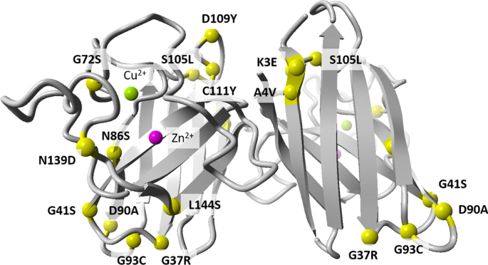
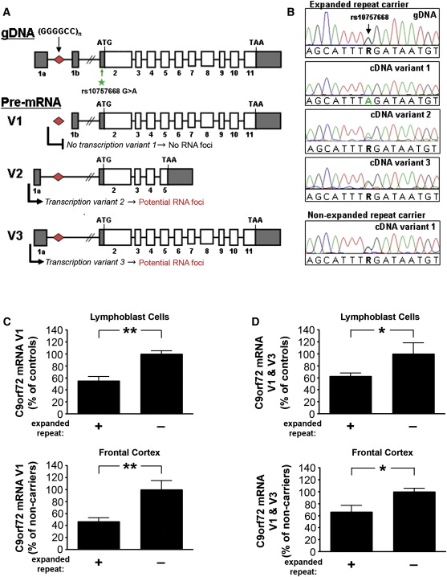
Genetic treatment of ALS
A literature study of the search for a gene specific treatment for amyotrophic lateral sclerosis.
Andreas Brakvatne Vetås
Tormod Hystad Hugaas University of Bergen
ave033@uib.no
ABSTRACT
In this study we present a review of the development of a genetically based treatment for ALS. We searched PubMed, using MeSH, for articles who matched the keywords Amyotrophic Lateral Sclerosis/genetics as well as one of Dependovirus, Antisense Oligonucleotides, Lentivirus, and CRISPR, the fields with the most notable progress on the subject. We filtered in those who describe independent progress in developing a genetic treatment, including stem cell, animal, and clinical studies.
Amyotrophic Lateral Sclerosis (ALS) is a devastating motor neuron disease with a prevalence of 6-7 per 100.000 in Norway. The etiology is largely unknown, and only a couple of treatments can provide a limited effect. However, some genes have been found to have a direct link to the disease. In recent years the search for a genetic treatment has intensified, particularly for the mutations SOD1 and C9orf72.
The results include thirteen articles on the SOD1-mutation, five on C9orf72, and one targeting sporadic ALS (sALS) through mediating Atxn2. On SOD1, three articles describe the research on Antisense Oligonucleotides (ASOs), whereof two are clinical studies. The highest number of articles, eight, concerned the use of Adeno-Associated Viral Vectors (AAV Vectors) against SOD1 ALS, and there were also two articles on the subject of CRISPR or Cytosine Base Editors (CBEs). Regarding C9orf72, we included four articles on ASO based treatment, and one about CRISPR on stem cells.
With a few modest clinical trials with ASOs and very promising results in animal studies with AAVs, the treatment of SOD1 ALS seems the most likely to withstand a third phase clinical trial in the near future. There are, however, promising aspects also for C9orf72, but more research is needed to map the specific functions of the gene and its mutations.
REFERENCES
Illustration 1: Berdyński M, Miszta P, Safranow K, Andersen PM, Morita M, Filipek S, Żekanowski C, Kuźma-Kozakiewicz M. SOD1 mutations associated with amyotrophic lateral sclerosis analysis of variant severity. Sci Rep. 2022 Jan 7;12(1):103. doi: 10.1038/s41598-021-03891-8.
Illustration 2: DeJesus-Hernandez M, Mackenzie IR, Boeve BF, Boxer AL, Baker M, Rutherford NJ, et al. Expanded GGGGCC heksanucleotide repeat in noncoding region of C9ORF72 causes chromosome 9p-linked FTD and ALS. Neuron. 2011 Oct 20;72(2):245-56. doi: 10.1016/j.neuron.2011.09.011.

