Slide 1
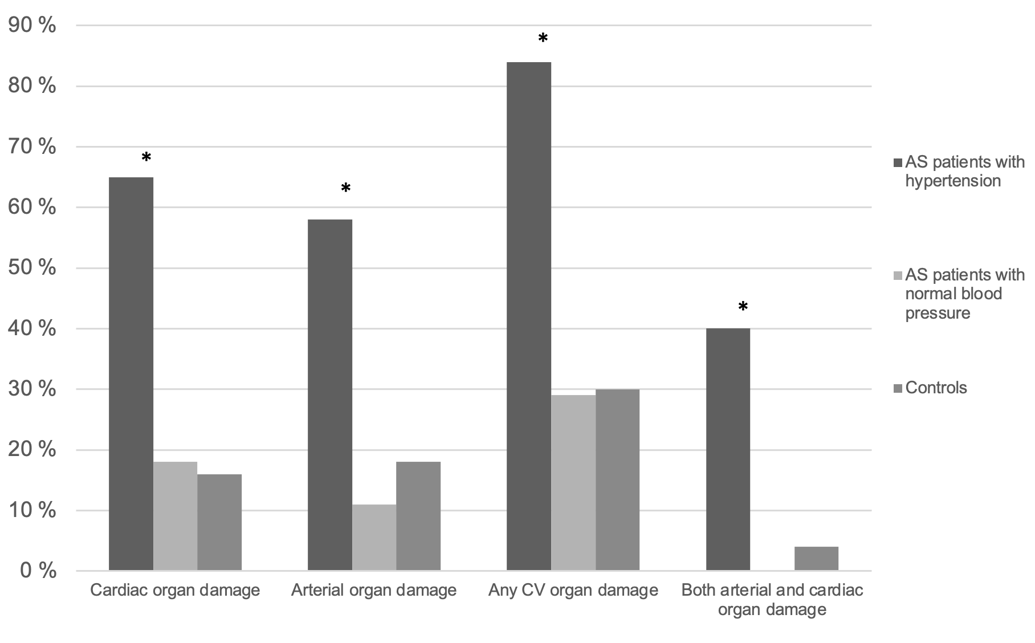
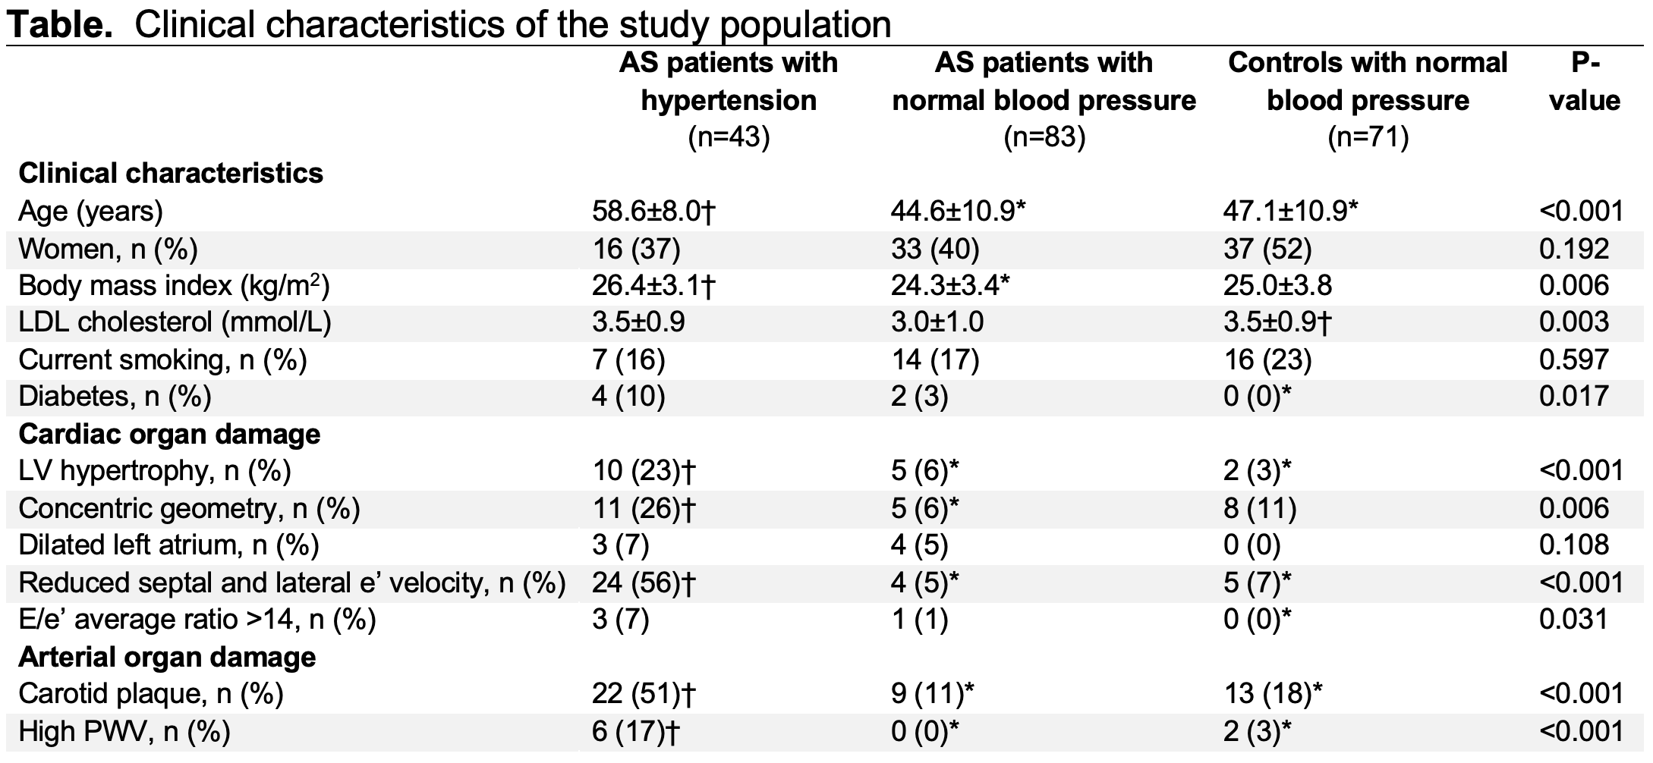
Hypertensive cardiovascular organ damage in ankylosing spondylitis
Gyda Ullensvang¹, Ester Kringeland^{1,2}, Eirik Ikdahl³, Sella Provan^{4,5}, Inger Jorid Berg⁴, Silvia Rollefstad³, Hanne Dagfinrud⁴, Eva Gerdts¹, Anne Grete Semb^{3*} & Helga Midtbø^{1,2*}
¹Center for research on cardiac disease in women, Department of Clinical Science, University of Bergen, Bergen, Norway; ²Department of Heart Disease, Haukeland University Hospital, Bergen, Norway; ³Preventive Cardio-Rheuma Clinic, Center for treatment of Rheumatic and Musculoskeletal Diseases (REMEDY), Diakonhjemmet Hospital, Oslo, Norway; ⁴Center for treatment of Rheumatic and Musculoskeletal Diseases (REMEDY), Diakonhjemmet Hospital, Oslo, Norway; ⁵Department of Public Health and Sport Sciences, Inland Norway University of Applied Sciences, Elverum, Norway.
*Anne Grete Semb and Helga Midtbø contributed equally to this manuscript.
Background
Hypertension is the most prevalent cardiovascular (CV) risk factor in ankylosing spondylitis (AS) patients. Less is known about the prevalence of CV organ damage in relation to hypertension status in AS patients.
Purpose
To assess the prevalence of CV organ damage assessed by echocardiography, carotid ultrasound and arterial stiffness in groups of AS patients with hypertension or normal blood pressure and healthy controls.
Materials and methods
Echocardiography, carotid ultrasound and pulse wave velocity (PWV) by applanation tonometry was assessed in 126 AS patients (mean age 49±12 years, 52% women) and 71 normotensive controls (mean age 47±11 years, 39% women).
Hypertension was defined as use of antihypertensive medication, a history of hypertension, or elevated office blood pressure (≥140/90 mmHg).
CV organ damage was defined as presence of abnormal left ventricular (LV) geometry, LV diastolic dysfunction, left atrial (AL) dilatation, carotid plaques and/or high PWV.
Results
Thirty-four percent of patients had hypertension.
AS patients with hypertension were older and had higher C-reactive protein (CRP) levels compared to AS patients with normal blood pressure and controls (p<0.05, Table).
The prevalence of CV organ damage was 84% in AS patients with hypertension, 29% in AS patients with normal blood pressure and 30% in controls (p<0.001), Table, Figure.
In multivariable logistic regression analyses in the total study population, presence of hypertension was associated with a fourfold increased risk of CV organ damage independent of age, presence of AS, gender, body mass index, CRP, and serum total cholesterol (odds ratio (OR) 4.57, 95% confidence interval (CI) 1.53-13.61, p=0.006).
In AS patients, presence of hypertension was the only covariable significantly associated with presence of CV organ damage (OR 4.40, 95% CI 1.40-13.84, p=0.011).
Figure. CV organ damage in AS patients with hypertension and normal blood pressure and controls. * p<0.05.
Conclusions
The prevalence of CV organ damage is strongly associated with hypertension status in AS patients.
The study underlines the importance of guideline-based hypertension management to prevent CV disease in AS patients.
* p<0.05 vs. AS patients with hypertension, † p<0.05 vs. AS patients with normal blood pressure.
CONTACT INFORMATION
Gyda Ullensvang
gyda.ullensvang@student.uib.no
ACKNOWLEDGEMENTS
Declaration of interest: AGS has received speaker honoraria and/or consulting fees from AbbVie, Bayer, Eli Lilly, Novartis, Amgen and Sanofi. EG has received speaker honoraria from Bayer and Novo Nordisk
Funding: The South-Eastern and Western Regional Health Authorities of Norway

