Slide 1
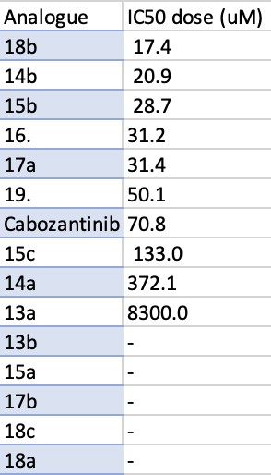
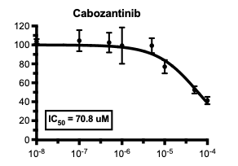
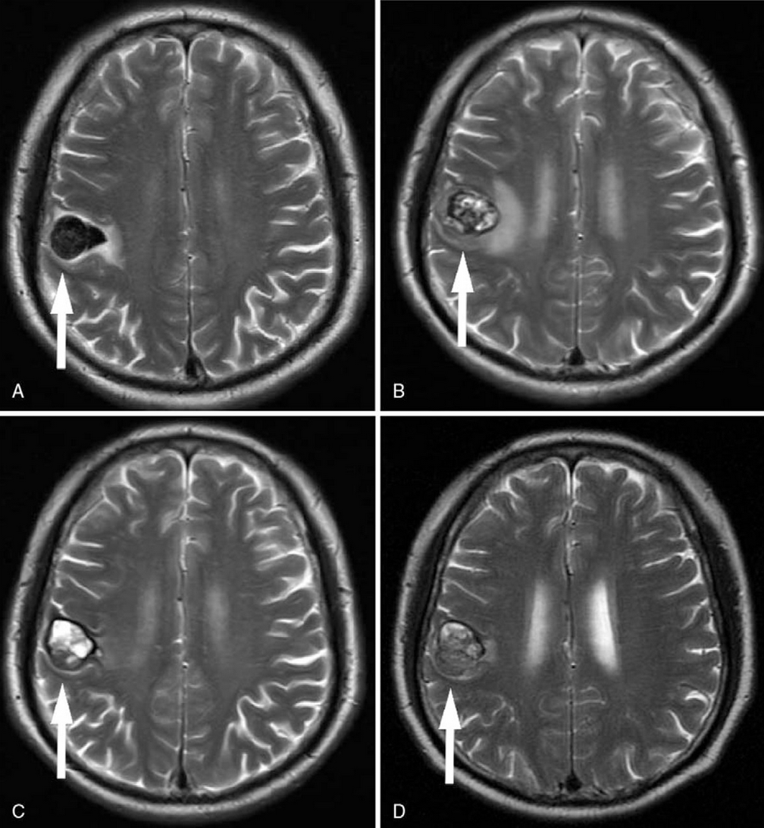
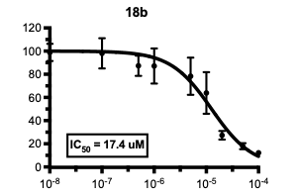
A pilot study of cabozantinib analogues
Six cabozantinib analogues inhibited viability more than original cabozantinib in this in vitro study.
Trond Are Mannsåker, Prof. Frits Thorsen University of Bergen
trond.mannsaker@student.uib.no
ABSTRACT
Melanoma brain metastasis (MBM) remains one of the deadliest cancers despite recent advances in targeted therapy.
Cabozantinib is a tyrosine kinase inhibitor which is FDA approved for renal cancer.
In this pilot study, we investigated the viability of one MBM cell line (H1) upon treatment by 14 different cabozantinib analogues using a monolayer experiment.
Our experiments showed that cabozantinib analogues 18b, 14b, 15b, 16, 17a and 19 had a stronger inhibition on H1 viability than original cabozantinib.
The promising results should be investigated further with other cell lines included, as well as migration, colony formation, apoptosis and Western Blot experiments.
Results Analog 18b had the most potent effect on MBM viability, with an IC50 dose of 17.4 μM. Analog 14b had a 70% drop in IC50 dose compared with cabozantinib. Analog 15b, 16 and 17a presented with IC50 doses in the same area, as the IC50 interval ranged between 28.7 μM and 31.4 μM. Analog 19 was the last of the analogues that outperformed cabozantinib with a 29% lower IC50 dose.
Discussion
Partners in Oslo synthesized the analogues. In their enzymatic assays non-fluorinated analogues performed better (Table 1). However, in their cellular experiments, fluorinated analogues inhibited viability more.
In our pilot study on H1 cells, fluorinated groups does not affect on viability either way. This needs to be investigated further with other cell lines.
Logos Leave out unnecessary institutional “brands” or logos. The only logo used in this template is the UiB logo signalizing that this poster reflects research carried out at this institution.
ACKNOWLEDGEMENTS
I wouldlike to thank Tuyen Hoang for helping me in the lab. I would also like to thank Vegard Torp Lien for synthesising and sending me the analogues.

